Slide 1

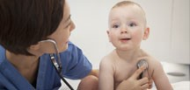

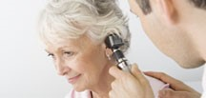

Derbyshire Joint Strategic Needs Assessment:
The State of Health and Social Care
in Derbyshire
A summary of performance against Outcomes Frameworks.
2018

Slide 2
Version control
The State of Derbyshire 2018
Title | Derbyshire Joint Strategic Needs Assessment: The State of Health and Social Care in Derbyshire 2018
Version | v1.0
Publishing Date | 18/03/18
Classification | PUBLIC/CONTROLLED/RESTRICTED
Author | Public Health Intelligence & Knowledge Services Public Health Derbyshire County Council County Hall Matlock Derbyshire DE4 3AG  Tel: (01629) 536053  Email: chris.mcmanus@derbyshire.gov.uk

Slide 3
Introduction
This report reviews the position of Derbyshire County in regard to the various Outcomes Frameworks available for health and social care, and highlights where performance is significantly poorer than England as a whole. Where available, comparisons with CIPFA (Chartered Institute of Public Finance and Accountancy) nearest neighbours are drawn and significant variation within the county is also highlighted. This report has been compiled using data available at the end of November 2018. This year’s report has also been structured on the basis of RAG performance, the Outcomes Frameworks and the Health and Wellbeing Strategy priorities.
This year the report is presented as a slide-set.
Run the slideshow to activate hyperlinks or right click on blue text and select Open Hyperlink

Slide 4
Documents relating to the JSNA
Our Lives, Our Health: Derbyshire Health & Wellbeing Strategy
Older People’s Housing, Accommodation and Support
Joint Health & Social Care Autism Strategy
Carers Strategy
Living Well with Dementia
Learning Disability Development Plan
Joint Vision and Strategic Direction of Travel for Adult Mental Health
Self-Harm and Suicide Prevention Strategic Framework
The State of Mental Health
Pharmaceutical Needs Assessment
Older Person’s Housing Needs Assessment and Review of Good Practice
Cardiovascular Disease
Tobacco Control
Falls in Older People
End of Life Care
Housing & Health
Special Educational Needs and Disabilities
Substance misuse of children and young people
Domestic abuse and sexual violence in Derby and Derbyshire
Hospital admission for Self-harm: 10-24 year olds
Derbyshire Health Protection Board- Air Quality Report
Survey of Adult Carers

Slide 5
Contents
The State of Derbyshire 2018
POF
Public Health Outcomes Framework
Red
Emotional Health & Wellbeing of Children & Young People
Healthy Communities
Build Social Capital
Keep People Healthy & Independent in their Own Homes
Population measures and strategy outcomes
NHS Outcomes Framework
Amber
CCG Outcomes Framework
Adult Social Care Outcomes Framework
Green

Slide 6
Key to indicator slides
Significantly worse than England
No Trend
Not significantly different from England
Falling
Significantly better than England
Rising
Not compared in terms of significance
No change
No significant change
Improving significantly
Worsening significantly

Slide 7
The State of Derbyshire 2018
Red
PHOF
0.1ii Life expectancy at birth - male
0.1ii Life expectancy at birth – female
0.1ii Life expectancy at 65 - male
0.1ii Life expectancy at 65 - female
0.2iii Inequality in life expectancy at birth – male
0.2iv Gap in life expectancy between Derbyshire and England as a whole - male
0.2iv Gap in life expectancy between Derbyshire and England as a whole - female
1.02i School Readiness - children with free school meals achieving a good level of development
1.02ii School Readiness - pupils achieving the expected level in the phonics screening check
1.02ii School Readiness - pupils with free school meals status achieving in the phonics screening check
1.08i Gap in the employment rate between those with a long-term health condition and the overall employment rate
1.08ii Gap in the employment rate between those with a learning disability and the overall employment rate
1.10 Killed and seriously injured casualties on England's roads
2.02ii Breastfeeding prevalence at 6-8 weeks after birth
2.03 Smoking status at time of delivery
2.06i Child excess weight in 4-5 and 10-11 year olds - 4-5 year olds
2.08ii Percentage of children aged 5-16 who have been in care for at least 12 months on 31st March whose score in the SDQ indicates cause for concern
2.10ii Emergency Hospital Admissions for Intentional Self-Harm
2.11v Average number of portions of fruit consumed daily at age 15 (WAY survey)
2.11vi Average number of portions of vegetables consumed daily at age 15 (WAY survey)
2.12 Percentage of adults (aged 18+) classified as overweight or obese
2.15i Successful completion of drug treatment - opiate users
2.15ii Successful completion of drug treatment – non-opiate users
2.15iii Successful completion of alcohol treatment
2.18 Admission episodes for alcohol-related conditions - narrow definition
2.19 Cancer diagnosed at early stage
2.22iii Cumulative percentage of the eligible population aged 40-74 offered an NHS Health Check in the five year period 2013/14 - 2017/18
3.02i Chlamydia detection rate (15-24 year olds) – persons
3.02ii Chlamydia detection rate (15-24 year olds) - males
3.02i Chlamydia detection rate (15-24 year olds) – females
3.03xvi Population vaccination coverage - HPV vaccination for two doses (females 13-14 years old)
4.09ii - Proportion of adults in the population in contact with secondary mental health services
4.14ii Hip fractures in people aged 65 and over - aged 65-79
NHSOF
1b Life expectancy at 75 - Male
1b Life expectancy at 75 – Female
3a Emergency admissions for acute conditions that should not usually require hospital admission
3.2 Emergency admissions for children with lower respiratory tract infections (LRTIs)
3.6.ii Proportion of older people (65 and over) who were offered rehabilitation following discharge from acute or community hospital

Slide 8
The State of Derbyshire 2018
Amber
2.23i Self-reported well-being - people with a low satisfaction score
2.23i Self-reported well-being - people with a low worthwhile score
2.23i Self-reported well-being - people with a low happiness score
2.23i Self-reported well-being - people with a high anxiety score
2.24i Emergency hospital admissions due to falls in people age 65 and over - 65+-
2.24ii Emergency hospital admissions due to falls in people age 65 and over - 65-79
2.24iii Emergency hospital admissions due to falls in people age 65 and over - 80+
3.04 HIV late diagnosis
3.06 NHS organisations with a board approved sustainable development management plan
4.01 Infant Mortality
4.05i Under 75 mortality rate from cancer
4.05ii Under 75 mortality rate from all cancer considered preventable
4.06i Under 75 mortality rate from liver disease
4.06ii Under 75 mortality rate from all liver disease considered preventable
4.07i Under 75 mortality rate from respiratory disease
4.07ii Under 75 mortality rate from all respiratory disease considered preventable
4.08 Mortality rate from a range of specified communicable diseases, including influenza
4.10 Suicide rate
4.12i Preventable sight loss – age related macular degeneration (AMD)
4.12ii Preventable sight loss - glaucoma
4.12iii Preventable sight loss - diabetic eye diseased
4.12iv Preventable sight loss - sight loss certifications
4.13 Health related quality of life for older people
4.14i Hip fractures in people aged 65 and over
4.14iii Hip fractures in people aged 65 and over - aged 80+
4.15i Excess winter mortality - excess winter deaths index (single year, all ages)
4.15ii Excess winter mortality - excess winter deaths index (single year, age 85+)
4.15iii Excess winter mortality - excess winter deaths index (3 years, all ages)
4.15iv Excess winter mortality - excess winter deaths index (3 years, age 85+)
4.16 Estimated diagnosis rate for people with dementia
Amber - NHSOF & ASCOF
PHOF
0.1i Healthy life expectancy at birth – males
0.1i Healthy life expectancy at birth – females
0.2iii Inequality in life expectancy at birth – female
0.2iii Inequality in life expectancy at 65 – male
0.2iii Inequality in life expectancy at 65 - female
1.02i School Readiness - children achieving a good level of development
1.09i Sickness Absence - The percentage of employees who had at least one day off in the previous week.
1.09ii Sickness Absence - The percentage of working days lost due to sickness absence
1.13i Re-offending levels - Percentage of offenders who re-offend
1.16 Utilisation of outdoor space for exercise/health reasons
1.18i Social Isolation - Percentage of adult social care users who have as much social contact as they would like
1.18ii Social Isolation - Percentage of adult carers who have as much social contact as they would like
2.02i Breastfeeding initiation
2.04 Under 18 conceptions
2.04 Under 18 conceptions: conceptions in those aged under 16
2.05ii Proportion of children aged 2-2½yrs offered ASQ-3 as part of the Healthy Child Programme or integrated review
2.07ii Hospital admissions caused by unintentional and deliberate injuries in young people (aged 15-24 years)
2.11iii Average number of portions of vegetables consumed daily (adults)
2.11iv Proportion of the population meeting the recommended ‘5-a-day’ at age 15
2.13ii Percentage of physically inactive adults
2.14 Smoking Prevalence in adults - current smokers (APS)
2.15iv Deaths from drugs misuse
2.17 Estimated diabetes diagnosis rate

Slide 9
The State of Derbyshire 2018
Amber
NHSOF
1.6.i Infant mortality
1c Neonatal mortality and stillbirths (formerly indicator 1.6.ii)
2.3.i Unplanned hospitalisation for chronic ambulatory care sensitive conditions
3.6.i The proportion of older people (aged 65 and over) who were still at home 91 days after discharge from hospital into reablement/rehabilitation services
4.4.ii Access to NHS dental services
ASCOF
1A Social care-related quality of life score
1B Proportion of people who use services who have control over their daily life
1I1 Proportion of people who use services who reported that they had as much social contact as they would like
3A Overall satisfaction of people who use services with their care and support
3D(1) The proportion of people who use services who find it easy to find information about support
4A Proportion of people who use services who feel safe
4B Proportion of people who use services who say that those services have made them feel safe and secure
Amber - PHOF

Slide 10
The State of Derbyshire 2018
Green
PHOF
1.01i Children in low income families - Under 20s
1.01ii Children in low income families - Under 16s
1.03 Pupil absence
1.04 First time entrants to the youth justice system
1.05 16-18 year olds not in education employment or training (NEET)
1.06i Adults with a learning disability / in contact with secondary mental health services who live in stable and appropriate accommodation
1.06ii Adults in contact with secondary mental health services who live in stable and appropriate accommodation
1.12i Violent crime - Hospital admissions for violence
1.12ii Violent crime - Violence offences per 1,000 population
1.12iii Violent crime - Rate of sexual offences per 1,000 population
1.13ii Re-offending levels - Average number of re-offences per offender
1.13iii First time offenders
1.14i Exposure to road, rail and air transport noise - Complaints about noise
1.15i Statutory homelessness - eligible homeless people not in priority need per 1,000 households
1.15ii Statutory homelessness - households in temporary accommodation
2.01 Low birth weight of term babies
2.06ii Child excess weight in 4-5 and 10-11 year olds - 10-11 year olds
2.07i Hospital admissions caused by unintentional and deliberate injuries in children (aged 1-14 years)
2.07i Hospital admissions caused by unintentional and deliberate injuries in children (aged 0-4 years)
2.13i Percentage of physically active adults
2.16 - Adults with substance misuse treatment need who successfully engage in community-based structured treatment following release from prison
2.20i Cancer screening coverage – breast cancer
2.20ii Cancer screening coverage – cervical cancer
2.20iii Cancer screening coverage – bowel cancer
2.20iv Abdominal Aortic Aneurysm Screening – Coverage
2.22iv Cumulative percentage of the eligible population aged 40-74 offered an NHS Health Check who received an NHS Health Check
2.22v Cumulative percentage of the eligible population aged 40-74 who received an NHS Health check
3.03i & ii Population vaccination coverage - Hepatitis B (1 year old & 2 years old)
3.03iii Population vaccination coverage - Dtap / IPV / Hib (1 year old)
3.03iii Population vaccination coverage - Dtap / IPV / Hib (2 years old)
3.03v Population vaccination coverage - PCV
Green (2) PHOF & NHSOF

Slide 11
The State of Derbyshire 2018
Green
PHOF
3.03vi Population vaccination coverage - Hib / Men C booster (2 years old)d)
3.03vi Population vaccination coverage - Hib / Men C booster (5 years old)
3.03vii Population vaccination coverage - PCV booster
3.03viii Population vaccination coverage - MMR for one dose (2 years old)
3.03ix Population vaccination coverage - MMR for one dose (5 years old)
3.03x Population vaccination coverage - MMR for two doses (5 years old)
3.03xii Population vaccination coverage - HPV vaccination for one dose (females 12-13 years old)
3.03xiii Population vaccination coverage - PPV
3.03xiv Population vaccination coverage - Flu (aged 65+)
3.03xv Population vaccination coverage - Flu (at risk individuals)
3.03xvii Population vaccination coverage - Shingles (70 years old)
3.03xviii Population vaccination coverage - Flu (2-3 years old)
3.05ii Incidence of TB
3.08 Adjusted antibiotic prescribing in primary care by the NHS
4.02 Proportion of five year old children free from dental decay
4.04i Under 75 mortality rate from all cardiovascular diseases
4.04ii Under 75 mortality rate from all cardiovascular diseases considered preventable
4.09i Excess under 75 mortality rate in adults with serious mental illness
4.10 Suicide rate
4.11 Emergency readmissions within 30 days of discharge from hospital
NHSOF
1.5.i Excess under 75 mortality rate in adults with serious mental illness
2.2 Employment of people with long-term conditions
2.3.ii Unplanned hospitalisation for asthma, diabetes and epilepsy in under 19s
2.5.i Employment of people with mental illness (formerly indicator 2.5)
3b Emergency readmissions within 30 days of discharge from hospital
3.7.ii Tooth extractions due to decay for children admitted as inpatients to hospital, aged 10 years and under
4.4.i Access to GP services
4a.i Patient experience of GP services
4a.ii Patient experience of GP out-of-hours services
4a.iii Patient experience of dental services
Green - PHOF-

Slide 12
The State of Derbyshire 2018
PHOF
1.11 Domestic abuse-related incidents and crimes
1.14ii Exposure to road, rail and air transport noise - 65dB(A) or more, during the daytime
1.14ii Exposure to road, rail and air transport noise - 55dB(A) or more, during the night-time
1.17 Fuel Poverty
2.08i Average difficulties score for all looked after children aged 5-16 who have been in care for at least 12 months on 31st March
3.01 Fraction of mortality attributable to particulate air pollution
3.03iv Population vaccination coverage - Men C
Not compared – NHSOF & ASCOF Not compared – CCGOF (1) Not compared – CCGOF (2)

Slide 13
The State of Derbyshire 2018
NHSOF
1a.i Potential years of life lost (PYLL) from causes considered amenable to healthcare - adults – Male
1a.i Potential years of life lost (PYLL) from causes considered amenable to healthcare - adults – Female
1.1 Under 75 mortality rate from cardiovascular disease
1.2 Under 75 mortality rate from respiratory disease
1.3 Under 75 mortality rate from liver disease
1.4 Under 75 mortality rate from cancer
2 Health-related quality of life for those with long term conditions
2.1 Proportion of people feeling supported to manage their condition
2.4 Health-related quality of life for carers
2.7 Health-related quality of life for people with three or more long-term conditions
ASCOF
1C(1A) The proportion of people using social care who receive self-directed support (adults aged over 18 receiving self-directed support)
1C(1B) The proportion of carers receiving self-directed support
1C(2A) The proportion of service users accessing long-term support at the year-end 31 March who were receiving direct payments
1C(2B) The proportion of carers receiving direct payments for support direct to carer
1E Proportion of adults with a learning disability in paid employment
1F Adults in contact with secondary mental health services in paid employment
1G Adults with a primary support reason of learning disability support who live in their own home or with their family
1H Adults in contact with secondary mental health services who live independently, with or without support
1I2 Proportion of carers who reported that they had as much social contact as they would like
2A(1) Long-term support needs of younger adults (aged 18-64) met by admission to residential and nursing care homes, per 100,000 population
2A(2) Long-term support needs of older adults (aged 65 and over) met by admission to residential and nursing care homes, per 100,000 population
2B(1) The proportion of older people (aged 65 and over) who were still at home 91 days after discharge from hospital into reablement/rehabilitation services
2B(2) The proportion of older people (aged 65 and over) who were offered reablement/rehabilitation services after discharge from hospital
2C(1): Delayed transfers of care from hospital, per 100,000
2C(2): Delayed transfers of care from hospital that are attributable to adult social care, per 100,000 population
2C(3): Delayed transfers of care from hospital that are attributable to NHS and adult social care, per 100,000 population
2D The outcome of short-term services: sequel to service
Not compared – PHOF Not compared – CCGOF (1) Not compared – CCGOF (2)

Slide 14
The State of Derbyshire 2018
CCGOF
1.1 Potential years of life lost (PYLL) from causes considered amenable to healthcare – male
1.1 Potential years of life lost (PYLL) from causes considered amenable to healthcare – female
1.2 Under 75 mortality rates from cardiovascular disease
1.3 Completion of cardiac rehabilitation following an admission for coronary heart disease
1.4 Myocardial infarction, stroke and stage 5 chronic kidney disease in people with diabetes
1.5 Mortality within 30 days of hospital admission for stroke
1.6 Under 75 mortality rates from respiratory disease
1.7 Under 75 mortality rates from liver disease
1.8 Emergency admissions for alcohol related liver disease
1.9 Under 75 mortality rate from cancer
1.10 One-year survival from all cancers
1.11 One-year survival from breast, lung and colorectal cancers
1.12 People with Serious Mental Illness (SMI) who have received the complete list of physical checks
1.14 Maternal smoking at delivery
1.17 Record of stage of cancer at diagnosis
1.18 Percentage of cancers detected at stage 1 and 2
1.19 Record of lung cancer stage at decision to treat
1.20 Mortality from breast cancer in females
1.21 All-cause mortality – 12 months following a first emergency admission to hospital for heart failure in people aged 16 and over
1.23 Smoking rates in people with serious mental illness (SMI)
1.24 Referrals to cardiac rehabilitation within 5 days of an admission for coronary heart disease
1.25 Neonatal mortality and stillbirths
2.1 Health-related quality of life for people with long term conditions
2.2 Proportion of people who are feeling supported to manage their condition
2.3 People with COPD and Medical Research Council (MRC) Dyspnoea Scale ≥3 referred to a pulmonary rehabilitation programme
2.5 People with diabetes diagnosed less than a year referred to structured education
2.6 Unplanned hospitalisation for chronic ambulatory care sensitive conditions
2.7 Unplanned hospitalisation for asthma, diabetes and epilepsy in under 19s
Not compared – PHOF Not compared – NHSOF & ASCOF Not compared – CCGOF (2)

Slide 15
The State of Derbyshire 2018
CCGOF
2.8 Complications associated with diabetes
2.9 Access to community mental health services by people from black and minority ethnic (BME) groups
2.10 Access to psychological therapies services by people from Black and Minority Ethnic (BME) groups
2.11a Percentage of referrals to Improving Access to Psychological Therapies (IAPT) services which indicated a reliable recovery following completion of treatment
2.11b Percentage of referrals to Improving Access to Psychological Therapies (IAPT) services which indicated a reliable improvement following completion of treatment
2.11c Percentage of referrals to Improving Access to Psychological Therapies (IAPT) services which indicated a reliable deterioration following completion of treatment
2.15 Health-related quality of life for carers, aged 18 and above
2.16 Health-related quality of life for people with a long-term mental health condition
3.1 Emergency admissions for acute conditions that should not usually require hospital admission
3.2 Emergency readmissions within 30 days of discharge from hospital
3.3a Elective procedures - patient reported outcomes measures (PROMS) - groin hernia
3.3b Elective procedures - patient reported outcomes measures (PROMS) - hip replacement (primary)
3.3c Elective procedures - patient reported outcomes measures (PROMS) - knee replacement (primary)
3.3d Elective procedures - patient reported outcomes measures (PROMS) - varicose veins
3.5 People who have had a stroke who are admitted to an acute stroke unit within 4 hours of arrival to hospital
3.6 People who have had an acute stroke who receive thrombolysis
3.7 People who have had a stroke who are discharged from hospital with a joint health and social care plan
3.8 People who have a follow-up assessment between 4 and 8 months after initial admission for stroke
3.9 People who have had an acute stroke who spend 90% or more of their stay on a stroke unit
3.11 Hip fracture: collaborative orthogeriatric care
3.12 Hip fracture: timely surgery
3.13 Hip fracture: multifactorial falls risk assessment
3.14 Alcohol-specific hospital admissions
3.15 Emergency alcohol-specific readmission to any hospital within 30 days of discharge following an alcohol-specific admission
3.16 Unplanned readmissions to mental health services within 30 days of a mental health inpatient discharge in people aged 17 and over
3.17 Percentage of adults in contact with secondary mental health services in employment
3.18 Hip fracture: care process composite indicator
4.1 Patient experience of GP out-of-hours services
4.2 Patient experience of hospital care
4.5 Responsiveness to Inpatients personal needs
Not compared – PHOF Not compared – NHSOF & ASCOF Not compared – CCGOF (1)

Slide 16
The State of Derbyshire 2018
Emotional Health & Wellbeing of Children & Young People
PHOF
1.01i Children in low income families - Under 20s
1.01ii Children in low income families - Under 16s
1.02i School Readiness - children achieving a good level of development
1.02i School Readiness - children with free school meals achieving a good level of development
1.02ii School Readiness - pupils achieving the expected level in the phonics screening check
1.02ii School Readiness - pupils with free school meals status achieving in the phonics screening check
1.03 Pupil absence
1.05 16-18 year olds not in education employment or training (NEET)
2.07i Hospital admissions caused by unintentional and deliberate injuries in children (aged 1-14 years)
2.07i Hospital admissions caused by unintentional and deliberate injuries in children (aged 0-4 years)
2.07ii Hospital admissions caused by unintentional and deliberate injuries in young people (aged 15-24 years)
2.08i Average difficulties score for all looked after children aged 5-16 who have been in care for at least 12 months on 31st March
2.08ii Percentage of children aged 5-16 who have been in care for at least 12 months on 31st March whose score in the SDQ indicates cause for concern
2.10ii Emergency Hospital Admissions for Intentional Self-Harm

Slide 17
The State of Derbyshire 2018
Healthy Communities
PHOF
2.01 Low birth weight of term babies
2.02i Breastfeeding initiation
2.02ii Breastfeeding prevalence at 6-8 weeks after birth
2.03 Smoking status at time of delivery
2.04 Under 18 conceptions
2.04 Under 18 conceptions: conceptions in those aged under 16
2.05ii Proportion of children aged 2-2½yrs offered ASQ-3 as part of the Healthy Child Programme or integrated review
2.06i Child excess weight in 4-5 and 10-11 year olds - 4-5 year olds
2.06ii Child excess weight in 4-5 and 10-11 year olds - 10-11 year olds
2.09i Smoking prevalence at age 15 - current smokers (WAY survey)
2.09ii Smoking prevalence at age 15 - regular smokers (WAY survey)
2.09iii Smoking prevalence at age 15 - occasional smokers (WAY survey)
2.11i Proportion of the population meeting the recommended '5-a-day' on a 'usual day' (adults)
2.11ii Average number of portions of fruit consumed daily (adults)
2.11iii Average number of portions of vegetables consumed daily (adults)
2.11iv Proportion of the population meeting the recommended ‘5-a-day’ at age 15
2.11v Average number of portions of fruit consumed daily at age 15 (WAY survey)
2.11vi Average number of portions of vegetables consumed daily at age 15 (WAY survey)
2.12 Percentage of adults (aged 18+) classified as overweight or obese
2.13i Percentage of physically active adults
2.13ii Percentage of physically inactive adults
2.14 Smoking Prevalence in adults - current smokers (APS)
2.15i Successful completion of drug treatment - opiate users
2.15ii Successful completion of drug treatment – non-opiate users
2.15iii Successful completion of alcohol treatment
2.15iv Deaths from drugs misuse
2.18 Admission episodes for alcohol-related conditions - narrow definition
2.19 Cancer diagnosed at early stage
2.20i Cancer screening coverage – breast cancer
2.20i Cancer screening coverage – cervical cancer
2.20i Cancer screening coverage – bowel cancer
2.20iv Abdominal Aortic Aneurysm Screening – Coverage
3.01 Fraction of mortality attributable to particulate air pollution
3.02i Chlamydia detection rate (15-24 year olds) – persons
3.02ii Chlamydia detection rate (15-24 year olds) - males
3.02i Chlamydia detection rate (15-24 year olds) – females
3.03i & ii Population vaccination coverage - Hepatitis B (1 year old & 2 years old)
3.03iii Population vaccination coverage - Dtap / IPV / Hib (1 year old)
3.03iii Population vaccination coverage - Dtap / IPV / Hib (2 years old)
3.03iv Population vaccination coverage - Men C
3.03v Population vaccination coverage - PCV
3.03vi Population vaccination coverage - Hib / Men C booster (2 years old)
3.03vi Population vaccination coverage - Hib / Men C booster (5 years old)
3.03vii Population vaccination coverage - PCV booster
3.03viii Population vaccination coverage - MMR for one dose (2 years old)
3.03ix Population vaccination coverage - MMR for one dose (5 years old)
3.03x Population vaccination coverage - MMR for two doses (5 years old)
3.03xii Population vaccination coverage - HPV vaccination for one dose (females 12-13 years old)
3.03xiii Population vaccination coverage - PPV
3.03xiv Population vaccination coverage - Flu (aged 65+)
3.03xv Population vaccination coverage - Flu (at risk individuals)
3.03xvi Population vaccination coverage - HPV vaccination for two doses (females 13-14 years old)
3.03xvii Population vaccination coverage - Shingles (70 years old)
3.03xviii Population vaccination coverage - Flu (2-3 years old)
3.04 HIV late diagnosis
3.05ii Incidence of TB
3.08 Adjusted antibiotic prescribing in primary care by the NHS
4.01 Infant Mortality
4.02 Proportion of five year old children free from dental decay
Healthy Communities - NHSOF & CCGOF

Slide 18
The State of Derbyshire 2018
Healthy Communities
NHSOF
1.6.i Infant mortality
1c Neonatal mortality and stillbirths (formerly indicator 1.6.ii)
2.2 Employment of people with long-term conditions
3.2 Emergency admissions for children with lower respiratory tract infections (LRTI)
3.7.ii Tooth extractions due to decay for children admitted as inpatients to hospital, aged 10 years and under
4.4.i Access to GP services
4.4.ii Access to NHS dental services
4a.i Patient experience of GP services
4a.ii Patient experience of GP out-of-hours services
4a.iii Patient experience of dental services
CCGOF
1.14 Maternal smoking at delivery
1.15 Breast feeding prevalence at 6 - 8 weeks
1.23 Smoking rates in people with serious mental illness (SMI)
1.24 Referrals to cardiac rehabilitation within 5 days of an admission for coronary heart disease
1.25 Neonatal mortality and stillbirths
1.26 Low birth weight full-term babies
2.9 Access to community mental health services by people from black and minority ethnic (BME) groups
2.10 Access to psychological therapies services by people from Black and Minority Ethnic (BME) groups
3.4 Emergency admissions for children with lower respiratory tract infections (LRTIs)
3.14 Alcohol-specific hospital admissions
4.1 Patient experience of GP out-of-hours services
4.2 Patient experience of hospital care
4.5 Responsiveness to Inpatients personal needs
3.15 Emergency alcohol-specific readmission to any hospital within 30 days of discharge following an alcohol-specific admission
Healthy Communities - PHOF

Slide 19
The State of Derbyshire 2018
Build Social Capital
PHOF
1.04 First time entrants to the youth justice system
1.08i Gap in the employment rate between those with a long-term health condition and the overall employment rate
1.08ii Gap in the employment rate between those with a learning disability and the overall employment rate
1.08iii Gap in the employment rate for those in contact with secondary mental health services and the overall employment rate
1.09i Sickness Absence - The percentage of employees who had at least one day off in the previous week.
1.09ii Sickness Absence - The percentage of working days lost due to sickness absence
1.10 Killed and seriously injured casualties on England's roads
1.11 Domestic abuse-related incidents and crimes
1.12i Violent crime - Hospital admissions for violence
1.12ii Violent crime - Violence offences per 1,000 population
1.12iii Violent crime - Rate of sexual offences per 1,000 population
1.13i Re-offending levels - Percentage of offenders who re-offend
1.13ii Re-offending levels - Average number of re-offences per offender
1.13iii First time offenders
1.14i Exposure to road, rail and air transport noise - Complaints about noise
1.14ii Exposure to road, rail and air transport noise - 65dB(A) or more, during the daytime
1.14ii Exposure to road, rail and air transport noise - 55dB(A) or more, during the night-time
1.15i Statutory homelessness - eligible homeless people not in priority need per 1,000 households
1.15ii Statutory homelessness - households in temporary accommodation
1.16 Utilisation of outdoor space for exercise/health reasons
1.18i Social Isolation - Percentage of adult social care users who have as much social contact as they would like
1.18ii Social Isolation - Percentage of adult carers who have as much social contact as they would like
2.16 Adults with substance misuse treatment need who successfully engage in community-based structured treatment following release from prison
2.23i Self-reported well-being - people with a low satisfaction score
2.23i Self-reported well-being - people with a low worthwhile score
2.23i Self-reported well-being - people with a low happiness score
2.23i Self-reported well-being - people with a high anxiety score
3.06 NHS organisations with a board approved sustainable development management plan
Build Social Capital – NHSOF, CCGOF & ASCOF

Slide 20
The State of Derbyshire 2018
Build Social Capital
NHSOF
2.5.i Employment of people with mental illness (formerly indicator 2.5)
CCGOF
3.17 Percentage of adults in contact with secondary mental health services in employment
ASCOF
1E Proportion of adults with a learning disability in paid employment
1F Adults in contact with secondary mental health services in paid employment
1I1 Proportion of people who use services who reported that they had as much social contact as they would like
1I2 Proportion of carers who reported that they had as much social contact as they would like
4A Proportion of people who use services who feel safe
4B Proportion of people who use services who say that those services have made them feel safe and secure
Build Social Capital - PHOF

Slide 21
The State of Derbyshire 2018
Keep People Healthy & Independent in their Own Homes
PHOF
1.06i Adults with a learning disability / in contact with secondary mental health services who live in stable and appropriate accommodation
1.06ii Adults in contact with secondary mental health services who live in stable and appropriate accommodation
1.17 Fuel Poverty
2.17 Estimated diabetes diagnosis rate
2.19 Cancer diagnosed at early stage
2.20i Cancer screening coverage – breast cancer
2.20i Cancer screening coverage – cervical cancer
2.20i Cancer screening coverage – bowel cancer
2.20iv Abdominal Aortic Aneurysm Screening – Coverage
2.22iii Cumulative percentage of the eligible population aged 40-74 offered an NHS Health Check in the five year period 2013/14 - 2017/18
2.22iv Cumulative percentage of the eligible population aged 40-74 offered an NHS Health Check who received an NHS Health Check
2.22v Cumulative percentage of the eligible population aged 40-74 who received an NHS Health check
2.24i Emergency hospital admissions due to falls in people age 65 and over - 65+-
2.24ii Emergency hospital admissions due to falls in people age 65 and over - 65-79
2.24iii Emergency hospital admissions due to falls in people age 65 and over - 80+
4.11 Emergency readmissions within 30 days of discharge from hospital
4.12i Preventable sight loss – age related macular degeneration (AMD)
4.12ii Preventable sight loss - glaucoma
4.12iii Preventable sight loss - diabetic eye diseased
4.12iv Preventable sight loss - sight loss certifications
4.14i Hip fractures in people aged 65 and over
4.14ii Hip fractures in people aged 65 and over - aged 65-79
4.14iii Hip fractures in people aged 65 and over - aged 80+
4.16 Estimated diagnosis rate for people with dementia
Keep People Healthy & Independent in their Own Homes - NHSOF & ASCOF
Keep People Healthy & Independent in their Own Homes - CCGOF (1)
Keep People Healthy & Independent in their Own Homes - CCGOF (2)

Slide 22
The State of Derbyshire 2018
Keep People Healthy & Independent in their Own Homes
NHSOF
2 Health-related quality of life for those with long term conditions
2.1 Proportion of people feeling supported to manage their condition
2.3.i Unplanned hospitalisation for chronic ambulatory care sensitive conditions
2.3.ii Unplanned hospitalisation for asthma, diabetes and epilepsy in under 19s
2.4 Health-related quality of life for carers
2.7 Health-related quality of life for people with three or more long-term conditions
3a Emergency admissions for acute conditions that should not usually require hospital admission
3b Emergency readmissions within 30 days of discharge from hospital
3.6.i The proportion of older people (aged 65 and over) who were still at home 91 days after discharge from hospital into reablement/rehabilitation services
3.6.ii Proportion of older people (65 and over) who were offered rehabilitation following discharge from acute or community hospital
ASCOF
1A Social care-related quality of life score
1B Proportion of people who use services who have control over their daily life
1C(1A) The proportion of people using social care who receive self-directed support (adults aged over 18 receiving self-directed support)
1C(1B) The proportion of carers receiving self-directed support
1C(2A) The proportion of service users accessing long-term support at the year-end 31 March who were receiving direct payments
1C(2B) The proportion of carers receiving direct payments for support direct to carer
1G Adults with a primary support reason of learning disability support who live in their own home or with their family
1H Adults in contact with secondary mental health services who live independently, with or without support
2A(1) Long-term support needs of younger adults (aged 18-64) met by admission to residential and nursing care homes, per 100,000 population
2A(2) Long-term support needs of older adults (aged 65 and over) met by admission to residential and nursing care homes, per 100,000 population
2B(1) The proportion of older people (aged 65 and over) who were still at home 91 days after discharge from hospital into reablement/rehabilitation services
2B(2) The proportion of older people (aged 65 and over) who were offered reablement/rehabilitation services after discharge from hospital
2C(1): Delayed transfers of care from hospital, per 100,000
2C(2): Delayed transfers of care from hospital that are attributable to adult social care, per 100,000 population
2C(3): Delayed transfers of care from hospital that are attributable to NHS and adult social care, per 100,000 population
2D The outcome of short-term services: sequel to service
3A Overall satisfaction of people who use services with their care and support
3D(1) The proportion of people who use services who find it easy to find information about support
Keep People Healthy & Independent in their Own Homes – PHOF
Keep People Healthy & Independent in their Own Homes - CCGOF (1)
Keep People Healthy & Independent in their Own Homes - CCGOF (2)

Slide 23
The State of Derbyshire 2018
Keep People Healthy & Independent in their Own Homes
CCGOF
1.3 Completion of cardiac rehabilitation following an admission for coronary heart disease
1.4 Myocardial infarction, stroke and stage 5 chronic kidney disease in people with diabetes
1.5 Mortality within 30 days of hospital admission for stroke
1.8 Emergency admissions for alcohol related liver disease
1.12 People with Serious Mental Illness (SMI) who have received the complete list of physical checks
1.17 Record of stage of cancer at diagnosis
1.18 Percentage of cancers detected at stage 1 and 2
1.19 Record of lung cancer stage at decision to treat
1.21 All-cause mortality – 12 months following a first emergency admission to hospital for heart failure in people aged 16 and over
1.22 Hip fracture: incidence
2.1 Health-related quality of life for people with long term conditions
2.2 Proportion of people who are feeling supported to manage their condition
2.3 People with COPD and Medical Research Council (MRC) Dyspnoea Scale ≥3 referred to a pulmonary rehabilitation programme
2.5 People with diabetes diagnosed less than a year referred to structured education
2.6 Unplanned hospitalisation for chronic ambulatory care sensitive conditions
2.7 Unplanned hospitalisation for asthma, diabetes and epilepsy in under 19s
2.8 Complications associated with diabetes
2.11a Percentage of referrals to Improving Access to Psychological Therapies (IAPT) services which indicated a reliable recovery following completion of treatment
2.11b Percentage of referrals to Improving Access to Psychological Therapies (IAPT) services which indicated a reliable improvement following completion of treatment
2.11c Percentage of referrals to Improving Access to Psychological Therapies (IAPT) services which indicated a reliable deterioration following completion of treatment
2.15 Health-related quality of life for carers, aged 18 and above
2.16 Health-related quality of life for people with a long-term mental health condition
3.1 Emergency admissions for acute conditions that should not usually require hospital admission
3.2 Emergency readmissions within 30 days of discharge from hospital
Keep People Healthy & Independent in their Own Homes – PHOF
Keep People Healthy & Independent in their Own Homes - NHSOF & ASCOF
Keep People Healthy & Independent in their Own Homes - CCGOF (2)

Slide 24
The State of Derbyshire 2018
Keep People Healthy & Independent in their Own Homes
CCGOF
3.3a Elective procedures - patient reported outcomes measures (PROMS) - groin hernia
3.3b Elective procedures - patient reported outcomes measures (PROMS) - hip replacement (primary)
3.3c Elective procedures - patient reported outcomes measures (PROMS) - knee replacement (primary)
3.3d Elective procedures - patient reported outcomes measures (PROMS) - varicose veins
3.5 People who have had a stroke who are admitted to an acute stroke unit within 4 hours of arrival to hospital
3.6 People who have had an acute stroke who receive thrombolysis
3.7 People who have had a stroke who are discharged from hospital with a joint health and social care plan
3.8 People who have a follow-up assessment between 4 and 8 months after initial admission for stroke
3.9 People who have had an acute stroke who spend 90% or more of their stay on a stroke unit
3.11 Hip fracture: collaborative orthogeriatric care
3.12 Hip fracture: timely surgery
3.13 Hip fracture: multifactorial falls risk assessment
3.16 Unplanned readmissions to mental health services within 30 days of a mental health inpatient discharge in people aged 17 and over
3.18 Hip fracture: care process composite indicator
Keep People Healthy & Independent in their Own Homes – PHOF
Keep People Healthy & Independent in their Own Homes - NHSOF & ASCOF
Keep People Healthy & Independent in their Own Homes - CCGOF (1)

Slide 25
The State of Derbyshire 2018
Population measures and strategy outcomes
PHOF
0.1i Healthy life expectancy at birth – males
0.1i Healthy life expectancy at birth – females
0.1ii Life expectancy at birth - male
0.1ii Life expectancy at birth – female
0.1ii Life expectancy at 65 - male
0.1ii Life expectancy at 65 - female
0.2iii Inequality in life expectancy at birth – male
0.2iii Inequality in life expectancy at birth – female
0.2iii Inequality in life expectancy at 65 – male
0.2iii Inequality in life expectancy at 65 – female
0.2iv Gap in life expectancy between Derbyshire and England as a whole - male
0.2iv Gap in life expectancy between Derbyshire and England as a whole - female
4.03 Mortality rate from causes considered preventable
4.04i Under 75 mortality rate from all cardiovascular diseases
4.04ii Under 75 mortality rate from all cardiovascular diseases considered preventable
4.05i Under 75 mortality rate from cancer
4.05ii Under 75 mortality rate from all cancer considered preventable
4.06i Under 75 mortality rate from liver disease
4.06ii Under 75 mortality rate from all liver disease considered preventable
4.07i Under 75 mortality rate from respiratory disease
4.07ii Under 75 mortality rate from all respiratory disease considered preventable
4.08 Mortality rate from a range of specified communicable diseases, including influenza
4.09i Excess under 75 mortality rate in adults with serious mental illness
4.09ii - Proportion of adults in the population in contact with secondary mental health services
4.10 Suicide rate
4.13 Health related quality of life for older people
4.15i Excess winter mortality - excess winter deaths index (single year, all ages)
4.15ii Excess winter mortality - excess winter deaths index (single year, age 85+)
4.15iii Excess winter mortality - excess winter deaths index (3 years, all ages)
4.15iv Excess winter mortality - excess winter deaths index (3 years, age 85+)
Population measures and strategy outcomes - NHSOF & CCGOF

Slide 26
The State of Derbyshire 2018
Population measures and strategy outcomes
NHSOF
1a.i Potential years of life lost (PYLL) from causes considered amenable to healthcare - adults – Male
1a.i Potential years of life lost (PYLL) from causes considered amenable to healthcare - adults – Female
1b Life expectancy at 75 - Male
1b Life expectancy at 75 – Female
1.1 Under 75 mortality rate from cardiovascular disease
1.2 Under 75 mortality rate from respiratory disease
1.3 Under 75 mortality rate from liver disease
1.4 Under 75 mortality rate from cancer 1.5.i Excess under 75 mortality rate in adults with serious mental illness
CCGOF
1.1 Potential years of life lost (PYLL) from causes considered amenable to healthcare – male
1.1 Potential years of life lost (PYLL) from causes considered amenable to healthcare – female
1.2 Under 75 mortality rates from cardiovascular disease
1.6 Under 75 mortality rates from respiratory disease
1.7 Under 75 mortality rates from liver disease
1.9 Under 75 mortality rate from cancer
1.10 One-year survival from all cancers
1.11 One-year survival from breast, lung and colorectal cancers
1.20 Mortality from breast cancer in females
Population measures and strategy outcomes - PHOF

Slide 27
The State of Derbyshire 2018
Public Health Outcomes Framework
Overarching Indicators
Wider Determinants of Health
Health Improvement
Health Protection
Healthcare and Premature Mortality

Slide 28
The State of Derbyshire 2018
Public Health Outcomes Framework
– Overarching Indicators
0.1i Healthy life expectancy at birth – males
0.1i Healthy life expectancy at birth – females
0.1ii Life expectancy at birth - male
0.1ii Life expectancy at birth – female
0.1ii Life expectancy at 65 - male
0.1ii Life expectancy at 65 - female
0.2iii Inequality in life expectancy at birth – male
0.2iii Inequality in life expectancy at birth – female
0.2iii Inequality in life expectancy at 65 – male
0.2iii Inequality in life expectancy at 65 – female
0.2iv Gap in life expectancy between Derbyshire and England as a whole – male
0.2iv Gap in life expectancy between Derbyshire and England as a whole - female

Slide 29
The State of Derbyshire 2018
Public Health Outcomes Framework
– Wider Determinants of Health
1.01 Children in low income families - Under 20s
1.01 Children in low income families - Under 16s
1.02i School Readiness - children achieving a good level of development
1.02i School Readiness - children with free school meals achieving a good level of development
1.02ii School Readiness - pupils achieving the expected level in the phonics screening check
1.02ii School Readiness - pupils with free school meals status achieving in the phonics screening check
1.03 Pupil absence
1.04 First time entrants to the youth justice system
1.05 16-18 year olds not in education employment or training (NEET)
1.06i Adults with a learning disability / in contact with secondary mental health services who live in stable and appropriate accommodation
1.06ii Adults in contact with secondary mental health services who live in stable and appropriate accommodation
1.08i Gap in the employment rate between those with a long-term health condition and the overall employment rate
1.08ii Gap in the employment rate between those with a learning disability and the overall employment rate
1.08iii Gap in the employment rate for those in contact with secondary mental health services and the overall employment rate
1.09i Sickness Absence - The percentage of employees who had at least one day off in the previous week.
1.09ii Sickness Absence - The percentage of working days lost due to sickness absence
1.10 Killed and seriously injured casualties on England's roads
1.11 Domestic abuse-related incidents and crimes
1.12i Violent crime - Hospital admissions for violence
1.12ii Violent crime - Violence offences per 1,000 population
1.12iii Violent crime - Rate of sexual offences per 1,000 population
1.13i Re-offending levels - Percentage of offenders who re-offend
1.13ii Re-offending levels - Average number of re-offences per offender
1.13iii First time offenders
1.14i Exposure to road, rail and air transport noise - Complaints about noise14
1.14ii Exposure to road, rail and air transport noise - 65dB(A) or more, during the daytime14
1.14ii Exposure to road, rail and air transport noise - 55dB(A) or more, during the night-time14 Exposure to road, rail and air transport noise
1.15i Statutory homelessness - eligible homeless people not in priority need per 1,000 households
1.15ii Statutory homelessness - households in temporary accommodation
1.16 Utilisation of outdoor space for exercise/health reasons
1.17 Fuel Poverty
1.18i Social Isolation - Percentage of adult social care users who have as much social contact as they would like
1.18ii Social Isolation - Percentage of adult carers who have as much social contact as they would like

Slide 30
The State of Derbyshire 2018
Public Health Outcomes Framework
– Health Improvement
2.01 Low birth weight of term babies
2.02i Breastfeeding initiation
2.02ii Breastfeeding prevalence at 6-8 weeks after birth
2.03 Smoking status at time of delivery
2.04 Under 18 conceptions
2.04 Under 18 conceptions: conceptions in those aged under 16
2.05ii Proportion of children aged 2-2½yrs offered ASQ-3 as part of the Healthy Child Programme or integrated review
2.06i Child excess weight in 4-5 and 10-11 year olds - 4-5 year olds
2.06ii Child excess weight in 4-5 and 10-11 year olds - 10-11 year olds
2.07i Hospital admissions caused by unintentional and deliberate injuries in children (aged 1-14 years)
2.07i Hospital admissions caused by unintentional and deliberate injuries in children (aged 0-4 years)
2.07ii Hospital admissions caused by unintentional and deliberate injuries in young people (aged 15-24 years)
2.08i Average difficulties score for all looked after children aged 5-16 who have been in care for at least 12 months on 31st March
2.08ii Percentage of children aged 5-16 who have been in care for at least 12 months on 31st March whose score in the SDQ indicates cause for concern
2.09i Smoking prevalence at age 15 - current smokers (WAY survey)
2.09ii Smoking prevalence at age 15 - regular smokers (WAY survey)
2.09iii Smoking prevalence at age 15 - occasional smokers (WAY survey)
2.10ii Emergency Hospital Admissions for Intentional Self-Harm
2.11i Proportion of the population meeting the recommended '5-a-day' on a 'usual day' (adults)
2.11ii Average number of portions of fruit consumed daily (adults)
2.11iii Average number of portions of vegetables consumed daily (adults)
2.11iv Proportion of the population meeting the recommended ‘5-a-day’ at age 15
2.11v Average number of portions of fruit consumed daily at age 15 (WAY survey)
2.11vi Average number of portions of vegetables consumed daily at age 15 (WAY survey)
2.12 Percentage of adults (aged 18+) classified as overweight or obese
2.13i Percentage of physically active adults
2.13ii Percentage of physically inactive adults
2.14 Smoking Prevalence in adults - current smokers (APS)
2.15i Successful completion of drug treatment - opiate users
2.15ii Successful completion of drug treatment – non-opiate users
2.15iii Successful completion of alcohol treatment
2.15iv Deaths from drugs misuse
2.16 Adults with substance misuse treatment need who successfully engage in community-based structured treatment following release from prison
2.17 Estimated diabetes diagnosis rate
2.18 Admission episodes for alcohol-related conditions - narrow definition
2.17 Estimated diabetes diagnosis rate
2.19 Cancer diagnosed at early stage
2.20i Cancer screening coverage – breast cancer
2.20i Cancer screening coverage – cervical cancer
2.20i Cancer screening coverage – bowel cancer
2.20iv Abdominal Aortic Aneurysm Screening – Coverage
2.22iii - Cumulative percentage of the eligible population aged 40-74 offered an NHS Health Check in the five year period 2013/14 - 2017/18
2.22iv Cumulative percentage of the eligible population aged 40-74 offered an NHS Health Check who received an NHS Health Check
2.22v Cumulative percentage of the eligible population aged 40-74 who received an NHS Health check
2.23i Self-reported well-being - people with a low satisfaction score
2.23i Self-reported well-being - people with a low worthwhile score
2.23i Self-reported well-being - people with a low happiness score
2.23i Self-reported well-being - people with a high anxiety score
2.24i Emergency hospital admissions due to falls in people age 65 and over - 65+-
2.24ii Emergency hospital admissions due to falls in people age 65 and over - 65-79
2.24iii Emergency hospital admissions due to falls in people age 65 and over - 80+

Slide 31
The State of Derbyshire 2018
Public Health Outcomes Framework
– Health Protection
3.01 Fraction of mortality attributable to particulate air pollution
3.02i Chlamydia detection rate (15-24 year olds) – persons
3.02ii Chlamydia detection rate (15-24 year olds) - males
3.02i Chlamydia detection rate (15-24 year olds) – females
3.03i & ii Population vaccination coverage - Hepatitis B (1 year old & 2 years old)
3.03iii Population vaccination coverage - Dtap / IPV / Hib (1 year old)
3.03iii Population vaccination coverage - Dtap / IPV / Hib (2 years old)
3.03iv Population vaccination coverage - Men C
3.03v Population vaccination coverage - PCV
3.03vi Population vaccination coverage - Hib / Men C booster (2 years old)d)
3.03vi Population vaccination coverage - Hib / Men C booster (5 years old)
3.03vii Population vaccination coverage - PCV booster
3.03viii Population vaccination coverage - MMR for one dose (2 years old)
3.03ix Population vaccination coverage - MMR for one dose (5 years old)
3.03x Population vaccination coverage - MMR for two doses (5 years old)
3.03xii Population vaccination coverage - HPV vaccination for one dose (females 12-13 years old)
3.03xiii Population vaccination coverage - PPV
3.03xiv Population vaccination coverage - Flu (aged 65+)
3.03xv Population vaccination coverage - Flu (at risk individuals)
3.03xvi Population vaccination coverage - HPV vaccination for two doses (females 13-14 years old)
3.03xvii Population vaccination coverage - Shingles (70 years old)
3.03xviii Population vaccination coverage - Flu (2-3 years old)
3.04 HIV late diagnosis
3.05ii Incidence of TB
3.06 NHS organisations with a board approved sustainable development management plan
3.08 Adjusted antibiotic prescribing in primary care by the NHS

Slide 32
The State of Derbyshire 2018
Public Health Outcomes Framework
– Healthcare and Premature Mortality
4.01 Infant Mortality
4.02 Proportion of five year old children free from dental decay
4.03 Mortality rate from causes considered preventable
4.04i Under 75 mortality rate from all cardiovascular diseases
4.04ii Under 75 mortality rate from all cardiovascular diseases considered preventable
4.05i Under 75 mortality rate from cancer
4.05ii Under 75 mortality rate from all cancer considered preventable
4.06i Under 75 mortality rate from liver disease
4.06ii Under 75 mortality rate from all liver disease considered preventable
4.07i Under 75 mortality rate from respiratory disease
4.07ii Under 75 mortality rate from all respiratory disease considered preventable
4.08 Mortality rate from a range of specified communicable diseases, including influenza
4.09i Excess under 75 mortality rate in adults with serious mental illness
4.09ii - Proportion of adults in the population in contact with secondary mental health services
4.10 Suicide rate
4.11 Emergency readmissions within 30 days of discharge from hospital
4.12i Preventable sight loss – age related macular degeneration (AMD)
4.12ii Preventable sight loss - glaucoma
4.12iii Preventable sight loss - diabetic eye diseased
4.12iv Preventable sight loss - sight loss certifications
4.13 Health related quality of life for older people
4.14i Hip fractures in people aged 65 and over
4.14ii Hip fractures in people aged 65 and over - aged 65-79
4.14iii Hip fractures in people aged 65 and over - aged 80+
4.15i Excess winter mortality - excess winter deaths index (single year, all ages)
4.15ii Excess winter mortality - excess winter deaths index (single year, age 85+)
4.15iii Excess winter mortality - excess winter deaths index (3 years, all ages)
4.15iv Excess winter mortality - excess winter deaths index (3 years, age 85+)
4.16 Estimated diagnosis rate for people with dementia

Slide 33
The State of Derbyshire 2018
CCG Outcomes Framework
1.1 Potential years of life lost (PYLL) from causes considered amenable to healthcare – male
1.1 Potential years of life lost (PYLL) from causes considered amenable to healthcare - female
1.2 Under 75 mortality rates from cardiovascular disease
1.3 Completion of cardiac rehabilitation following an admission for coronary heart disease
1.4 Myocardial infarction, stroke and stage 5 chronic kidney disease in people with diabetes
1.5 Mortality within 30 days of hospital admission for stroke
1.6 Under 75 mortality rates from respiratory disease
1.7 Under 75 mortality rates from liver disease
1.8 Emergency admissions for alcohol related liver disease
1.9 Under 75 mortality rates from cancer
1.10 One-year survival from all cancers
1.11 One-year survival from breast, lung and colorectal cancers
1.12 People with Serious Mental Illness (SMI) who have received the complete list of physical checks
1.14 Maternal smoking at delivery
1.15 Breast feeding prevalence at 6 - 8 weeks
1.17 Record of stage of cancer at diagnosis
1.18 Percentage of cancers detected at stage 1 and 2
1.19 Record of lung cancer stage at decision to treat
1.20 Mortality from breast cancer in females
1.21 All-cause mortality – 12 months following a first emergency admission to hospital for heart failure in people aged 16 and over
1.22 Hip fracture: incidence
1.23 Smoking rates in people with serious mental illness (SMI)
1.24 Referrals to cardiac rehabilitation within 5 days of an admission for coronary heart disease
1.25 Neonatal mortality and stillbirths
1.26 Low birth weight full-term babies
2.1 Health-related quality of life for people with long term conditions
2.2 Proportion of people who are feeling supported to manage their condition
2.3 People with COPD and Medical Research Council (MRC) Dyspnoea Scale ≥3 referred to a pulmonary rehabilitation programme
2.5 People with diabetes diagnosed less than a year referred to structured education
2.6 Unplanned hospitalisation for chronic ambulatory care sensitive conditions
2.7 Unplanned hospitalisation for asthma, diabetes and epilepsy in under 19s
2.8 Complications associated with diabetes
2.9 Access to community mental health services by people from black and minority ethnic (BME) groups
CCGOF Page 2

Slide 34
The State of Derbyshire 2018
CCG Outcomes Framework
2.10 Access to psychological therapies services by people from Black and Minority Ethnic (BME) groups
2.11a Percentage of referrals to Improving Access to Psychological Therapies (IAPT) services which indicated a reliable recovery following completion of treatment
2.11b Percentage of referrals to Improving Access to Psychological Therapies (IAPT) services which indicated a reliable improvement following completion of treatment
2.11c Percentage of referrals to Improving Access to Psychological Therapies (IAPT) services which indicated a reliable deterioration following completion of treatment
2.15 Health-related quality of life for carers, aged 18 and above
2.16 Health-related quality of life for people with a long-term mental health condition
3.1 Emergency admissions for acute conditions that should not usually require hospital admission
3.2 Emergency readmissions within 30 days of discharge from hospital
3.3a Elective procedures - patient reported outcomes measures (PROMS) - groin hernia
3.3b Elective procedures - patient reported outcomes measures (PROMS) - hip replacement (primary)
3.3c Elective procedures - patient reported outcomes measures (PROMS) - knee replacement (primary)
3.3d Elective procedures - patient reported outcomes measures (PROMS) - varicose veins
3.4 Emergency admissions for children with lower respiratory tract infections (LRTIs)
3.5 People who have had a stroke who are admitted to an acute stroke unit within 4 hours of arrival to hospital
3.6 People who have had an acute stroke who receive thrombolysis
3.7 People who have had a stroke who are discharged from hospital with a joint health and social care plan
3.8 People who have a follow-up assessment between 4 and 8 months after initial admission for stroke
3.9 People who have had an acute stroke who spend 90% or more of their stay on a stroke unit
3.11 Hip fracture: collaborative orthogeriatric care
3.12 Hip fracture: timely surgery
3.13 Hip fracture: multifactorial falls risk assessment
3.14 Alcohol-specific hospital admissions
3.15 Emergency alcohol-specific readmission to any hospital within 30 days of discharge following an alcohol-specific admission
3.16 Unplanned readmissions to mental health services within 30 days of a mental health inpatient discharge in people aged 17 and over
3.17 Percentage of adults in contact with secondary mental health services in employment
3.18 Hip fracture: care process composite indicator
4.1 Patient experience of GP out-of-hours services
4.2 Patient experience of hospital care
4.5 Responsiveness to Inpatients personal needs
CCGOF Page 1

Slide 35
The State of Derbyshire 2018
Adult Social Care Outcomes Framework
1A Social care-related quality of life score
1B Proportion of people who use services who have control over their daily life
1C(1A) The proportion of people using social care who receive self-directed support (adults aged over 18 receiving self-directed support)
1C(1B) The proportion of carers receiving self-directed support
1C(2A) The proportion of service users accessing long-term support at the year-end 31 March who were receiving direct payments
1C(2B) The proportion of carers receiving direct payments for support direct to carer
1E Proportion of adults with a learning disability in paid employment
1F Adults in contact with secondary mental health services in paid employment
1G Adults with a primary support reason of learning disability support who live in their own home or with their family
1H Adults in contact with secondary mental health services who live independently, with or without support
1I1 Proportion of people who use services who reported that they had as much social contact as they would like
1I2 Proportion of carers who reported that they had as much social contact as they would like
2A(1) Long-term support needs of younger adults (aged 18-64) met by admission to residential and nursing care homes, per 100,000 population
2A(2) Long-term support needs of older adults (aged 65 and over) met by admission to residential and nursing care homes, per 100,000 population
2B(1) The proportion of older people (aged 65 and over) who were still at home 91 days after discharge from hospital into reablement/rehabilitation services
2B(2) The proportion of older people (aged 65 and over) who were offered reablement/rehabilitation services after discharge from hospital
2C(1): Delayed transfers of care from hospital, per 100,000
2C(2): Delayed transfers of care from hospital that are attributable to adult social care, per 100,000 population
2C(2): Delayed transfers of care from hospital that are attributable to adult social care, per 100,000 population
2D The outcome of short-term services: sequel to service
3A Overall satisfaction of people who use services with their care and support
3D(1) The proportion of people who use services who find it easy to find information about support
4A Proportion of people who use services who feel safe
4B Proportion of people who use services who say that those services have made them feel safe and secure

Slide 36
The State of Derbyshire 2018
NHS Outcomes Framework
1a.i Potential years of life lost (PYLL) from causes considered amenable to healthcare - adults – Male
1a.i Potential years of life lost (PYLL) from causes considered amenable to healthcare - adults – Female
1b Life expectancy at 75 - Male
1b Life expectancy at 75 – Female
1c Neonatal mortality and stillbirths (formerly indicator 1.6.ii)
1.1 Under 75 mortality rate from cardiovascular disease
1.2 Under 75 mortality rate from respiratory disease
1.3 Under 75 mortality rate from liver disease
1.4 Under 75 mortality rate from cancer
1.5.i Excess under 75 mortality rate in adults with serious mental illness
1.6.i Infant mortality
2 Health-related quality of life for those with long term conditions
2.1 Proportion of people feeling supported to manage their condition 2.2 Employment of people with long-term conditions
2.3.i Unplanned hospitalisation for chronic ambulatory care sensitive conditions
2.3.ii Unplanned hospitalisation for asthma, diabetes and epilepsy in under 19s
2.4 Health-related quality of life for carers
2.5.i Employment of people with mental illness (formerly indicator 2.5)
2.7 Health-related quality of life for people with three or more long-term conditions
3a Emergency admissions for acute conditions that should not usually require hospital admission
3b Emergency readmissions within 30 days of discharge from hospital
3.2 Emergency admissions for children with lower respiratory tract infections (LRTIs)
3.6.i The proportion of older people (aged 65 and over) who were still at home 91 days after discharge from hospital into reablement/rehabilitation services
3.6.ii Proportion of older people (65 and over) who were offered rehabilitation following discharge from acute or community hospital
3.7.ii Tooth extractions due to decay for children admitted as inpatients to hospital, aged 10 years and under
4.4.i Access to GP services
4.4.ii Access to NHS dental services
4a.i Patient experience of GP services
4a.ii Patient experience of GP out-of-hours services
4a.iii Patient experience of dental services

Slide 37
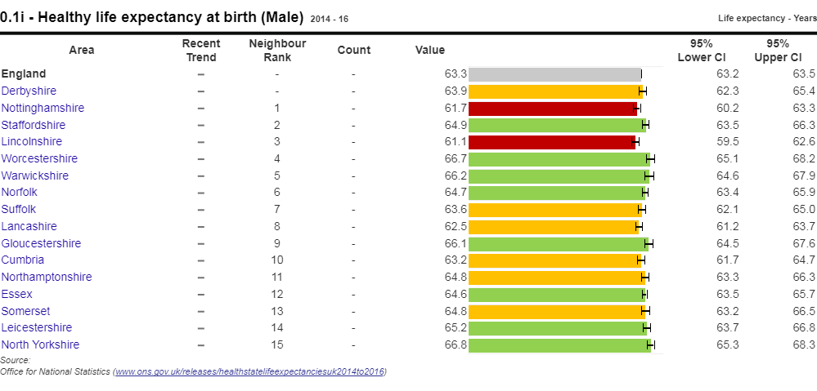
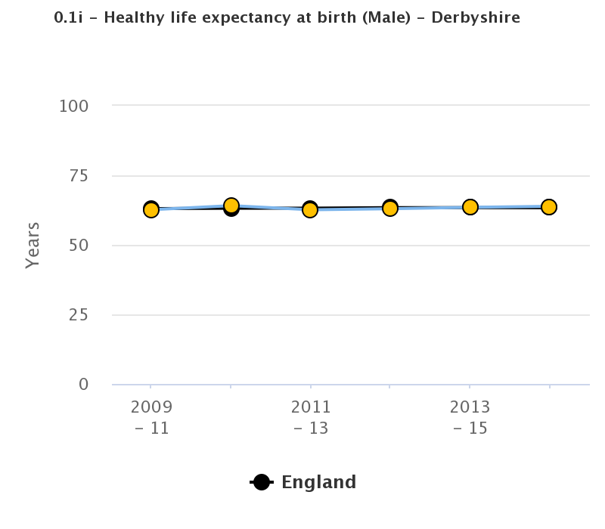
The State of Derbyshire 2018
0.1i Healthy life expectancy at birth
Healthy life expectancy shows the years a person can expect to live in good health (rather than with a disability or in poor health).
It complements the supporting indicators by showing the overall trends in a major population health measure, setting the context in which local authorities can assess the other indicators and identify the drivers of healthy life expectancy.
Male
The average number of years a person would expect to live in good health based on contemporary mortality rates and prevalence of self-reported good health, in Derbyshire in 2014-16, was 63.9 years. This was higher than for England as a whole, at 63.3 years, and had risen from 63.5 years previously.
CIPFA neighbours
Trends
Variation within the County
Not available for this indicator
POF
PHOF

Slide 38
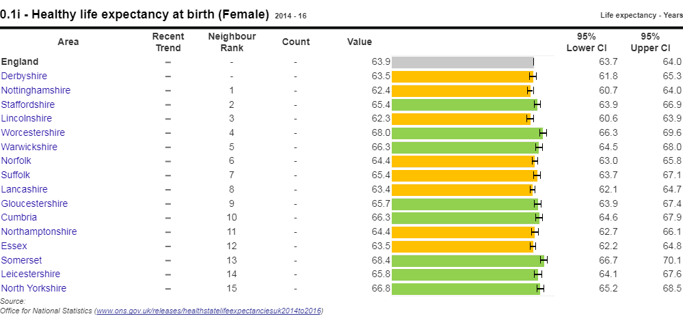
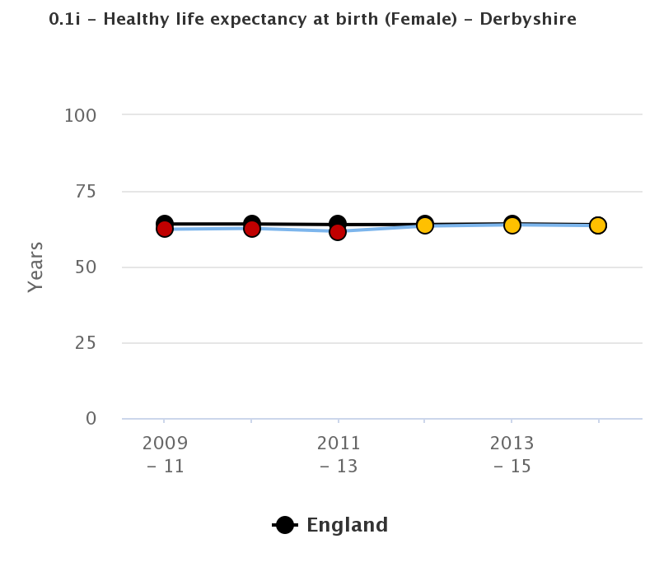
The State of Derbyshire 2018
0.1i Healthy life expectancy at birth
Healthy life expectancy shows the years a person can expect to live in good health (rather than with a disability or in poor health).
It complements the supporting indicators by showing the overall trends in a major population health measure, setting the context in which local authorities can assess the other indicators and identify the drivers of healthy life expectancy.
Female
The average number of years a person would expect to live in good health based on contemporary mortality rates and prevalence of self-reported good health, in Derbyshire in 2014-16, was 63.5 years. This was higher than for England as a whole, at 63.9 years, and had risen from 62.2 years previously.
CIPFA neighbours
Trends
Variation within the County
Not available for this indicator
POF
PHOF

Slide 39
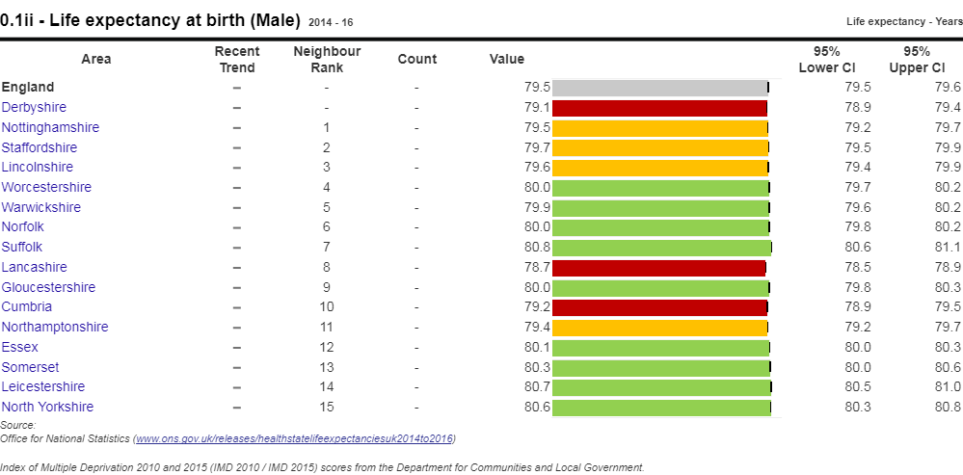
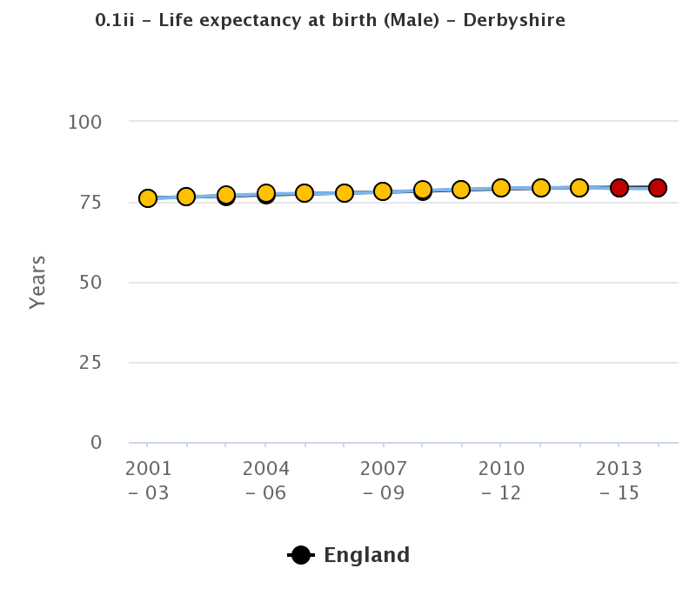
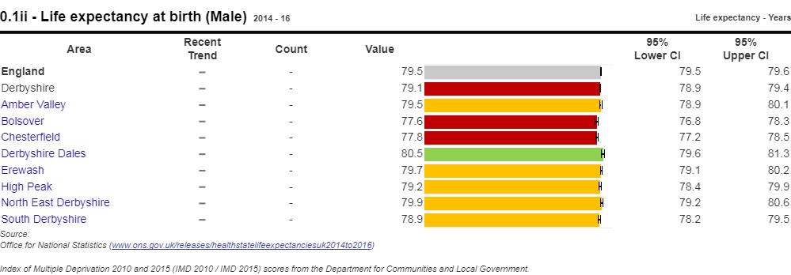
The State of Derbyshire 2018
0.1ii Life expectancy at birth
Life expectancy shows the average number of years a person would expect to live based on contemporary mortality rates.
It complements the supporting indicators by showing the overall trends in a major population health measure, setting the context in which local authorities can assess the other indicators and identify the drivers of healthy life expectancy.
Male
The average number of years a person would expect to live based on contemporary mortality rates, in Derbyshire in 2014-16, was 79.1 years. This was significantly lower than for England as a whole, at 79.5 years, and had fallen from 79.2 years previously.
CIPFA neighbours
Trends
Variation within the County
Not available for this indicator
POF
PHOF

Slide 40
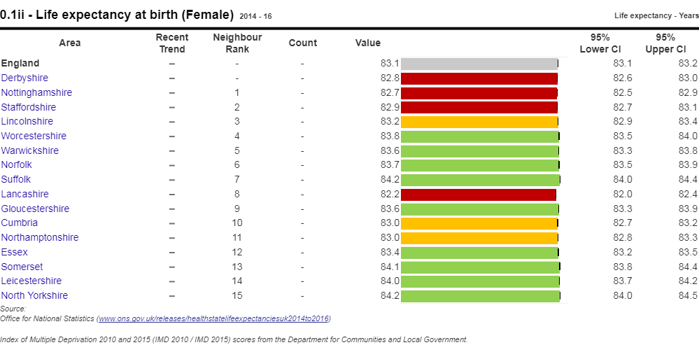
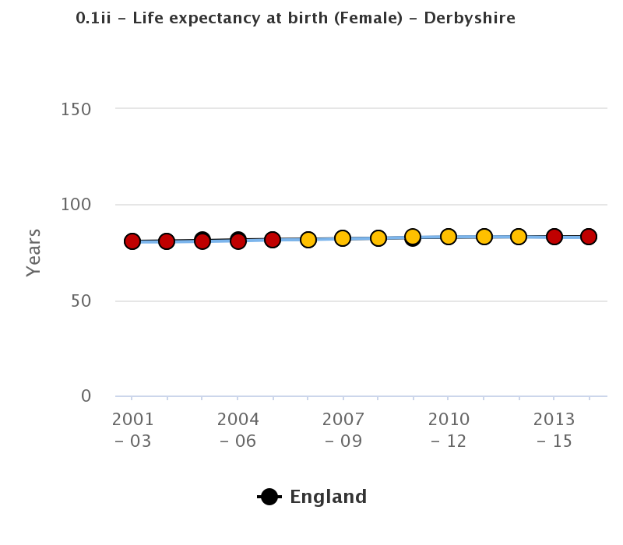
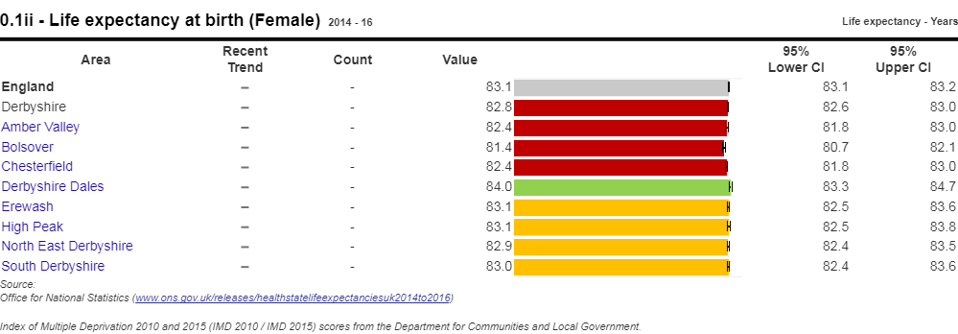
The State of Derbyshire 2018
0.1ii Life expectancy at birth
Life expectancy shows the average number of years a person would expect to live based on contemporary mortality rates.
It complements the supporting indicators by showing the overall trends in a major population health measure, setting the context in which local authorities can assess the other indicators and identify the drivers of healthy life expectancy.
Female
The average number of years a person would expect to live based on contemporary mortality rates, in Derbyshire in 2014-16, was 82.8 years. This was significantly lower than for England as a whole, at 83.1 years, and remained the same as previously.
CIPFA neighbours
Trends
Variation within the County
Not available for this indicator
POF
PHOF

Slide 41
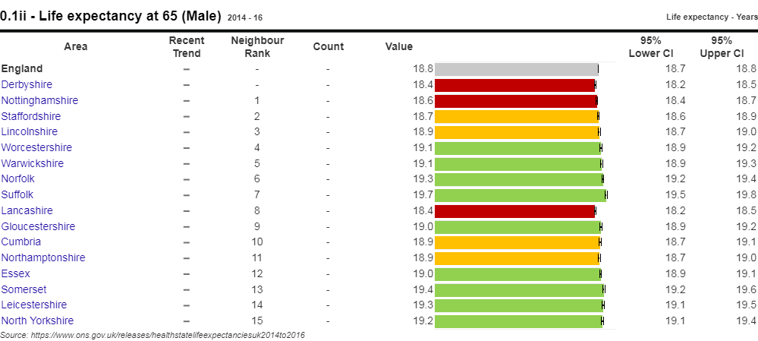
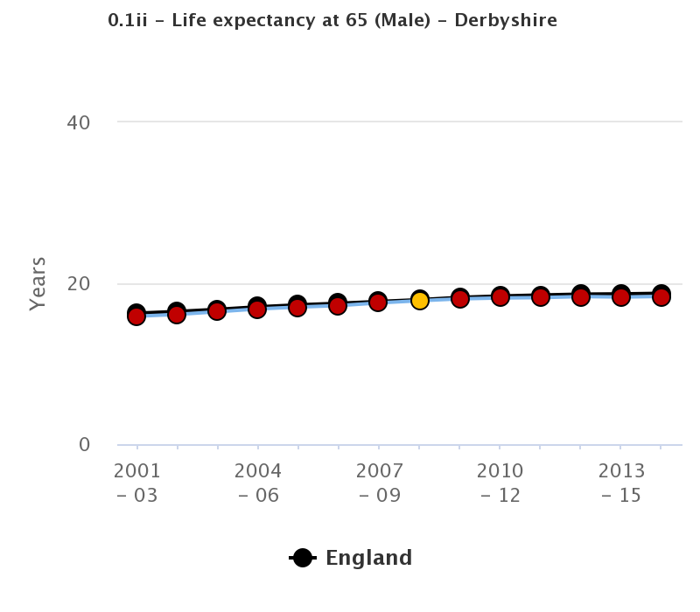
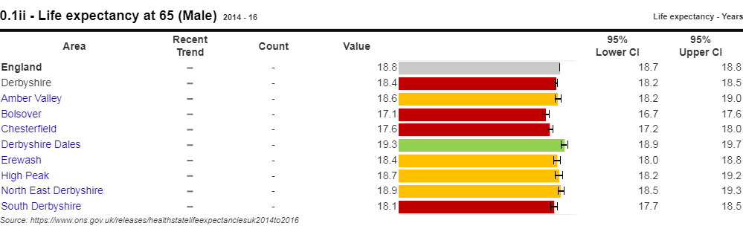
The State of Derbyshire 2018
0.1ii Life expectancy at 65
Life expectancy shows the average number of years a person would expect to live based on contemporary mortality rates.
It complements the supporting indicators by showing the overall trends in a major population health measure, setting the context in which local authorities can assess the other indicators and identify the drivers of healthy life expectancy.
Male
The average number of years a person would expect to live based on contemporary mortality rates, in Derbyshire in 2014-16, was 18.4 years. This was significantly lower than for England as a whole, at 18.8 years, but had risen from 18.3.
CIPFA neighbours
Trends
Variation within the County
Not available for this indicator
POF
PHOF

Slide 42
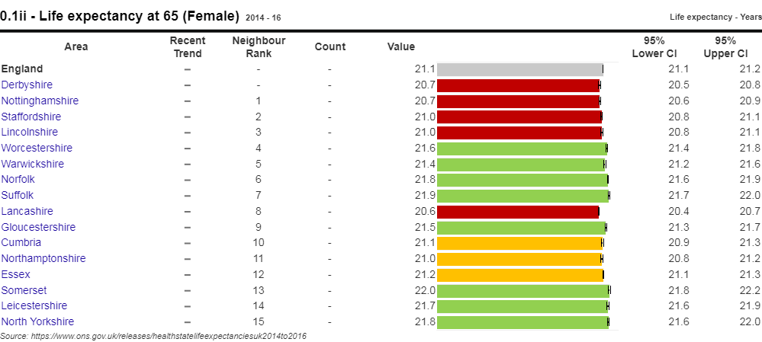
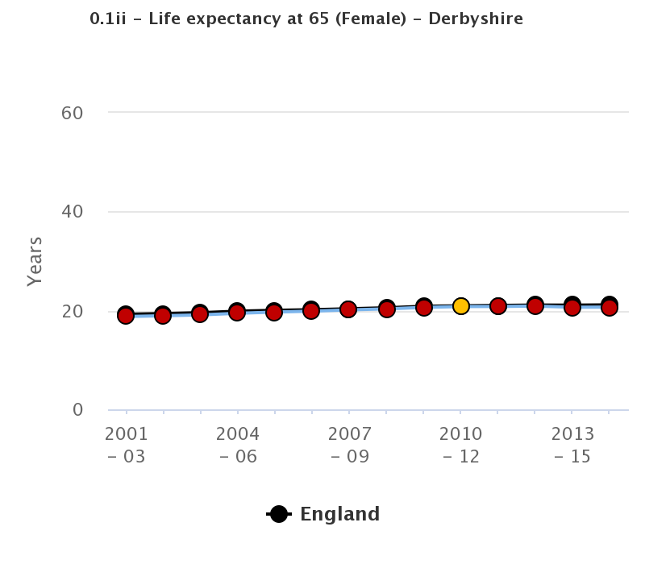
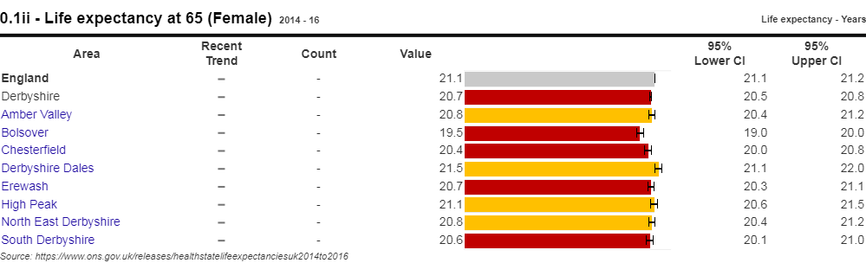
The State of Derbyshire 2018
0.1ii Life expectancy at 65
Life expectancy shows the average number of years a person would expect to live based on contemporary mortality rates.
It complements the supporting indicators by showing the overall trends in a major population health measure, setting the context in which local authorities can assess the other indicators and identify the drivers of healthy life expectancy.
Female
The average number of years a person would expect to live based on contemporary mortality rates, in Derbyshire in 2014-16, was 20.7 years. This was significantly lower than for England as a whole, at 21.1 years, and remained the same as previously.
CIPFA neighbours
Trends
Variation within the County
Not available for this indicator
POF
PHOF

Slide 43
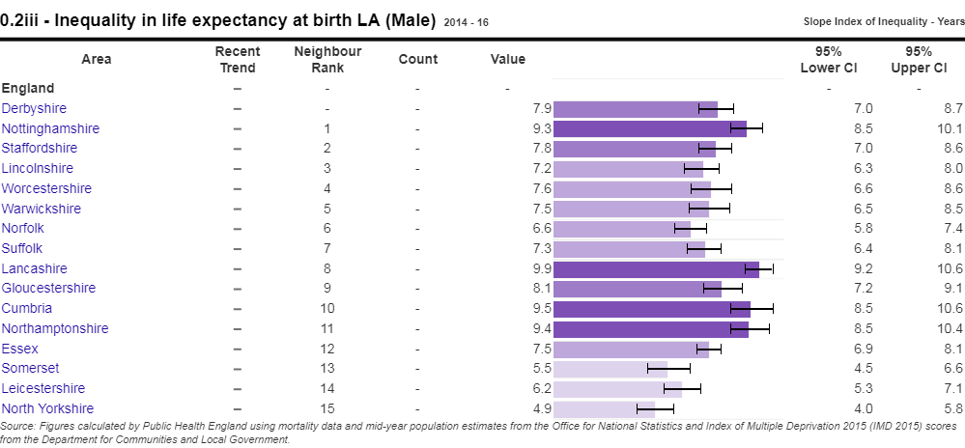
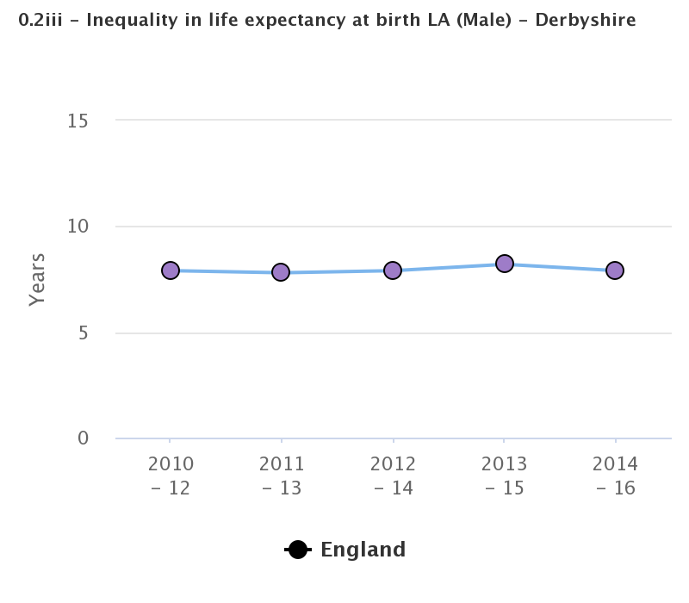
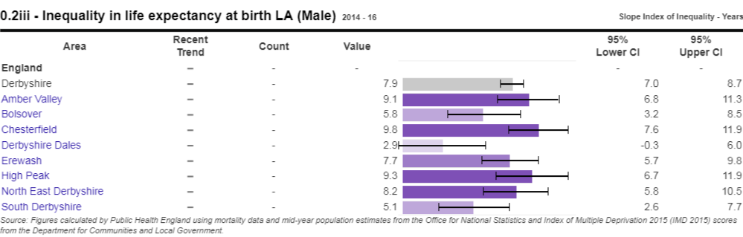
The State of Derbyshire 2018
0.1ii Inequality in life expectancy at birth
This indicator shows inequalities within local authorities, enabling a focus on the deprivation that exists everywhere at small area level. By highlighting area based inequalities, it sets the context within which local areas can assess the other indicators within the framework and set priorities, identifying the drivers of life expectancy, especially in areas where life expectancy is low.
Male
0.2iii - Slope index of inequality in life expectancy at birth based on local deprivation deciles: the range in years of life expectancy across the social gradient from most to least deprived.
The value for Derbyshire in 2014-16 was 7.9, significantly lower than for England (9.3), having fallen from 8.2 previously
CIPFA neighbours
Trends
Variation within the County
Not available for this indicator
POF
PHOF

Slide 44
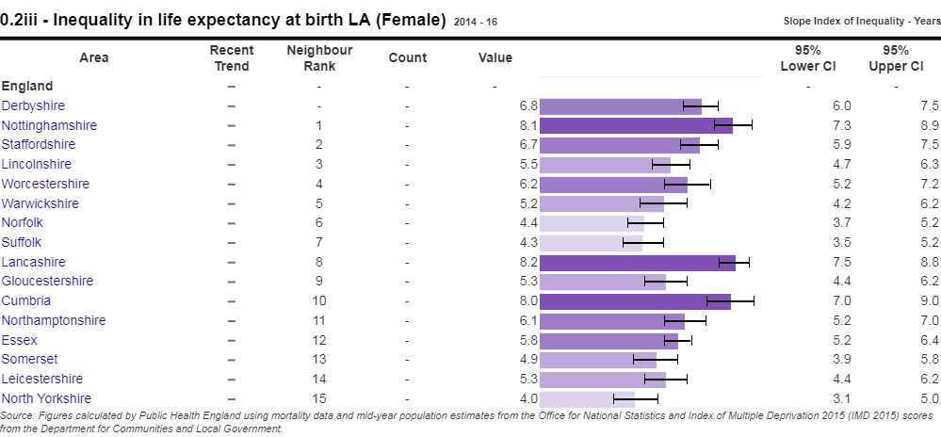
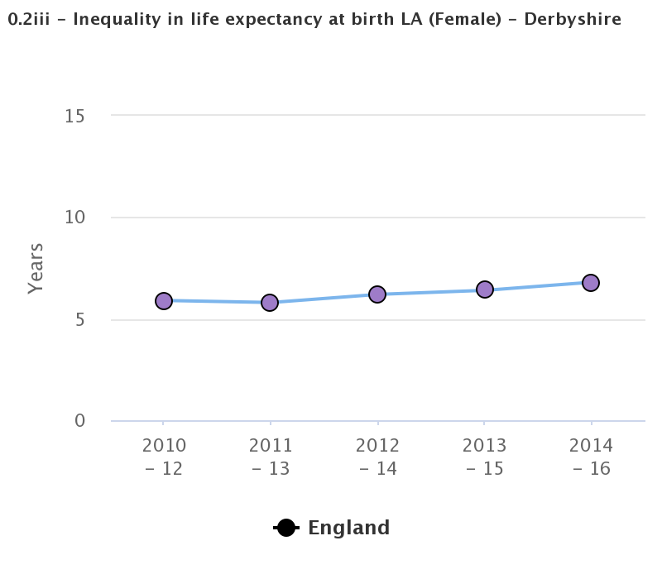
The State of Derbyshire 2018
0.1ii Inequality in life expectancy at birth
This indicator shows inequalities within local authorities, enabling a focus on the deprivation that exists everywhere at small area level. By highlighting area based inequalities, it sets the context within which local areas can assess the other indicators within the framework and set priorities, identifying the drivers of life expectancy, especially in areas where life expectancy is low.
Female
0.2iii - Slope index of inequality in life expectancy at birth based on local deprivation deciles: the range in years of life expectancy across the social gradient from most to least deprived.
The value for Derbyshire in 2014-16 was 6.8, lower than for England (7.3), having risen from 6.4 previously
CIPFA neighbours
Trends
Variation within the County
Not available for this indicator
POF
PHOF

Slide 45
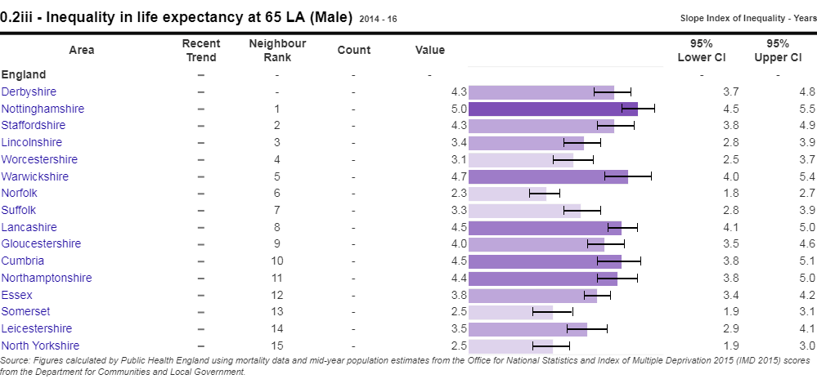
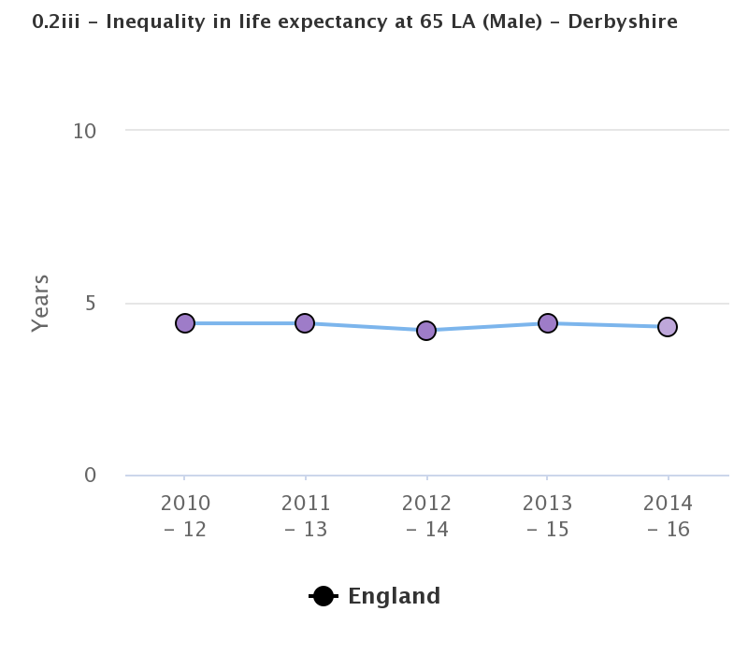
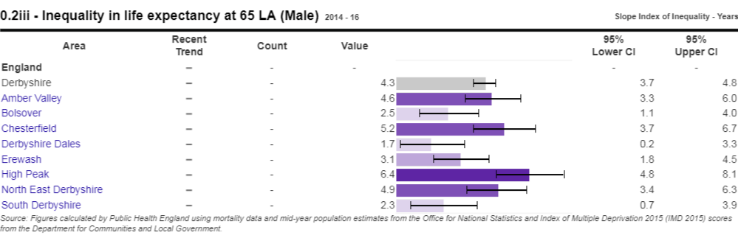
The State of Derbyshire 2018
0.2iii Inequality in life expectancy at 65
This indicator shows inequalities within local authorities, enabling a focus on the deprivation that exists everywhere at small area level. By highlighting area based inequalities, it sets the context within which local areas can assess the other indicators within the framework and set priorities, identifying the drivers of life expectancy, especially in areas where life expectancy is low.
Male
0.2iii - Slope index of inequality in life expectancy at 65 based on local deprivation deciles: the range in years of life expectancy across the social gradient from most to least deprived.
The value for Derbyshire in 2014-16 was 4.3, lower than for England (4.8), having fallen from 4.4 previously
CIPFA neighbours
Trends
Variation within the County
Not available for this indicator
POF
PHOF

Slide 46
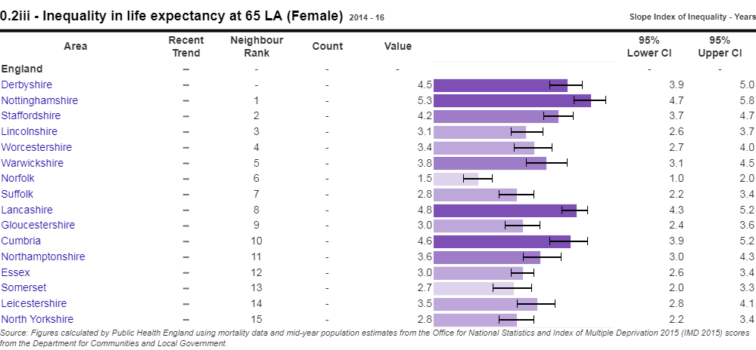
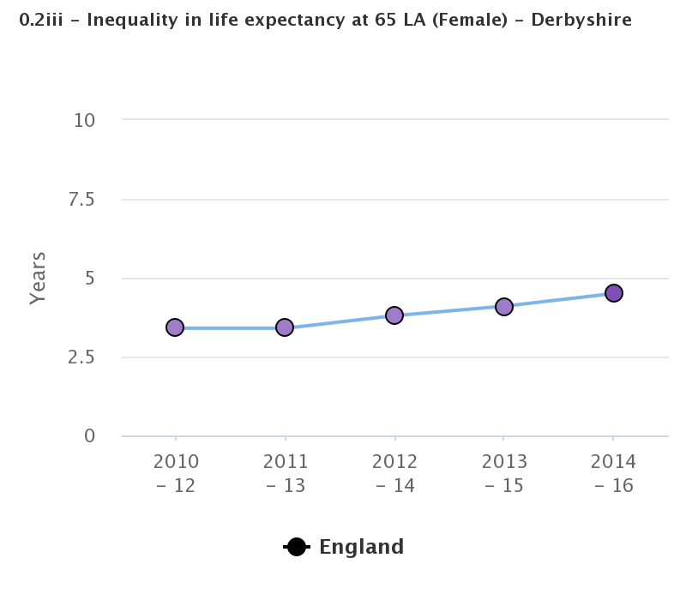
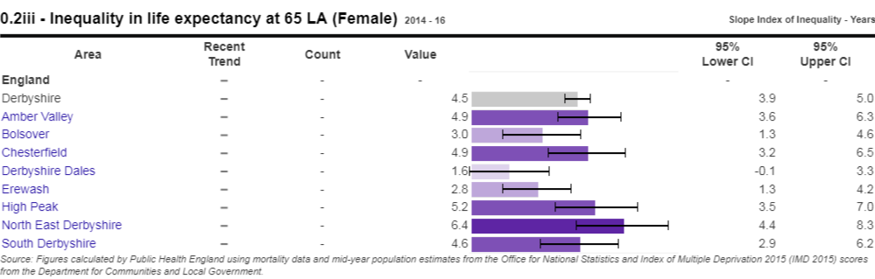
The State of Derbyshire 2018
0.1ii Inequality in life expectancy at 65
This indicator shows inequalities within local authorities, enabling a focus on the deprivation that exists everywhere at small area level. By highlighting area based inequalities, it sets the context within which local areas can assess the other indicators within the framework and set priorities, identifying the drivers of life expectancy, especially in areas where life expectancy is low.
Female
0.2iii - Slope index of inequality in life expectancy at 65 based on local deprivation deciles: the range in years of life expectancy across the social gradient from most to least deprived.
The value for Derbyshire in 2014-16 was 4.5, higher than for England (4.4), having risen from 4.1 previously
CIPFA neighbours
Trends
Variation within the County
Not available for this indicator
POF
PHOF

Slide 47
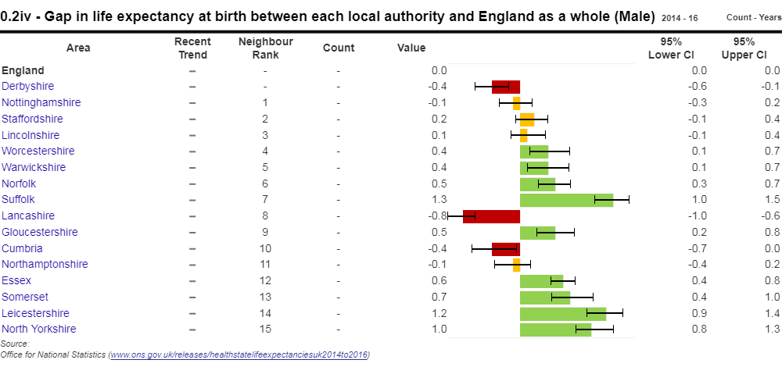
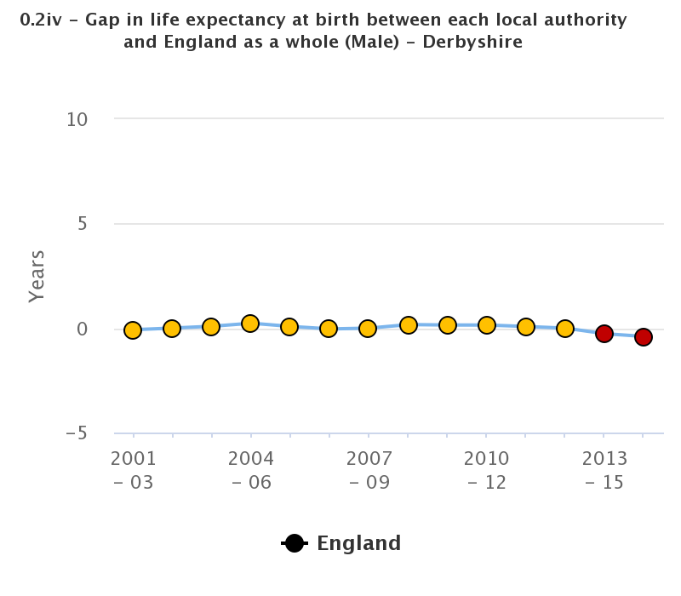
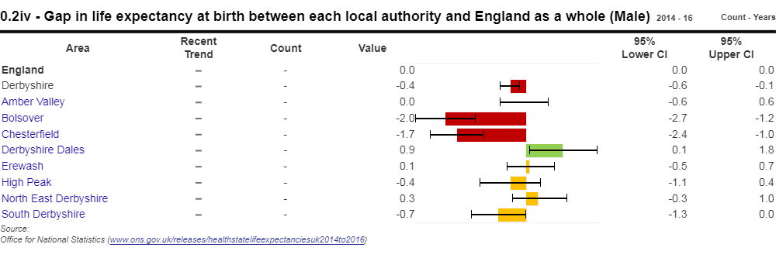
The State of Derbyshire 2018
0.2iv Gap in life expectancy between Derbyshire and England as a whole
This provides an indication of overall life expectancy in the local authority relative to the level for England. For local authority areas where overall life expectancy is lower than the England value, it will focus attention on the need to improve the health of the whole population relative to England, in addition to addressing within-area inequalities, as shown in Indicator 0.2iii.
Male
In 2014-16 the life expectancy at birth in Derbyshire was 0.4 years lower than in England as a whole, a significant difference which had risen from 0.3 years previously.
CIPFA neighbours
Trends
Variation within the County
Not available for this indicator
POF
PHOF

Slide 48
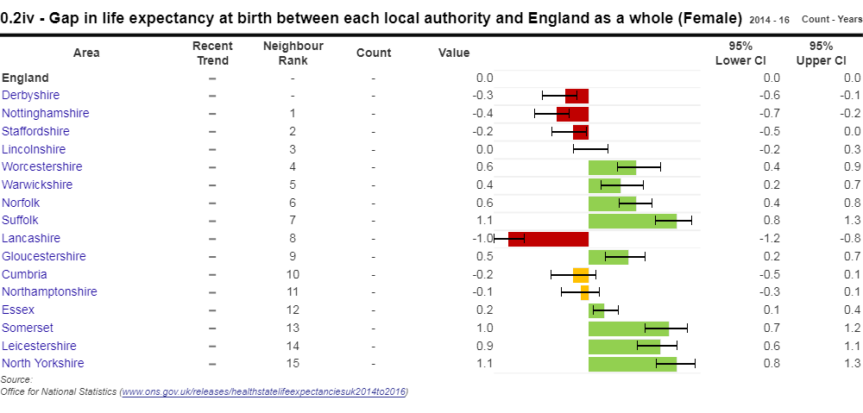
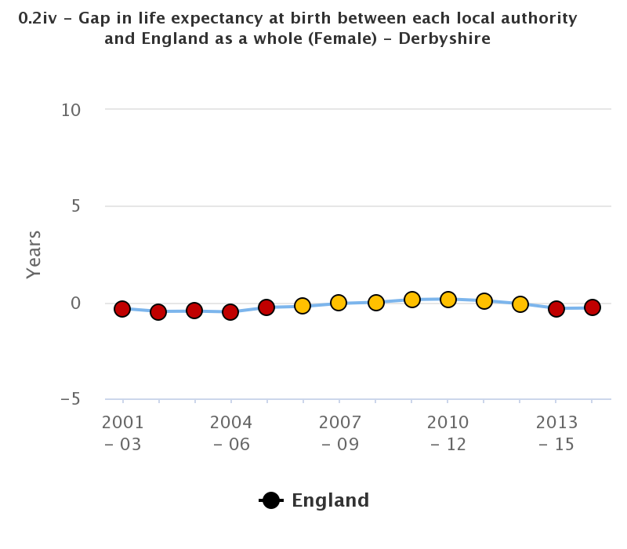
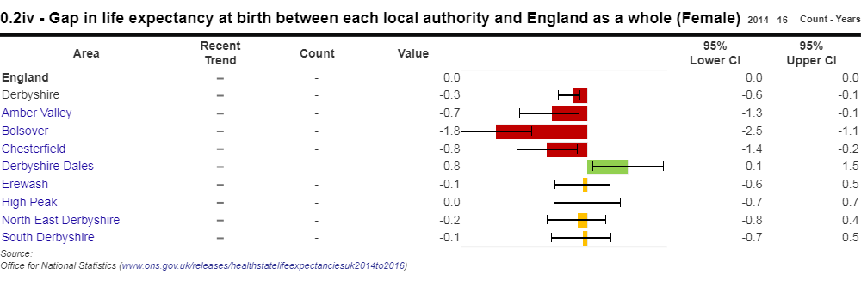
The State of Derbyshire 2018
0.2iv Gap in life expectancy between Derbyshire and England as a whole
This provides an indication of overall life expectancy in the local authority relative to the level for England. For local authority areas where overall life expectancy is lower than the England value, it will focus attention on the need to improve the health of the whole population relative to England, in addition to addressing within-area inequalities, as shown in Indicator 0.2iii.
Female
In 2014-16 the life expectancy at birth in Derbyshire was 0.3 years lower than in England as a whole, a significant difference which was the same as previously.
CIPFA neighbours
Trends
Variation within the County
Not available for this indicator
POF
PHOF

Slide 49
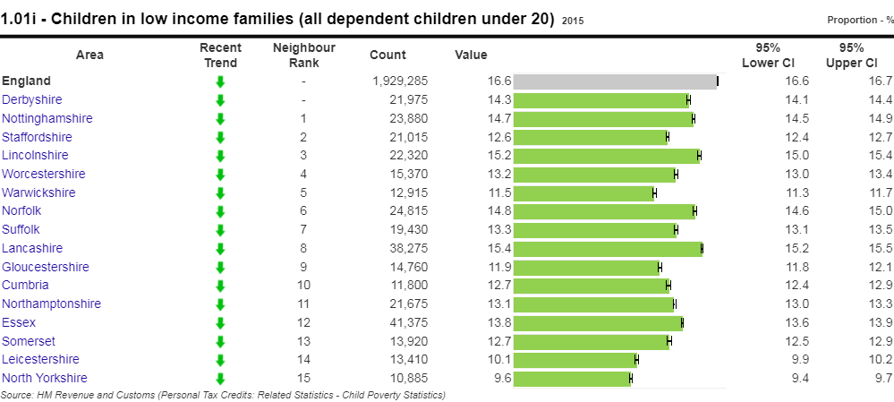
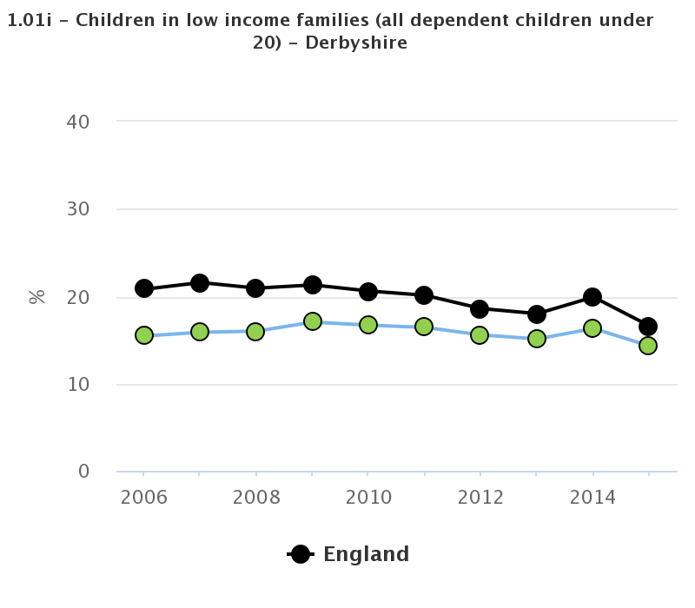
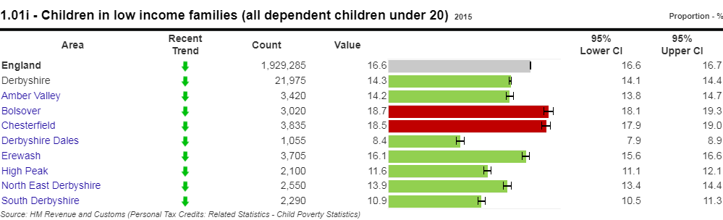
The State of Derbyshire 2018
1.01 Children in low income families
The Marmot Review (2010) suggests there is evidence that childhood poverty leads to premature mortality and poor health outcomes for adults. Reducing the numbers of children who experience poverty should improve these adult health outcomes and increase healthy life expectancy.
i Percentage of all dependent children under 20 in relative poverty
In 2015, 14.3% of children aged under 20 in Derbyshire were living in relative poverty, a significantly lower proportion than for England (16.6%). The Derbyshire rate has fallen significantly from 16.3%.
CIPFA neighbours
Trends
Variation within the County
Not available for this indicator
POF
PHOF

Slide 50
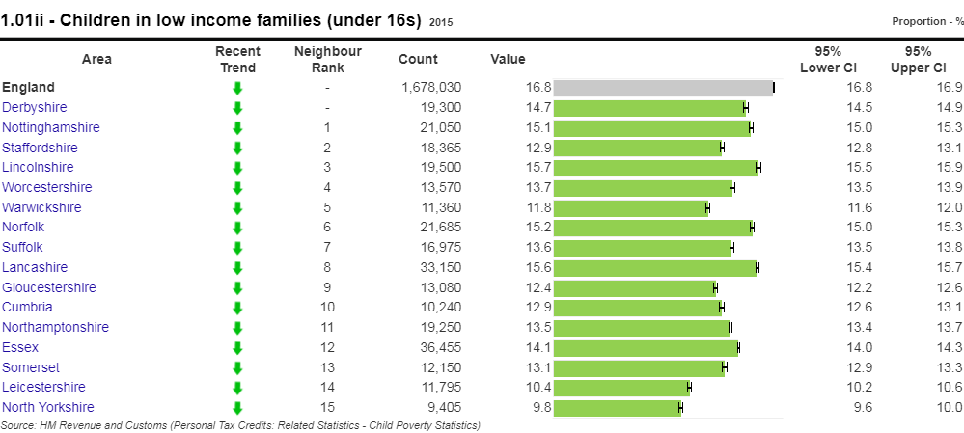
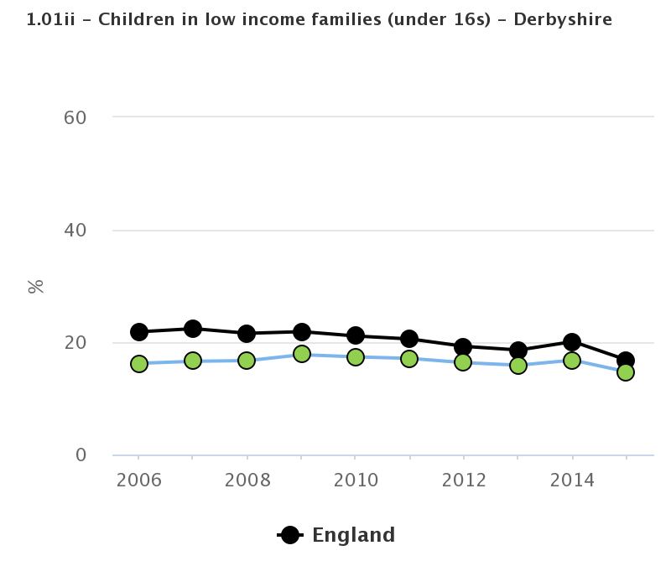
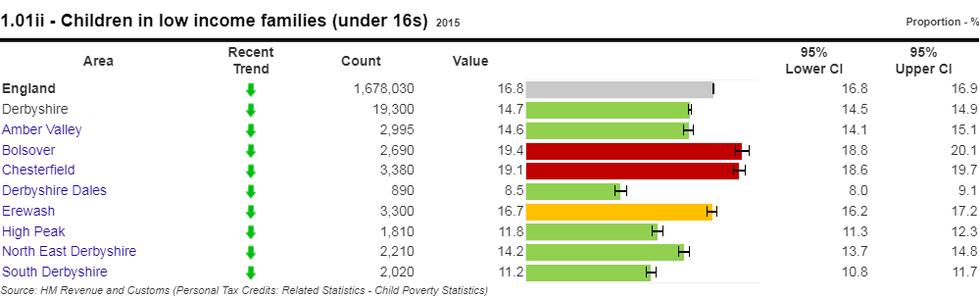
The State of Derbyshire 2018
1.01 Children in low income families
The Marmot Review (2010) suggests there is evidence that childhood poverty leads to premature mortality and poor health outcomes for adults. Reducing the numbers of children who experience poverty should improve these adult health outcomes and increase healthy life expectancy.
ii Percentage of children under 16 in low income families
In 2015, 14.7% of children aged under 16 in Derbyshire were living in low income families, a significantly lower proportion than for England (16.8%). The Derbyshire rate has fallen significantly from 16.8%.
CIPFA neighbours
Trends
Variation within the County
Not available for this indicator
POF
PHOF

Slide 51
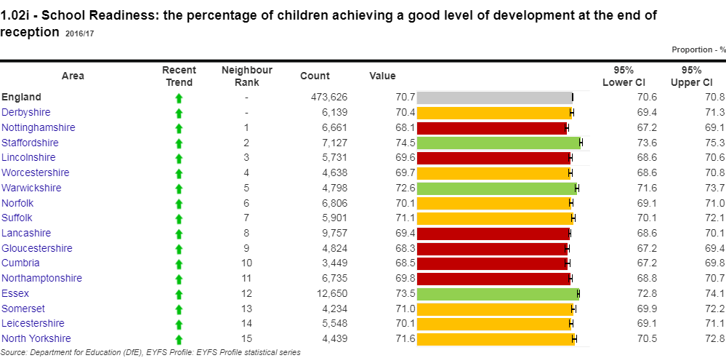
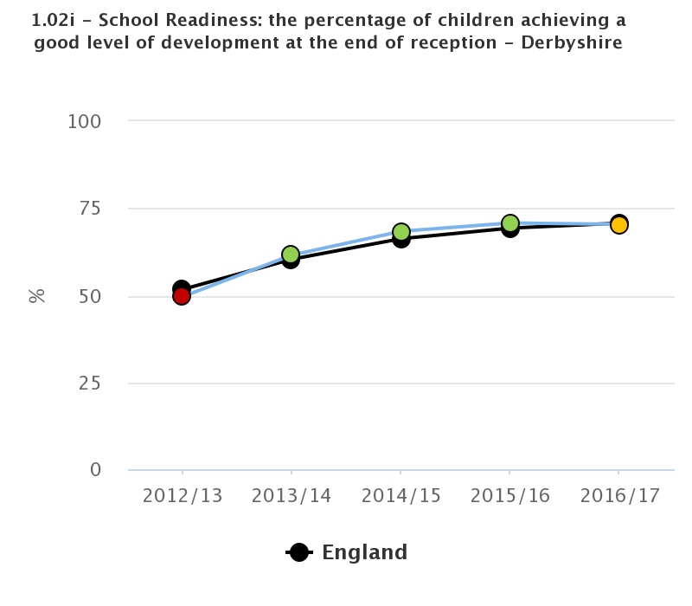
The State of Derbyshire 2018
1.02i School Readiness
Children are defined as having reached a good level of development if they achieve at least the expected level in the early learning goals in the prime areas of learning (personal, social and emotional development; physical development; and communication and language) and the early learning goals in the specific areas of mathematics and literacy.
All children achieving a good level of development at the end of reception as a percentage of all eligible children.
In 2016/17, 70.4% of children in Derbyshire achieved a good level of development at the end of reception. This was similar to England (70.7%). The Derbyshire rate has fallen from 70.4%.
CIPFA neighbours
Trends
Variation within the County
Not available for this indicator
POF
PHOF

Slide 52
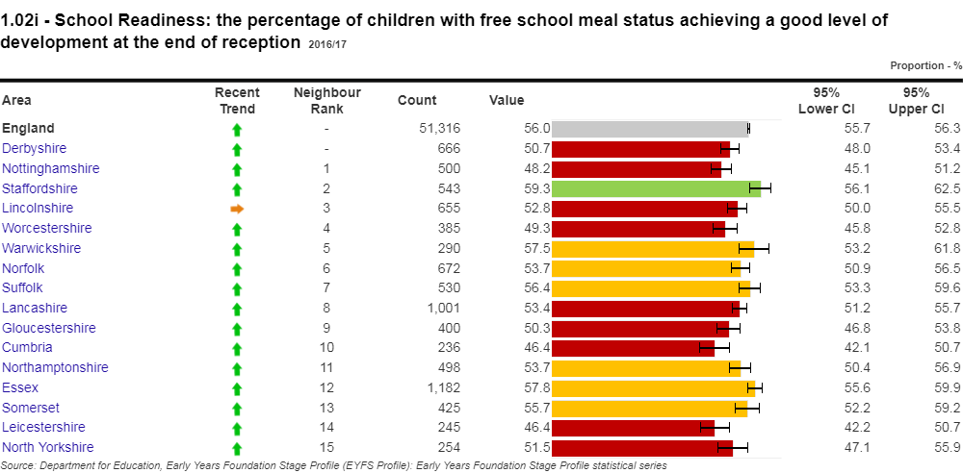
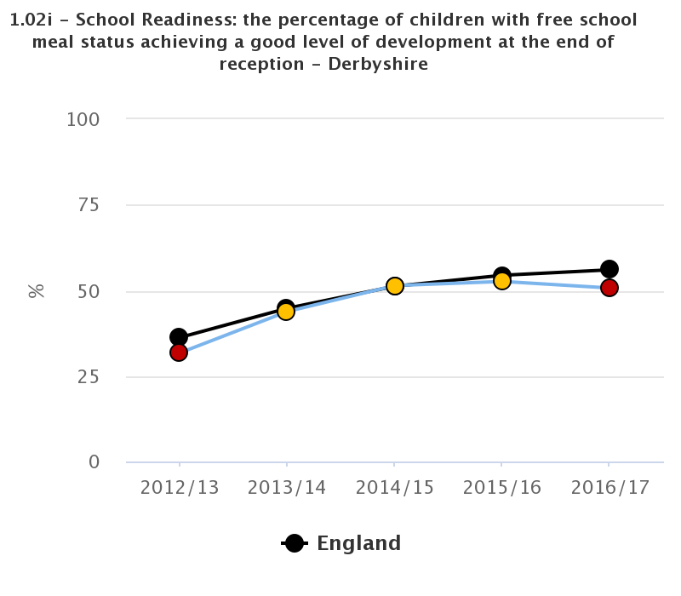
The State of Derbyshire 2018
1.02i School Readiness
Children are defined as having reached a good level of development if they achieve at least the expected level in the early learning goals in the prime areas of learning (personal, social and emotional development; physical development; and communication and language) and the early learning goals in the specific areas of mathematics and literacy.
The percentage of children with free school meal status achieving a good level of development at the end of reception
In 2016/17, 50.7% of children in Derbyshire achieved a good level of development at the end of reception. This was significantly lower than for England (56.0%). The Derbyshire rate has fallen from 52.6%.
CIPFA neighbours
Trends
Variation within the County
Not available for this indicator
POF
PHOF

Slide 53
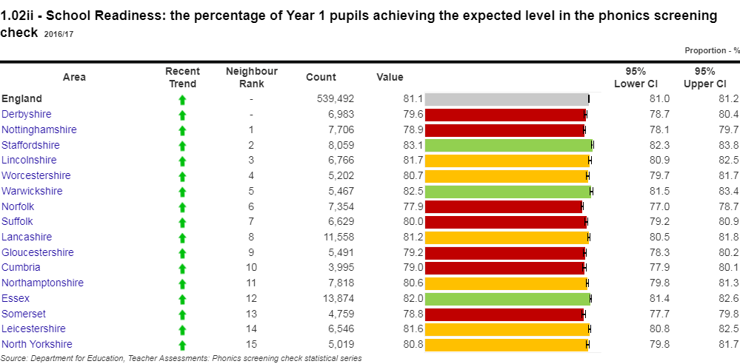
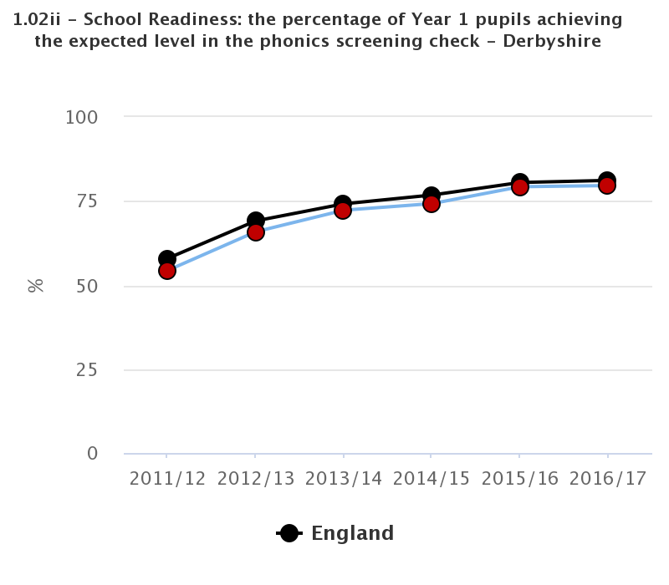
The State of Derbyshire 2018
1.02ii School Readiness
Children are defined as having reached a good level of development if they achieve at least the expected level in the early learning goals in the prime areas of learning (personal, social and emotional development; physical development; and communication and language) and the early learning goals in the specific areas of mathematics and literacy.
Year 1 pupils achieving the expected level in the phonics screening check as a percentage of all eligible pupils
In 2016/17, 79.6% of children in Derbyshire achieved the expected level. This was significantly lower than for England (81.1%). The Derbyshire rate has risen from 79.3%.
CIPFA neighbours
Trends
Variation within the County
Not available for this indicator
POF
PHOF

Slide 54
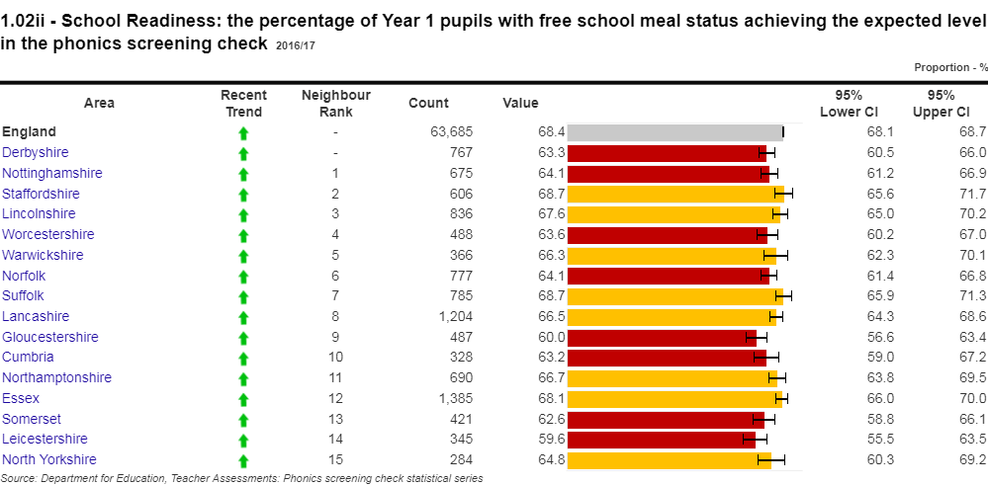
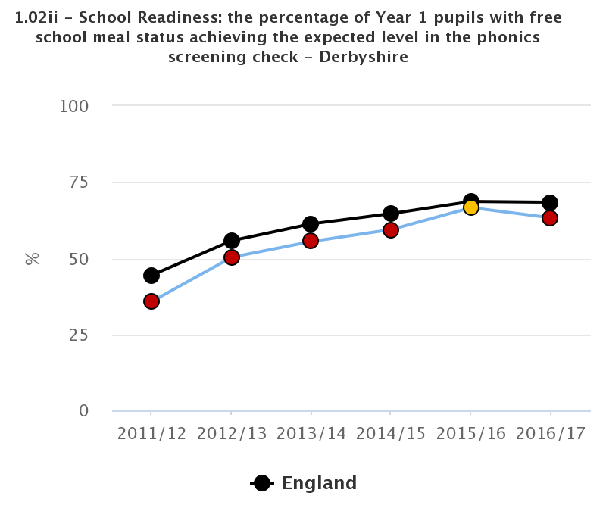
The State of Derbyshire 2018
1.02ii School Readiness
Children are defined as having reached a good level of development if they achieve at least the expected level in the early learning goals in the prime areas of learning (personal, social and emotional development; physical development; and communication and language) and the early learning goals in the specific areas of mathematics and literacy.
The percentage of Year 1 pupils with free school meal status achieving the expected level in the phonics screening check
In 2016/17, 63.3% of children in Derbyshire achieved the expected level. This was significantly lower than for England (68.4%). The Derbyshire rate has risen from 66.6%.
CIPFA neighbours
Trends
Variation within the County
Not available for this indicator
POF
PHOF

Slide 55
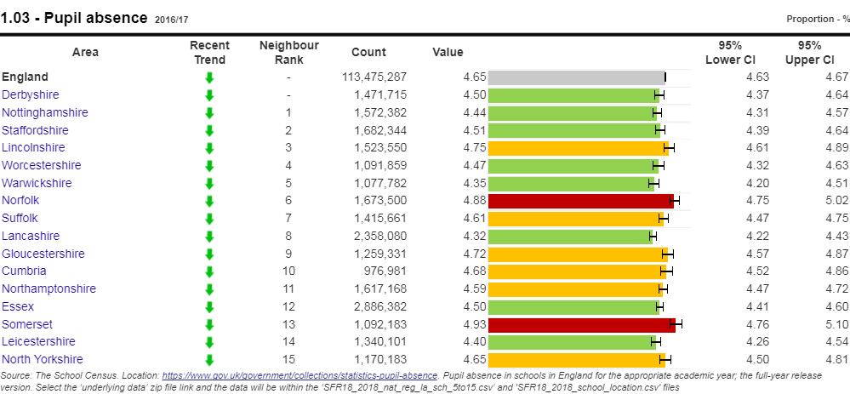


The State of Derbyshire 2018
1.03 Pupil absence
Parents of children of compulsory school age (aged 5 to 15 at the start of the school year) are required to ensure that they receive a suitable education by regular attendance at school or otherwise. Education attainment is influenced by both the quality of education they receive and their family socio-economic circumstances. Educational qualifications are a determinant of an individual's labour market position, which in turn influences income, housing and other material resources. These are related to health and health inequalities.
CIPFA neighbours
The percentage of half days missed by pupils in 2016/17 was significantly lower in Derbyshire (4.50%) than in England (4.65%). It has, however, risen from 4.40%.
Trends
Variation within the County
Not available for this indicator
POF
PHOF

Slide 56


The State of Derbyshire 2018
1.04 First time entrants to the youth justice system
Children and young people at risk of offending or within the youth justice system often have more unmet health needs than other children.
The rate for Derbyshire in 2017 was 133.2 per 100,000 population, which is significantly lower than for England, at 292.5. The Derbyshire rate has been falling since 2010, reflecting trends regionally and nationally, most recently falling significantly from 181.1.
CIPFA neighbours
Trends
Variation within the County
Not available for this indicator
POF
PHOF

Slide 57

The State of Derbyshire 2018
1.05 16-18 year olds not in education employment or training (NEET)
Young people who are not in education, employment or training are at greater risk of a range of negative outcomes, including poor health, depression or early parenthood.
The rate for Derbyshire is 3.6%, which is significantly lower than East Midlands at 3.9% and England at 4.2%. The Derbyshire rate has fallen significantly from the 2011 baseline (7.1%).
The method of calculating this indicator has been changed and previous data is no longer comparable.
CIPFA neighbours
Trends
Not available for this indicator
Variation within the County
Not available for this indicator
POF
PHOF

Slide 58


The State of Derbyshire 2018
1.06i Adults with a learning disability / in contact with secondary mental health services who live in stable and appropriate accommodation
The nature of accommodation for people with a primary support reason of learning disability support has a strong impact on their safety and overall quality of life and the risk of social exclusion.
See also ASCOF 1G
In 2016/17 84.3% of adults with a learning disability who were known to the council lived in their own home or with their family - significantly more than the 76.2% in England. This was the same as for the last period in Derbyshire.
CIPFA neighbours
Trends
Variation within the County
Not available for this indicator
POF
PHOF

Slide 59


The State of Derbyshire 2018
1.06ii - Adults in contact with secondary mental health services who live in stable and appropriate accommodation
Stable and appropriate accommodation is closely linked to improving their safety and reducing their risk of social exclusion.
As of 2016/17 this stood at 86.0% of adults in contact with secondary mental health services living independently, significantly more than the 54.0% in England as a whole. It has risen from 82.1% previously.
There are data quality issues with this indicator.
CIPFA neighbours
Trends
Variation within the County
Not available for this indicator
POF
ASCOF
PHOF

Slide 60



The State of Derbyshire 2018
1.08 - Gap in the employment rate
The review "Is work good for your health and wellbeing" (2006) concluded that work was generally good for both physical and mental health and wellbeing. The strategy for public health takes a life course approach and this indicator provides a good indication of the impact limiting long-term illness has on employment among those in the "working well" life stage.
i Between those with a long-term health condition and the overall employment rate
In 2016/17, the gap in the employment rate between those with long term conditions (LTCs) and the overall rate was significantly higher in Derbyshire (36.0%) than in England (29.4%). It also rose from 33.5% previously.
CIPFA neighbours
Trends
Variation within the County
Not available for this indicator
POF
PHOF

Slide 61


The State of Derbyshire 2018
1.08 Gap in the employment rate
The review "Is work good for your health and wellbeing" (2006) concluded that work was generally good for both physical and mental health and wellbeing. The strategy for public health takes a life course approach and this indicator provides a good indication of the impact limiting long-term illness has on employment among those in the "working well" life stage.
ii Between those with a learning disability and the overall employment rate
In 2016/17, the gap in the employment rate between those with learning disabilities and the overall rate was significantly higher in Derbyshire (77.0%) than in England (68.7%). It also rose from 76.0% previously.
CIPFA neighbours
Trends
Variation within the County
Not available for this indicator
POF
PHOF

Slide 62


The State of Derbyshire 2018
1.08 Gap in the employment rate
The review "Is work good for your health and wellbeing" (2006) concluded that work was generally good for both physical and mental health and wellbeing. The strategy for public health takes a life course approach and this indicator provides a good indication of the impact limiting long-term illness has on employment among those in the "working well" life stage. See also ASCOF 1F, NHSOF 2.5i and CCGOF 3.17.
iii For those in contact with secondary mental health services and the overall employment rate
In 2016/17, the gap in the employment rate between those in contact with secondary mental health and the overall rate is slightly higher in Derbyshire (68.4%) than in England (67.4%). It also rose from 62.6% previously.
There is a data quality issue with this indicator.
CIPFA neighbours
Trends
Variation within the County
Not available for this indicator
POF
PHOF

Slide 63



The State of Derbyshire 2018
1.09 Sickness Absence
The Government's strategy for public health, which adopts a life-course approach and includes a focus on the working-age population in the "working well" stage to help people with health conditions to stay in or return to work.
i The percentage of employees who had at least one day off in the previous week.
In 2015-17, this percentage was slightly lower, at 2.0%, than in England (2.1%), having fallen from 2.3%.
CIPFA neighbours
Trends
Variation within the County
Not available for this indicator
POF
PHOF

Slide 64



The State of Derbyshire 2018
1.09 Sickness Absence
The Government's strategy for public health, which adopts a life-course approach and includes a focus on the working-age population in the "working well" stage to help people with health conditions to stay in or return to work.
ii The percentage of working days lost due to sickness absence
In 2015-17, this percentage was, at 1.1%, the same as for England, having fallen from 1.1%.
CIPFA neighbours
Trends
Variation within the County
Not available for this indicator
POF
PHOF

Slide 65



The State of Derbyshire 2018
1.10 Killed and seriously injured casualties on England's roads
Motor vehicle traffic accidents are a major cause of preventable deaths and morbidity, particularly in younger age groups. For children and for men aged 20-64 years, mortality rates for motor vehicle traffic accidents are higher in lower socioeconomic groups. The vast majority of road traffic collisions are preventable and can be avoided through improved education, awareness, road infrastructure and vehicle safety.
In2014-16, the rate per 100,000 population, at 44.9 was significantly higher than for England, at 39.7; it also had risen from 44.5.
CIPFA neighbours
Trends
Variation within the County
Not available for this indicator
POF
PHOF

Slide 66


The State of Derbyshire 2018
1.11 Domestic abuse-related incidents and crimes
Tackling domestic abuse as a public health issue is vital for ensuring that some of the most vulnerable people in society receive the support, understanding and treatment they deserve through effective interventions to treat victims and prevent future re-victimisation.
Domestic abuse related offences and incidents are defined as threatening behaviour, violence or abuse (psychological, physical, sexual, financial or emotional) between adults, aged 16 and over, who are or have been intimate partners or family members, regardless of gender or sexuality. Offences have been recorded as a crime, whereas the number of incidents refers to those that were not recorded as a crime and the two categories are mutually exclusive.
In 2016/17, the rate per 1,000 population, at 21.7, was lower than for England, at 22.5, having fallen from 22.8.
LAs are allocated the rate of the police force area in which they sit.
CIPFA neighbours
Trends
Variation within the County
Not available for this indicator
POF
PHOF

Slide 67



The State of Derbyshire 2018
1.12 Violent crime
Public health services have an important role to play in tackling violence. Directors of Public Health, located within local authorities, are tasked with looking widely at issues including crime reduction, violence prevention, responses to violence and reducing levels of reoffending, which can also prevent health inequalities.
i Hospital admissions for violence
In 201/15-2016/17, the rate of admission per 100,000 population was significantly lower at 33.9, than for either England at 42.9, having fallen from 37.1.
CIPFA neighbours
Trends
Variation within the County
Not available for this indicator
POF
PHOF

Slide 68



The State of Derbyshire 2018
1.12 Violent crime
Public health services have an important role to play in tackling violence. Directors of Public Health, located within local authorities, are tasked with looking widely at issues including crime reduction, violence prevention, responses to violence and reducing levels of reoffending, which can also prevent health inequalities.
ii Violence offences per 1,000 population
In 2017/18, the rate of offences per 1,000 population was significantly lower at 9.9, than for England at 23.7. However, the rate had risen from 9.5.
.
CIPFA neighbours
Trends
Variation within the County
Not available for this indicator
POF
PHOF

Slide 69



The State of Derbyshire 2018
1.12 Violent crime
Public health services have an important role to play in tackling violence. Directors of Public Health, located within local authorities, are tasked with looking widely at issues including crime reduction, violence prevention, responses to violence and reducing levels of reoffending, which can also prevent health inequalities.
iii Rate of sexual offences per 1,000 population
The rate of offences per 1,000 population was significantly lower at 1.4, than for either England, at 2.4. The rate remained the same as previously.
CIPFA neighbours
Trends
Variation within the County
Not available for this indicator
POF
PHOF

Slide 70



The State of Derbyshire 2018
1.13 Re-offending levels
Tackling a person’s offending behaviour is often intrinsically linked to their physical and mental health, and in particular any substance misuse issues. Offenders often also experience significant health inequalities that will need to be identified, examined and addressed locally in partnership with organisations across the criminal justice system. Furthermore, a large proportion of families with multiple needs are managed through the criminal justice system, and their issues are inter-generational.
i Percentage of offenders who re-offend
In 2014, reoffending was lower in Derbyshire than in England as a whole, at 24.2%, compared with 25.4%, having fallen from 24.9%.
CIPFA neighbours
Trends
Variation within the County
Not available for this indicator
POF
PHOF

Slide 71



The State of Derbyshire 2018
1.13 Re-offending levels
Tackling a person’s offending behaviour is often intrinsically linked to their physical and mental health, and in particular any substance misuse issues. Offenders often also experience significant health inequalities that will need to be identified, examined and addressed locally in partnership with organisations across the criminal justice system. Furthermore, a large proportion of families with multiple needs are managed through the criminal justice system, and their issues are inter-generational.
ii Average number of re-offences per offender
In 2014 , reoffending was significantly lower in Derbyshire than in England as a whole, 0.75 re-offences per offender, compared with 0.82, having fallen from 0.76.
CIPFA neighbours
Trends
Variation within the County
Not available for this indicator
POF
PHOF

Slide 72


The State of Derbyshire 2018
13iii First time offenders
Tackling a person’s offending behaviour is often intrinsically linked to their physical and mental health, and in particular any substance misuse issues. Offenders often also experience significant health inequalities that will need to be identified, examined and addressed locally in partnership with organisations across the criminal justice system. Furthermore, a large proportion of families with multiple needs are managed through the criminal justice system, and their issues are inter-generational.
In 2017, the rate of first offending was 113.6 per 1,000 population in Derbyshire, significantly lower than in England as a whole, at 166.4, having fallen significantly from 173.9.
CIPFA neighbours
Trends
Variation within the County
Not available for this indicator
POF
PHOF

Slide 73



The State of Derbyshire 2018
1.14 Exposure to road, rail and air transport noise
There are a number of direct and indirect links between exposure to noise and health and wellbeing outcomes. Complaints about noise are the largest single cause of complaint to most local authorities. Exposure to noise can cause disturbance and interfere with activities, leading to annoyance and increased stress. Furthermore, there is increasing evidence that exposure to high levels of noise can cause direct health effects such as heart attacks and other health issues.
i Complaints about noise
The rate per 1,000 population in 2015/16 was significantly lower in Derbyshire (4.3) than in England (6.3), but remains the same as for the previous year.
CIPFA neighbours
Trends
Variation within the County
Not available for this indicator
POF
PHOF

Slide 74


The State of Derbyshire 2018
1.14 Exposure to road, rail and air transport noise
There are a number of direct and indirect links between exposure to noise and health and wellbeing outcomes. Complaints about noise are the largest single cause of complaint to most local authorities. Exposure to noise can cause disturbance and interfere with activities, leading to annoyance and increased stress. Furthermore, there is increasing evidence that exposure to high levels of noise can cause direct health effects such as heart attacks and other health issues.
ii 65dB(A) or more, during the daytime
In 2011, the percentage of the population exposed, at 3.5%, was lower than for England (5.2%), up from the previous value of 3.1% in 2006.
CIPFA neighbours
Trends
Variation within the County
Not available for this indicator
POF
PHOF

Slide 75


The State of Derbyshire 2018
1.14 Exposure to road, rail and air transport noise
There are a number of direct and indirect links between exposure to noise and health and wellbeing outcomes. Complaints about noise are the largest single cause of complaint to most local authorities. Exposure to noise can cause disturbance and interfere with activities, leading to annoyance and increased stress. Furthermore, there is increasing evidence that exposure to high levels of noise can cause direct health effects such as heart attacks and other health issues.
ii 55dB(A) or more, during the night-time
In 2011, the percentage of the population exposed, at 6.3%, was lower than for England (58.0%), down from the previous value of 9.1% in 2006.
CIPFA neighbours
Trends
Variation within the County
Not available for this indicator
POF
PHOF

Slide 76



The State of Derbyshire 2018
1.15 Statutory homelessness
Homelessness is associated with severe poverty and is a social determinant of health. Homelessness is associated with adverse health, education and social outcomes, particularly for children. To be deemed statutorily homeless a household must have become unintentionally homeless. Households and individuals that are in temporary accommodation or are eligible but not in priority need can have greater public health needs than the population as a whole. As such, statutorily homeless households contain some of the most vulnerable and needy members of our communities.
i eligible homeless people not in priority need per 1,000 households
At 0.5 in 2017/18 the rate was significantly lower than England (0.8) and had fallen from 0.6 in the previous period.
CIPFA neighbours
Trends
Variation within the County
Not available for this indicator
POF
PHOF

Slide 77



The State of Derbyshire 2018
1.15 Statutory homelessness
Homelessness is associated with severe poverty and is a social determinant of health. Homelessness is associated with adverse health, education and social outcomes, particularly for children. To be deemed statutorily homeless a household must have become unintentionally homeless. Households and individuals that are in temporary accommodation or are eligible but not in priority need can have greater public health needs than the population as a whole. As such, statutorily homeless households contain some of the most vulnerable and needy members of our communities.
ii households in temporary accommodation
At 0.1 in 2017/18 the rate per 1,000 population was significantly lower than England (3.4) and had fallen from 0.2 in the previous period.
CIPFA neighbours
Trends
Variation within the County
Not available for this indicator
POF
PHOF

Slide 78


The State of Derbyshire 2018
1.16 Utilisation of outdoor space for exercise/health reasons
There is strong evidence to suggest that green spaces have a beneficial impact on physical and mental wellbeing and cognitive function through both physical access and usage.
The proportion of residents using outdoor space in Derbyshire between March 2015 and February 2016 was, at (18.5%), higher than in England (at 17.9) but had not changed from the previous period.
CIPFA neighbours
Trends
Variation within the County
Not available for this indicator
POF
PHOF

Slide 79



The State of Derbyshire 2018
1.17 Fuel Poverty
There is compelling evidence that the drivers of fuel poverty (low income, poor energy efficiency and energy prices) are strongly linked to living at low temperatures and that low temperatures are strongly linked to a range of negative health outcomes.
In 2016, the proportion of households living in fuel poverty in Derbyshire, at 11.6%, was higher than in England 11.1%, falling from 12.1% in the previous period.
CIPFA neighbours
Trends
Variation within the County
Not available for this indicator
POF
PHOF

Slide 80


The State of Derbyshire 2018
Social Isolation
There is a clear link between loneliness and poor mental and physical health. A key element of the Government’s vision for social care is to tackle loneliness and social isolation, supporting people to remain connected to their communities and to develop and maintain connections to their friends and family.
1.18i - Percentage of adult social care users who have as much social contact as they would like
In 2017/18, 44.6% of users said that they had as much social contact as they would like, falling from 47.8%, compared to 46.0% in England.
CIPFA neighbours
Trends
Variation within the County
Not available for this indicator
POF
ASCOF
PHOF

Slide 81


The State of Derbyshire 2018
Social Isolation
There is a clear link between loneliness and poor mental and physical health. A key element of the Government’s vision for social care is to tackle loneliness and social isolation, supporting people to remain connected to their communities and to develop and maintain connections to their friends and family.
1.18ii - Percentage of adult carers who have as much social contact as they would like
In 2016/17, 34.9% of carers said that they had as much social contact as they would like, falling from 36.9% two years previously, compared to 35.5% in England.
CIPFA neighbours
Trends
Variation within the County
Not available for this indicator
POF
ASCOF
PHOF

Slide 82



The State of Derbyshire 2018
2.01 Low birth weight of term babies
Low birth weight increases the risk of childhood mortality and of developmental problems for the child and is associated with poorer health in later life. At a population level there are inequalities in low birth weight and a high proportion of low birth weight births could indicate lifestyle issues of the mothers and/or issues with the maternity services.
See also CCGOF 1.26
CIPFA neighbours
In 2016, the proportion in Derbyshire, at 2.20% was significantly lower than for England (2.79%) and had fallen from 2.28%.
Trends
Variation within the County
Not available for this indicator
POF
PHOF

Slide 83


The State of Derbyshire 2018
2.02i Breastfeeding initiation
Increases in breastfeeding are expected to reduce illness in young children, have health benefits for the infant and the mother and result in cost savings to the NHS through reduced hospital admission for the treatment of infection in infants
In 2014/15, the proportion of all mothers in Derbyshire who breastfeed their babies in the first 48hrs after delivery, at 73.4% was similar to that for England (74.3%) but had risen from 72.6%.
Data quality issue mean that no Derbyshire figures have been calculated for 2015/16 or 2016/17
CIPFA neighbours
Not currently available for this indicator
Trends
Variation within the County
Not available for this indicator
POF
CCOF
PHOF

Slide 84


The State of Derbyshire 2018
2.02ii Breastfeeding prevalence at 6-8 weeks after birth
The proportion of all infants due a 6-8 week check that are totally or partially breastfed.
Increases in breastfeeding are expected to reduce illness in young children, have health benefits for the infant and the mother and result in cost savings to the NHS through reduced hospital admission for the treatment of infection in infants
services.
See also CCGOF 1.15
CIPFA neighbours
In 2017/18, the proportion in Derbyshire, at 41.2% was significantly lower than for England (42.7%) but had risen from 40.3%.
Trends
Variation within the County
Not available for this indicator
POF
PHOF

Slide 85



The State of Derbyshire 2018
2.03 - Smoking status at time of delivery See also CCGOG 1.14
Smoking in pregnancy has well known detrimental effects for the growth and development of the baby and health of the mother. On average, smokers have more complications during pregnancy and labour, including bleeding during pregnancy, placental abruption and premature rupture of membranes. Encouraging pregnant women to stop smoking during pregnancy may also help them kick the habit for good, and thus provide health benefits for the mother and reduce exposure to secondhand smoke by the infant. Smoking during pregnancy can cause serious pregnancy-related health problems. These include complications during labour and an increased risk of miscarriage, premature birth, stillbirth, low birth-weight and sudden unexpected death in infancy.
In 2017/18, the proportion of mothers still smokers at the time of delivery was significantly higher in Derbyshire, at 15.4%, than in England (10.8%), and has risen from 14.1%.
CIPFA neighbours
Trends
Variation within the County
Not available for this indicator
POF
PHOF

Slide 86



The State of Derbyshire 2018
2.04 Under 18 conceptions
Research evidence, particularly from longitudinal studies, shows that teenage pregnancy is associated with poorer outcomes for both young parents and their children. Teenage mothers are less likely to finish their education, are more likely to bring up their child alone and in poverty and have a higher risk of poor mental health than older mothers. Infant mortality rates for babies born to teenage mothers are around 60% higher than for babies born to older mothers. The children of teenage mothers have an increased risk of living in poverty and poor quality housing and are more likely to have accidents and behavioural problems.
In 2016, the rate of conception per 1,000 in females aged 15-17 was, at 16.9, similar to that for England (18.8), but had risen from 15.4.
CIPFA neighbours
Trends
Variation within the County
Not available for this indicator
POF
PHOF

Slide 87


The State of Derbyshire 2018
2.04 Under 18 conceptions: conceptions in those aged under 16
Research evidence, particularly from longitudinal studies, shows that teenage pregnancy is associated with poorer outcomes for both young parents and their children. Teenage mothers are less likely to finish their education, are more likely to bring up their child alone and in poverty and have a higher risk of poor mental health than older mothers. Infant mortality rates for babies born to teenage mothers are around 60% higher than for babies born to older mothers. The children of teenage mothers have an increased risk of living in poverty and poor quality housing and are more likely to have accidents and behavioural problems.
In 2016, the rate of conception per 1,000 in females aged 13-15 was, at 3.4, similar to that for England (3.0), but had risen from 2.4.
CIPFA neighbours
Trends
Variation within the County
Not available for this indicator
POF
PHOF

Slide 88

The State of Derbyshire 2018
2.05ii Proportion of children aged 2-2½yrs offered ASQ-3 as part of the Healthy Child Programme or integrated review
The Ages and Stages Questionnaire-3 (ASQ-3) covers five domains of child development: communication, gross motor skills, fine motor skills, problem solving and personal-social development. Health visiting teams should have been using ASQ-3 as part of HCP two year reviews from April 2015.
The proportion of children offered assessment in 2017/18 was 89.9% in Derbyshire, similar to that in England as a whole. This proportion had risen significantly from 72.0 in 2016/17, following a significant fall from 2015/16.
CIPFA neighbours
Trends
Variation within the County
Not available for this indicator
POF
PHOF

Slide 89



The State of Derbyshire 2018
2.06 Child excess weight in 4-5 and 10-11 year olds
There is concern about the rise of childhood obesity and the implications of such obesity persisting into adulthood. The risk of obesity in adulthood and risk of future obesity-related ill health are greater as children get older. Studies tracking child obesity into adulthood have found that the probability of overweight and obese children becoming overweight or obese adults increases with age. The health consequences of childhood obesity include: increased blood lipids, glucose intolerance, Type 2 diabetes, hypertension, increases in liver enzymes associated with fatty liver, exacerbation of conditions such as asthma and psychological problems such as social isolation, low self-esteem, teasing and bullying.
i 4-5 year olds
In 2017/18, the proportion of children who were overweight or obese was significantly higher in Derbyshire (23.9%) than England (22.4%), and had risen from 23.7%.
CIPFA neighbours
Trends
Variation within the County
Not available for this indicator
POF
PHOF

Slide 90



The State of Derbyshire 2018
2.06 Child excess weight in 4-5 and 10-11 year olds
There is concern about the rise of childhood obesity and the implications of such obesity persisting into adulthood. The risk of obesity in adulthood and risk of future obesity-related ill health are greater as children get older. Studies tracking child obesity into adulthood have found that the probability of overweight and obese children becoming overweight or obese adults increases with age. The health consequences of childhood obesity include: increased blood lipids, glucose intolerance, Type 2 diabetes, hypertension, increases in liver enzymes associated with fatty liver, exacerbation of conditions such as asthma and psychological problems such as social isolation, low self-esteem, teasing and bullying.
ii 10-11 year olds
In 2017/18, the proportion of children who were overweight or obese was significantly lower in Derbyshire (33.0%) than England (34.3%), but had risen from 32.7%.
CIPFA neighbours
Trends
Variation within the County
Not available for this indicator
POF
PHOF

Slide 91



The State of Derbyshire 2018
2.07 Hospital admissions caused by unintentional and deliberate injuries in children
Injuries are a leading cause of hospitalisation and represent a major cause of premature mortality for children and young people. They are also a source of long-term health issues, including mental health related to experience(s).
i (aged 0-14 years)
In 2016/17, the rate of 85.8 admissions per 10,000 population was significantly lower than for England (101.5), having fallen from 91.0 in 2015/16.
CIPFA neighbours
Trends
Variation within the County
Not available for this indicator
POF
PHOF

Slide 92



The State of Derbyshire 2018
2.07 Hospital admissions caused by unintentional and deliberate injuries in children
Injuries are a leading cause of hospitalisation and represent a major cause of premature mortality for children and young people. They are also a source of long-term health issues, including mental health related to experience(s).
i (aged 0-4 years)
In 2016/17, the rate of 105.4 admissions per 10,000 population was significantly lower than for England (126.3), having fallen from 109.3 in 2015/16.
CIPFA neighbours
Trends
Variation within the County
Not available for this indicator
POF
PHOF

Slide 93



The State of Derbyshire 2018
2.07 Hospital admissions caused by unintentional and deliberate injuries in young people
Injuries are a leading cause of hospitalisation and represent a major cause of premature mortality for children and young people. They are also a source of long-term health issues, including mental health related to experience(s).
ii (aged 15-24 years)
In 2016/17, the rate of 136.6 admissions per 10,000 population was higher than for England (129.2), having fallen from 140.0 in 2015/16.
CIPFA neighbours
Trends
Variation within the County
Not available for this indicator
POF
PHOF

Slide 94


The State of Derbyshire 2018
2.08 Looked after children
The mental health of all children is important. With half of adult mental health problems starting before the age of 14, early intervention to support children and young people with mental health and emotional well-being issues is very important.
i Average difficulties score for all looked after children aged 5-16 who have been in care for at least 12 months on 31st March
In 2017/18 the average score for Derbyshire was 16.2, higher than that for England, at 14.1, but having fallen from 16.9.
CIPFA neighbours
Trends
Variation within the County
Not available for this indicator
POF
PHOF

Slide 95


The State of Derbyshire 2018
2.08 Looked after children
The mental health of all children is important. With half of adult mental health problems starting before the age of 14, early intervention to support children and young people with mental health and emotional well-being issues is very important.
ii Percentage of children aged 5-16 who have been in care for at least 12 months on 31st March whose score in the SDQ indicates cause for concern (17 or over)
In 2017/18 the percentage of looked after children with cause for concern in Derbyshire was 48.5%, significantly higher than for England, at 38.1%, but having fallen from 50.8%.
CIPFA neighbours
Trends
Variation within the County
Not available for this indicator
POF
PHOF

Slide 96

The State of Derbyshire 2018
2.09 Smoking prevalence at age 15
Smoking is a major cause of preventable morbidity and premature death. There is a large body of evidence showing that smoking behaviour in early adulthood affects health behaviours later in life.
CIPFA neighbours
i Current smokers (WAY survey)
In 2014/15, the proportion of 15 year olds in Derbyshire who were current smokers (8.0%) was lower than for England (8.2%).
Trends
Variation within the County
Not available for this indicator
Not available for this indicator
POF
PHOF

Slide 97

The State of Derbyshire 2018
2.09 Smoking prevalence at age 15
Smoking is a major cause of preventable morbidity and premature death. There is a large body of evidence showing that smoking behaviour in early adulthood affects health behaviours later in life.
CIPFA neighbours
ii Regular smokers (WAY survey)
In 2014/15, the proportion of 15 year olds in Derbyshire who were regular smokers (5.4%) was higher than for England (5.3%)
Trends
Variation within the County
Not available for this indicator
Not available for this indicator
POF
PHOF

Slide 98

The State of Derbyshire 2018
2.09 Smoking prevalence at age 15
Smoking is a major cause of preventable morbidity and premature death. There is a large body of evidence showing that smoking behaviour in early adulthood affects health behaviours later in life.
CIPFA neighbours
ii Occasional smokers (WAY survey)
In 2014/15, the proportion of 15 year olds in Derbyshire who were occasional smokers (2.7%) was the same as for England.
Trends
Variation within the County
Not available for this indicator
Not available for this indicator
POF
PHOF

Slide 99



The State of Derbyshire 2018
2.10ii Emergency Hospital Admissions for Intentional Self-Harm
Self-harm is an expression of personal distress and there are varied reasons for a person to harm themselves irrespective of the purpose of the act. There is a significant and persistent risk of future suicide following an episode of self-harm.
CIPFA neighbours
At 242.6 per 100,000 population, in 2016/17 the rate remained significantly worse than for England (185.3) but had fallen from the previous period (242.6).
Trends
Variation within the County
Not available for this indicator
Not available for this indicator
POF
PHOF

Slide 100



The State of Derbyshire 2018
2.11 Diet
In England, two thirds of adults are overweight or obese. Poor diet and obesity are leading causes of premature death and mortality, and are associated with a wide range of diseases including cardiovascular disease and some cancers, which can have a significant impact on an individual’s physical and mental health and wellbeing. The costs of diet related chronic diseases to the NHS and more broadly to society are considerable.
i Proportion of the population meeting the recommended '5-a-day' on a 'usual day' (adults)
In 2016/17, the proportion of adults in Derbyshire eating ‘5-a-day’ (57.8%) was higher than for England (57.4%), having risen from 57.7%.
CIPFA neighbours
Trends
Variation within the County
Not available for this indicator
Not available for this indicator
POF
PHOF

Slide 101



The State of Derbyshire 2018
2.11 Diet
In England, two thirds of adults are overweight or obese. Poor diet and obesity are leading causes of premature death and mortality, and are associated with a wide range of diseases including cardiovascular disease and some cancers, which can have a significant impact on an individual’s physical and mental health and wellbeing. The costs of diet related chronic diseases to the NHS and more broadly to society are considerable.
ii Average number of portions of fruit consumed daily (adults)
In 2016/17, the average number of portions consumed in Derbyshire (2.61) was lower than for England (2.65), but the same as previously.
CIPFA neighbours
Trends
Variation within the County
Not available for this indicator
Not available for this indicator
POF
PHOF

Slide 102



The State of Derbyshire 2018
2.11 Diet
In England, two thirds of adults are overweight or obese. Poor diet and obesity are leading causes of premature death and mortality, and are associated with a wide range of diseases including cardiovascular disease and some cancers, which can have a significant impact on an individual’s physical and mental health and wellbeing. The costs of diet related chronic diseases to the NHS and more broadly to society are considerable.
iii Average number of portions of vegetables consumed daily (adults)
The average number of portions consumed in Derbyshire (2.69) was lower than for England (2.70), having fallen from (2.71).
CIPFA neighbours
Trends
Variation within the County
Not available for this indicator
Not available for this indicator
POF
PHOF

Slide 103

The State of Derbyshire 2018
2.11 Diet
In England, two thirds of adults are overweight or obese. Poor diet and obesity are leading causes of premature death and mortality, and are associated with a wide range of diseases including cardiovascular disease and some cancers, which can have a significant impact on an individual’s physical and mental health and wellbeing. The costs of diet related chronic diseases to the NHS and more broadly to society are considerable.
2.11iv Proportion of the population meeting the recommended ‘5-a-day’ at age 15
In 2014/15, the proportion of 15 year olds in Derbyshire eating ‘5-a-day’ (50.9%) was lower than for England (52.4%).
CIPFA neighbours
Trends
Variation within the County
Not available for this indicator
Not available for this indicator
POF
PHOF

Slide 104

The State of Derbyshire 2018
2.11 Diet
In England, two thirds of adults are overweight or obese. Poor diet and obesity are leading causes of premature death and mortality, and are associated with a wide range of diseases including cardiovascular disease and some cancers, which can have a significant impact on an individual’s physical and mental health and wellbeing. The costs of diet related chronic diseases to the NHS and more broadly to society are considerable.
2.11v Average number of portions of fruit consumed daily at age 15 (WAY survey)
In 2014/15, the average number of portions of fruit consumed by 15 year olds in Derbyshire (2.17) was significantly lower than for England (2.39).
CIPFA neighbours
Trends
Variation within the County
Not available for this indicator
Not available for this indicator
POF
PHOF

Slide 105

The State of Derbyshire 2018
2.11 Diet
In England, two thirds of adults are overweight or obese. Poor diet and obesity are leading causes of premature death and mortality, and are associated with a wide range of diseases including cardiovascular disease and some cancers, which can have a significant impact on an individual’s physical and mental health and wellbeing. The costs of diet related chronic diseases to the NHS and more broadly to society are considerable.
2.11vi Average number of portions of vegetables consumed daily at age 15 (WAY survey)
In 2014/15, the average number of portions of fruit consumed by 15 year olds in Derbyshire (2.34) was significantly lower than for England (2.40).
CIPFA neighbours
Trends
Variation within the County
Not available for this indicator
Not available for this indicator
POF
PHOF

Slide 106



The State of Derbyshire 2018
2.12 Percentage of adults (aged 18+) classified as overweight or obese
Obesity is a priority area for Government. The Government's "Call to Action" on obesity (published Oct 2011) included national ambitions relating to excess weight in adults, which is recognised as a major determinant of premature mortality and avoidable ill health.
CIPFA neighbours
In 2016/17, the proportion of adults carrying excess weight was significantly higher in Derbyshire (63.8%) than for England (61.3%), having fallen from 66%.
Trends
Variation within the County
Not available for this indicator
POF
PHOF

Slide 107



The State of Derbyshire 2018
2.13 Physical activity
Physical inactivity is the 4th leading risk factor for global mortality accounting for 6% of deaths globally. People who have a physically active lifestyle have a 20-35% lower risk of cardiovascular disease, coronary heart disease and stroke compared to those who have a sedentary lifestyle. Regular physical activity is also associated with a reduced risk of diabetes, obesity, osteoporosis and colon/breast cancer and with improved mental health. In older adults physical activity is associated with increased functional capacities. The estimated direct cost of physical inactivity to the NHS across the UK is over £0.9 billion per year.
i Percentage of physically active adults
In 2016/17, the proportion of adults who were physically active was significantly higher in Derbyshire (68.0%) than for England (66.0%), but had fallen from 69.9%.
CIPFA neighbours
Trends
Variation within the County
Not available for this indicator
POF
PHOF

Slide 108


The State of Derbyshire 2018
2.13 Physical activity
Physical inactivity is the 4th leading risk factor for global mortality accounting for 6% of deaths globally. People who have a physically active lifestyle have a 20-35% lower risk of cardiovascular disease, coronary heart disease and stroke compared to those who have a sedentary lifestyle. Regular physical activity is also associated with a reduced risk of diabetes, obesity, osteoporosis and colon/breast cancer and with improved mental health. In older adults physical activity is associated with increased functional capacities. The estimated direct cost of physical inactivity to the NHS across the UK is over £0.9 billion per year.
i Percentage of physically inactive adults
In 2016/17, the proportion of adults who were physically inactive was lower in Derbyshire (20.9%) than for England (22.2%), but had risen from 19.7%.
CIPFA neighbours
Trends
Variation within the County
Not available for this indicator
POF
PHOF

Slide 109



The State of Derbyshire 2018
2.14 Smoking Prevalence in adults - current smokers (APS)
Smoking is the most important cause of preventable ill health and premature mortality in the UK. Smoking is a major risk factor for many diseases, such as lung cancer, chronic obstructive pulmonary disease (COPD) and heart disease. It is also associated with cancers in other organs, including lip, mouth, throat, bladder, kidney, stomach, liver and cervix. Smoking is a modifiable lifestyle risk factor; effective tobacco control measures can reduce the prevalence of smoking in the population.
CIPFA neighbours
In 2017, the prevalence of smoking in Derbyshire (15.1%) was higher than in England (14.9%) and had risen from 13.9%.
Trends
Variation within the County
Not available for this indicator
POF
PHOF

Slide 110


The State of Derbyshire 2018
2.15i Successful completion of drug treatment - opiate users
Individuals achieving this outcome demonstrate a significant improvement in health and wellbeing in terms of increased longevity, reduced blood-borne virus transmission, improved parenting skills and improved physical and psychological health.
In 2017, the proportion of opiate users completing treatment was significantly lower in Derbyshire (5.0%) than for England (6.5%), but the same as in 2016.
CIPFA neighbours
Trends
Variation within the County
Not available for this indicator
POF
PHOF

Slide 111


The State of Derbyshire 2018
2.15ii Successful completion of drug treatment – non-opiate users
Individuals achieving this outcome demonstrate a significant improvement in health and wellbeing in terms of increased longevity, reduced blood-borne virus transmission, improved parenting skills and improved physical and psychological health.
In 2017, the proportion of opiate users completing treatment was significantly lower in Derbyshire (23.4%) than for England (36.9%), having fallen significantly from 32.1.
CIPFA neighbours
Trends
Variation within the County
Not available for this indicator
POF
PHOF

Slide 112


The State of Derbyshire 2018
2.15iii Successful completion of alcohol treatment
Individuals achieving this outcome demonstrate a significant improvement in health and well-being in terms of increased longevity, reduced alcohol related illnesses and hospital admissions, improved parenting skills and improved psychological health. It will also reduce the harms to others caused by dependent drinking.
In 2017, the proportion of alcohol mis-users completing treatment was significantly lower in Derbyshire (27.9%) than for England (38.9%), having fallen significantly from 41.0.
CIPFA neighbours
Trends
Variation within the County
Not available for this indicator
POF
PHOF

Slide 113



The State of Derbyshire 2018
2.15iv Deaths from drugs misuse
Drug misuse is a significant cause of premature mortality in the UK. Analysis of the Global Burden of Disease Survey 2013 shows that drug use disorders are now the third ranked cause of death in the 15–49 age group in England. Nearly one in nine deaths registered among people in their 20s and 30s in England and Wales in 2014 were related to drug misuse.
CIPFA neighbours
In 2015/17, the rate of death per 100,000 population in Derbyshire, at 4.4, was higher than in England (4.3) having risen from 3.7.
Trends
Variation within the County
Not available for this indicator
POF
PHOF

Slide 114


The State of Derbyshire 2018
2.16 Adults with substance misuse treatment need who successfully engage in community-based structured treatment following release from prison
Individuals achieving this outcome demonstrate a significant improvement in health and wellbeing in terms of increased longevity, reduced blood-borne virus transmission, improved parenting skills and improved physical and psychological health.
CIPFA neighbours
In 2017/18, the proportion of released prisoners engaging with treatment was, in Derbyshire, 52.6%, significantly higher than in England (32.1%), having fallen from 52.9%.
Trends
Variation within the County
Not available for this indicator
POF
PHOF

Slide 115



The State of Derbyshire 2018
2.17 Estimated diabetes diagnosis rate
Type 2 diabetes (approximately 90% of diagnosed cases) is partially preventable – it can be prevented or delayed by lifestyle changes (exercise, weight loss, healthy eating). Earlier detection of type 2 diabetes followed by effective treatment reduces the risk of developing diabetic complications (including cardiovascular, kidney, foot and eye diseases) which result in considerable morbidity and have a detrimental impact on quality of life.
CIPFA neighbours
In 2017, the estimated diabetes diagnosis rate (the observed number of people with a formal diagnosis of diabetes as a proportion of the estimated number), in Derbyshire was 80.7%, higher than in England (77.1%) and up from 79.5%.
Trends
Variation within the County
Not available for this indicator
POF
PHOF

Slide 116



The State of Derbyshire 2018
2.18 Admission episodes for alcohol-related conditions - narrow definition
Alcohol consumption is a contributing factor to hospital admissions and deaths from a diverse range of conditions. Alcohol misuse is estimated to cost the NHS about £3.5 billion per year and society as a whole £21 billion annually.
See also CCGOF 3.14
In 2016/17, the rate per 100,000 population in Derbyshire, at 711, was significantly higher than for England (636), but had fallen from 713.
CIPFA neighbours
Trends
Variation within the County
Not available for this indicator
POF
PHOF

Slide 117



The State of Derbyshire 2018
2.19 - Cancer diagnosed at early stage
Cancer is a major cause of death, accounting for around a quarter of deaths in England. More than 1 in 3 people will develop cancer at some point in their life. Diagnosis at an early stage of the cancer’s development leads to dramatically improved survival chances. Specific public health interventions, such as screening programmes and information/education campaigns aim to improve rates of early diagnosis.
See also CCGOF 1.8
The proportion of invasive malignancies of breast, prostate, colorectal, lung, bladder, kidney, ovary and uterus, non-Hodgkin lymphomas, and melanomas of skin, diagnosed at stage 1 or 2.
In 2016, the proportion in Derbyshire, at 50.1%, was significantly lower than for England (52.6%), having fallen from 50.7%.
There are data quality issues with this indicator.
CIPFA neighbours
Trends
Variation within the County
Not available for this indicator
POF
PHOF

Slide 118



The State of Derbyshire 2018
2.20i Cancer screening coverage – breast cancer
Breast screening supports early detection of cancer and is estimated to save 1,400 lives in England each year. Inclusion of this indicator will provide an opportunity to incentivise screening promotion and other local initiatives to increase coverage of cancer screening. Improvements in coverage would mean more breast cancers are detected at earlier, more treatable stages.
At 31st March 2017, the proportion of eligible women screened adequately within the previous 3 years was, at 78.8%, significantly higher than for England (75.4%), but had fallen significantly from 79.6%.
CIPFA neighbours
Trends
Variation within the County
Not available for this indicator
POF
PHOF

Slide 119



The State of Derbyshire 2018
2.20ii Cancer screening coverage – cervical cancer
Cervical cancer screening supports detection of symptoms that may become cancer and is estimated to save 4,500 lives in England each year. Inclusion of this indicator will provide an opportunity to incentivise screening promotion and other local initiatives to increase coverage of cancer screening. Improvements in coverage would mean more cervical cancer is prevented or detected at earlier, more treatable stages
At 31st March 2017, the proportion of eligible women screened adequately within the previous 3 years was, at 78.7%, significantly higher than for England (72.0%), but had fallen from 79.1%.
CIPFA neighbours
Trends
Variation within the County
Not available for this indicator
POF
PHOF

Slide 120



The State of Derbyshire 2018
2.20ii Cancer screening coverage – bowel cancer
About one in 20 people in the UK will develop bowel cancer during their lifetime. It is the third most common cancer in the UK, and the second leading cause of cancer deaths, with over 16,000 people dying from it each year.
Regular bowel cancer screening has been shown to reduce the risk of dying from bowel cancer by 16%.
At 31st March 2017, the proportion of eligible people screened adequately within the previous 2.5 years was, at 62.9%, significantly higher than for England (58.8%), and had risen significantly from 62.1%.
CIPFA neighbours
Trends
Variation within the County
Not available for this indicator
POF
PHOF

Slide 121



The State of Derbyshire 2018
2.20iv Abdominal Aortic Aneurysm Screening - Coverage
Coverage is a key measure for the screening programme as it provides an indication of the accessibility of the service and that men are aware of the importance of screening.
Proportion of men eligible for the initial screen who have had a conclusive scan result within the screening year plus an additional 3 months. A conclusive test is one where the aorta could be visualised such that measurements in the both the transverse and longitudinal planes can be taken.
In 2016/17, in Derbyshire, 87.8% of eligible men had a conclusive scan result, significantly higher than for England as a whole (80.9%) and having risen from 86.3%.
CIPFA neighbours
Trends
Variation within the County
Not available for this indicator
POF
PHOF

Slide 122

The State of Derbyshire 2018
2.22 Take up of the NHS Health Check programme
The NHS Health Check programme aims to help prevent heart disease, stroke, diabetes and kidney disease. Everyone between the ages of 40 and 74, who has not already been diagnosed with one of these conditions, will be invited (once every five years) to have a check to assess, raise awareness and support them to manage their risk of cardiovascular disease.
iii - Cumulative percentage of the eligible population aged 40-74 offered an NHS Health Check in the five year period 2013/14 - 2017/18
The proportion offered a Health Check remained significantly lower in Derbyshire, at 84.5%, than for England (90.9%).
CIPFA neighbours
Trends
Not available for this indicator
Variation within the County
Not available for this indicator
POF
PHOF

Slide 123

The State of Derbyshire 2018
2.22 Take up of the NHS Health Check programme
The NHS Health Check programme aims to help prevent heart disease, stroke, diabetes and kidney disease. Everyone between the ages of 40 and 74, who has not already been diagnosed with one of these conditions, will be invited (once every five years) to have a check to assess, raise awareness and support them to manage their risk of cardiovascular disease.
iv Cumulative percentage of the eligible population aged 40-74 offered an NHS Health Check who received an NHS Health Check
The proportion offered a Health Check who received it remained significantly higher in Derbyshire, at 53.0%, than for England (48.7%).
CIPFA neighbours
Trends
Not available for this indicator
Variation within the County
Not available for this indicator
POF
PHOF

Slide 124
The State of Derbyshire 2018
2.22 Take up of the NHS Health Check programme
The NHS Health Check programme aims to help prevent heart disease, stroke, diabetes and kidney disease. Everyone between the ages of 40 and 74, who has not already been diagnosed with one of these conditions, will be invited (once every five years) to have a check to assess, raise awareness and support them to manage their risk of cardiovascular disease.
v Cumulative percentage of the eligible population aged 40-74 who received an NHS Health check
The proportion receiving a Health Check remained significantly higher in Derbyshire, at 44.8%, than for England (44.3%).
CIPFA neighbours
Trends
Not available for this indicator
Variation within the County
Not available for this indicator
POF
PHOF

Slide 125


The State of Derbyshire 2018
2.23 Self-reported well-being
Well-being is a key issue for the Government and ONS are leading a programme of work to develop new measures of national well-being. People with higher well-being have lower rates of illness, recover more quickly and for longer, and generally have better physical and mental health.
i People with a low satisfaction score
In 2016/17, the proportion in Derbyshire (4.2%) was lower than in England (4.5%) having risen from 3.4%
CIPFA neighbours
Trends
Not available for this indicator
Variation within the County
Not available for this indicator
POF
PHOF

Slide 126

The State of Derbyshire 2018
2.23 Self-reported well-being
Well-being is a key issue for the Government and ONS are leading a programme of work to develop new measures of national well-being. People with higher well-being have lower rates of illness, recover more quickly and for longer, and generally have better physical and mental health.
ii People with a low worthwhile score
Could not be calculated as number of cases was too small.
In 2015/16, the proportion in Derbyshire (4.4%) was higher than in England (3.6%) and had risen from 3.6%.
CIPFA neighbours
Not available for this indicator
Trends
Not available for this indicator
Variation within the County
Not available for this indicator
POF
PHOF

Slide 127


The State of Derbyshire 2018
2.23 Self-reported well-being
Well-being is a key issue for the Government and ONS are leading a programme of work to develop new measures of national well-being. People with higher well-being have lower rates of illness, recover more quickly and for longer, and generally have better physical and mental health.
iii People with a low happiness score
In 2016/17, the proportion in Derbyshire (9.9%) was higher than in England (8.5%) and had risen from 8.0%.
CIPFA neighbours
Trends
Not available for this indicator
Variation within the County
Not available for this indicator
POF
PHOF

Slide 128


The State of Derbyshire 2018
2.23 Self-reported well-being
Well-being is a key issue for the Government and ONS are leading a programme of work to develop new measures of national well-being. People with higher well-being have lower rates of illness, recover more quickly and for longer, and generally have better physical and mental health.
iii People with a high anxiety score
In 2016/17, the proportion in Derbyshire (19.8%) was lower than in England (19.9%) and remained the same as previously.
CIPFA neighbours
Trends
Not available for this indicator
Variation within the County
Not available for this indicator
POF
PHOF

Slide 129



The State of Derbyshire 2018
2.24 Emergency hospital admissions due to falls in people age 65 and over
Falls are the largest cause of emergency hospital admissions for older people, and significantly impact on long term outcomes, e.g. being a major precipitant of people moving from their own home to long-term nursing or residential care. Falls that results in injury can be very serious - approximately 1 in 20 older people living in the community experience a fracture or need hospitalisation after a fall. Falls and fractures in those aged 65 and above account for over 4 million bed days per year in England alone, at an estimated cost of £2 billion.
i People aged 65 and over
In 2016/17, the rate of admission was similar, at 2117 per 100,000, to that for England, at 2114, and has fallen significantly from 2267.
CIPFA neighbours
Trends
Not available for this indicator
Variation within the County
Not available for this indicator
POF
PHOF

Slide 130



The State of Derbyshire 2018
2.24 Emergency hospital admissions due to falls in people age 65 and over
Falls are the largest cause of emergency hospital admissions for older people, and significantly impact on long term outcomes, e.g. being a major precipitant of people moving from their own home to long-term nursing or residential care. Falls that results in injury can be very serious - approximately 1 in 20 older people living in the community experience a fracture or need hospitalisation after a fall. Falls and fractures in those aged 65 and above account for over 4 million bed days per year in England alone, at an estimated cost of £2 billion.
ii People aged 65-79
In 2016/17, the rate of admission was lower, at 945 per 100,000, than that for England, at 993, and has fallen from 988.
CIPFA neighbours
Trends
Not available for this indicator
Variation within the County
Not available for this indicator
POF
PHOF

Slide 131



The State of Derbyshire 2018
2.24 Emergency hospital admissions due to falls in people age 65 and over
Falls are the largest cause of emergency hospital admissions for older people, and significantly impact on long term outcomes, e.g. being a major precipitant of people moving from their own home to long-term nursing or residential care. Falls that results in injury can be very serious - approximately 1 in 20 older people living in the community experience a fracture or need hospitalisation after a fall. Falls and fractures in those aged 65 and above account for over 4 million bed days per year in England alone, at an estimated cost of £2 billion.
ii People aged 80+
In 2016/17, the rate of admission was higher, at 5513 per 100,000, than that for England, at 5363, but had fallen from 5974.
CIPFA neighbours
Trends
Not available for this indicator
Variation within the County
Not available for this indicator
POF
PHOF

Slide 132



The State of Derbyshire 2018
3.01 - Fraction of mortality attributable to particulate air pollution
Poor air quality is a significant public health issue. The burden of particulate air pollution in the UK in 2008 was estimated to be equivalent to nearly 29,000 deaths at typical ages and an associated loss of population life of 340,000 life years lost.
In 2016/17, 5.2% of deaths in Derbyshire were attributed to particulate air pollution, lower than for England, and up from 4.7% previously.
CIPFA neighbours
Trends
Not available for this indicator
Variation within the County
Not available for this indicator
POF
PHOF

Slide 133



The State of Derbyshire 2018
3.02 Chlamydia detection rate (15-24 year olds)
Chlamydia is the most commonly diagnosed bacterial sexually transmitted infection in England, with rates substantially higher in young adults than any other age group. It causes avoidable sexual and reproductive ill-health, including symptomatic acute infections and complications such as pelvic inflammatory disease (PID), ectopic pregnancy and tubal-factor infertility. The National Chlamydia Screening Programme (NCSP) recommends screening for all sexually active young people under 25 annually or on change of partner (whichever is more frequent).
i Persons
In 2017, the detection rate per 100,000 was significantly lower, at 1527, in Derbyshire than in England (1882), and had fallen from 1667.
This indicator is also benchmarked against a goal of 1900, which it is significantly lower than.
CIPFA neighbours
Trends
Not available for this indicator
Variation within the County
Not available for this indicator
POF
PHOF

Slide 134



The State of Derbyshire 2018
3.02 Chlamydia detection rate (15-24 year olds)
Chlamydia is the most commonly diagnosed bacterial sexually transmitted infection in England, with rates substantially higher in young adults than any other age group. It causes avoidable sexual and reproductive ill-health, including symptomatic acute infections and complications such as pelvic inflammatory disease (PID), ectopic pregnancy and tubal-factor infertility. The National Chlamydia Screening Programme (NCSP) recommends screening for all sexually active young people under 25 annually or on change of partner (whichever is more frequent).
ii Males
In 2017, the detection rate per 100,000 was significantly lower, at 478, in Derbyshire than in England (1264) and had fallen from 1165.
CIPFA neighbours
Trends
Not available for this indicator
Variation within the County
Not available for this indicator
POF
PHOF

Slide 135



The State of Derbyshire 2018
3.02 Chlamydia detection rate (15-24 year olds)
Chlamydia is the most commonly diagnosed bacterial sexually transmitted infection in England, with rates substantially higher in young adults than any other age group. It causes avoidable sexual and reproductive ill-health, including symptomatic acute infections and complications such as pelvic inflammatory disease (PID), ectopic pregnancy and tubal-factor infertility. The National Chlamydia Screening Programme (NCSP) recommends screening for all sexually active young people under 25 annually or on change of partner (whichever is more frequent).
iii Females
In 2017, the detection rate per 100,000 was significantly lower, at 1975, in Derbyshire than in England (2502) and had fallen from 2193.
CIPFA neighbours
Trends
Not available for this indicator
Variation within the County
Not available for this indicator
POF
PHOF

Slide 136


The State of Derbyshire 2018
3.03 Population vaccination coverage
Vaccination coverage is the best indicator of the level of protection a population will have against vaccine preventable communicable diseases. Coverage is closely correlated with levels of disease. Monitoring coverage identifies possible drops in immunity before levels of disease rise.
i Hepatitis B (1 year old)
In 2017/18, coverage remained at 100%
ii Hepatitis B (2 year old)
The value for Derbyshire has been suppressed owing to a small denominator
CIPFA neighbours
Trends
Not available for this indicator
Variation within the County
Not available for this indicator
POF
PHOF

Slide 137


The State of Derbyshire 2018
3.03 Population vaccination coverage
Vaccination coverage is the best indicator of the level of protection a population will have against vaccine preventable communicable diseases. Coverage is closely correlated with levels of disease. Monitoring coverage identifies possible drops in immunity before levels of disease rise.
iii Dtap / IPV / Hib (1 year old)
In 2017/18, coverage in Derbyshire stood at 96.6%, significantly higher than for England, at 93.1%, having risen from 96.4%.
This indicator was also benchmarked against a goal of 90%, which it is significantly higher than.
CIPFA neighbours
Trends
Not available for this indicator
Variation within the County
Not available for this indicator
POF
PHOF

Slide 138


The State of Derbyshire 2018
3.03 Population vaccination coverage
Vaccination coverage is the best indicator of the level of protection a population will have against vaccine preventable communicable diseases. Coverage is closely correlated with levels of disease. Monitoring coverage identifies possible drops in immunity before levels of disease rise.
iii Dtap / IPV / Hib (2 years old)
In 2017/18, coverage in Derbyshire stood at 97.8%, significantly higher than for England, at 95.1%, having fallen from 98.2%.
This indicator was also benchmarked against a goal of 90%, which it is significantly higher than.
CIPFA neighbours
Trends
Not available for this indicator
Variation within the County
Not available for this indicator
POF
PHOF

Slide 139


The State of Derbyshire 2018
3.03 Population vaccination coverage
Vaccination coverage is the best indicator of the level of protection a population will have against vaccine preventable communicable diseases. Coverage is closely correlated with levels of disease. Monitoring coverage identifies possible drops in immunity before levels of disease rise.
iv Men C
In 2017/18, coverage in Derbyshire stood at 98.1%, having risen significantly from 95.5%. No England comparator was available.
This indicator was also benchmarked against a goal of 90%, which it is significantly higher than.
CIPFA neighbours
Trends
Not available for this indicator
Variation within the County
Not available for this indicator
POF
PHOF

Slide 140


The State of Derbyshire 2018
3.03 Population vaccination coverage
Vaccination coverage is the best indicator of the level of protection a population will have against vaccine preventable communicable diseases. Coverage is closely correlated with levels of disease. Monitoring coverage identifies possible drops in immunity before levels of disease rise.
v PCV
In 2017/18, coverage in Derbyshire stood at 96.7%, significantly higher than England, at 93.3%, having risen from 96.5%.
This indicator was also benchmarked against a goal of 90%, which it is significantly higher than.
CIPFA neighbours
Trends
Not available for this indicator
Variation within the County
Not available for this indicator
POF
PHOF

Slide 141


The State of Derbyshire 2018
3.03 Population vaccination coverage
Vaccination coverage is the best indicator of the level of protection a population will have against vaccine preventable communicable diseases. Coverage is closely correlated with levels of disease. Monitoring coverage identifies possible drops in immunity before levels of disease rise.
vi Hib / Men C booster (2 years old)
In 2017/18, coverage in Derbyshire stood at 96.1%, significantly higher than England, at 91.2%, having fallen from 96.3%.
This indicator was also benchmarked against a goal of 90%, which it is significantly higher than.
CIPFA neighbours
Trends
Not available for this indicator
Variation within the County
Not available for this indicator
POF
PHOF

Slide 142


The State of Derbyshire 2018
3.03 Population vaccination coverage
Vaccination coverage is the best indicator of the level of protection a population will have against vaccine preventable communicable diseases. Coverage is closely correlated with levels of disease. Monitoring coverage identifies possible drops in immunity before levels of disease rise.
vi Hib / Men C booster (5 years old)
In 2017/18, coverage in Derbyshire stood at 96.2%, significantly higher than England, at 92.4%, having fallen from 96.9%.
This indicator was also benchmarked against a goal of 90%, which it is significantly higher than.
CIPFA neighbours
Trends
Not available for this indicator
Variation within the County
Not available for this indicator
POF
PHOF

Slide 143


The State of Derbyshire 2018
3.03 Population vaccination coverage
Vaccination coverage is the best indicator of the level of protection a population will have against vaccine preventable communicable diseases. Coverage is closely correlated with levels of disease. Monitoring coverage identifies possible drops in immunity before levels of disease rise.
vii PCV booster
In 2017/18, coverage in Derbyshire stood at 96.1%, significantly higher than England, at 91.0%, having fallen from 96.3%.
This indicator was also benchmarked against a goal of 90%, which it is significantly higher than.
CIPFA neighbours
Trends
Not available for this indicator
Variation within the County
Not available for this indicator
POF
PHOF

Slide 144


The State of Derbyshire 2018
3.03 Population vaccination coverage
Vaccination coverage is the best indicator of the level of protection a population will have against vaccine preventable communicable diseases. Coverage is closely correlated with levels of disease. Monitoring coverage identifies possible drops in immunity before levels of disease rise.
viii MMR for one dose (2 years old)
In 2017/18, coverage in Derbyshire stood at 95.9%, significantly higher than England, at 91.2%, having fallen from 96.0%.
This indicator was also benchmarked against a goal of 90%, which it is significantly higher than.
CIPFA neighbours
Trends
Not available for this indicator
Variation within the County
Not available for this indicator
POF
PHOF

Slide 145


The State of Derbyshire 2018
3.03 Population vaccination coverage
Vaccination coverage is the best indicator of the level of protection a population will have against vaccine preventable communicable diseases. Coverage is closely correlated with levels of disease. Monitoring coverage identifies possible drops in immunity before levels of disease rise.
ix MMR for one dose (5 years old)
In 2017/18, coverage in Derbyshire stood at 98.0%, significantly higher than England, at 94.9%, having fallen significantly from 98.7%.
This indicator was also benchmarked against a goal of 90%, which it is significantly higher than.
CIPFA neighbours
Trends
Not available for this indicator
Variation within the County
Not available for this indicator
POF
PHOF

Slide 146


The State of Derbyshire 2018
3.03 Population vaccination coverage
Vaccination coverage is the best indicator of the level of protection a population will have against vaccine preventable communicable diseases. Coverage is closely correlated with levels of disease. Monitoring coverage identifies possible drops in immunity before levels of disease rise.
x MMR for two doses (5 years old)
In 2017/18, coverage in Derbyshire stood at 92.9%, significantly higher than England, at 87.2%, having fallen from 93.1%.
This indicator was also benchmarked against a goal of 90%, which it is higher than, but not significantly so.
CIPFA neighbours
Trends
Not available for this indicator
Variation within the County
Not available for this indicator
POF
PHOF

Slide 147


The State of Derbyshire 2018
3.03 Population vaccination coverage
Vaccination coverage is the best indicator of the level of protection a population will have against vaccine preventable communicable diseases. Coverage is closely correlated with levels of disease. Monitoring coverage identifies possible drops in immunity before levels of disease rise.
xii HPV vaccination for one dose (females 12-13 years old)
In 2017/18, coverage in Derbyshire stood at 90.9%, significantly higher than England, at 87.2%, having risen significantly from 80.4%.
This indicator was also benchmarked against a goal of 80%, which it is significantly higher than.
CIPFA neighbours
Trends
Not available for this indicator
Variation within the County
Not available for this indicator
POF
PHOF

Slide 148


The State of Derbyshire 2018
3.03 Population vaccination coverage
Vaccination coverage is the best indicator of the level of protection a population will have against vaccine preventable communicable diseases. Coverage is closely correlated with levels of disease. Monitoring coverage identifies possible drops in immunity before levels of disease rise.
xiii PPV
In 2017/18, coverage in Derbyshire stood at 71.9%, significantly higher than England, at 69.5%, having fallen from 72.3%.
This indicator was also benchmarked against a goal of 65%, which it is higher than, but not significantly so.
CIPFA neighbours
Trends
Not available for this indicator
Variation within the County
Not available for this indicator
POF
PHOF

Slide 149


The State of Derbyshire 2018
3.03 Population vaccination coverage
Vaccination coverage is the best indicator of the level of protection a population will have against vaccine preventable communicable diseases. Coverage is closely correlated with levels of disease. Monitoring coverage identifies possible drops in immunity before levels of disease rise.
xiv Flu (aged 65+)
In 2017/18, coverage in Derbyshire stood at 75.6%, significantly higher than England, at 72.6%, having risen significantly from 73.3%.
This indicator was also benchmarked against a goal of 75%, which it is significantly higher than.
CIPFA neighbours
Trends
Not available for this indicator
Variation within the County
Not available for this indicator
POF
PHOF

Slide 150


The State of Derbyshire 2018
3.03 Population vaccination coverage
Vaccination coverage is the best indicator of the level of protection a population will have against vaccine preventable communicable diseases. Coverage is closely correlated with levels of disease. Monitoring coverage identifies possible drops in immunity before levels of disease rise.
xv Flu (at risk individuals)
In 2017/18, coverage in Derbyshire stood at 52.6%, significantly higher than England, at 48.9%, having risen significantly from 46.0%.
This indicator was also benchmarked against a goal of 55%, which it is significantly lower than.
CIPFA neighbours
Trends
Not available for this indicator
Variation within the County
Not available for this indicator
POF
PHOF

Slide 151


The State of Derbyshire 2018
3.03 Population vaccination coverage
Vaccination coverage is the best indicator of the level of protection a population will have against vaccine preventable communicable diseases. Coverage is closely correlated with levels of disease. Monitoring coverage identifies possible drops in immunity before levels of disease rise.
xvi HPV vaccination for two doses (females 13-14 years old)
In 2017/18, coverage in Derbyshire stood at 79.5%, significantly lower than England, at 83.1%, having risen significantly from 43.7%.
This indicator was also benchmarked against a goal of 80%, which it is lower than, but not significantly so.
CIPFA neighbours
Trends
Not available for this indicator
Variation within the County
Not available for this indicator
POF
PHOF

Slide 152


The State of Derbyshire 2018
3.03 Population vaccination coverage
Vaccination coverage is the best indicator of the level of protection a population will have against vaccine preventable communicable diseases. Coverage is closely correlated with levels of disease. Monitoring coverage identifies possible drops in immunity before levels of disease rise.
xvii Shingles (70 years old)
In 2017/18, coverage in Derbyshire stood at 50.5%, significantly lower than England, at 48.3%, having fallen significantly from 58.1%.
This indicator was also benchmarked against a goal of 50%, which it is higher than, but not significantly so.
CIPFA neighbours
Trends
Not available for this indicator
Variation within the County
Not available for this indicator
POF
PHOF

Slide 153

The State of Derbyshire 2018
3.03 Population vaccination coverage
Vaccination coverage is the best indicator of the level of protection a population will have against vaccine preventable communicable diseases. Coverage is closely correlated with levels of disease. Monitoring coverage identifies possible drops in immunity before levels of disease rise.
xviii Flu (2-3 years old)
In 2017/18, coverage in Derbyshire stood at 54.7%, significantly higher than England, at 43.5%, having fallen significantly from 58.1%.
This indicator was also benchmarked against a goal of 40%, which it is higher than, but not significantly so.
This indicator was previously defined for 2-4 year olds; Derbyshire performed consistently significantly better that England and achieved the goal of 40%
CIPFA neighbours
Trends
Not available for this indicator
Variation within the County
Not available for this indicator
POF
PHOF

Slide 154



The State of Derbyshire 2018
3.04 HIV late diagnosis
Late diagnosis is the most important predictor of morbidity and mortality among those with HIV infection. Those diagnosed late have a ten-fold risk of death compared to those diagnosed promptly and is essential to evaluate the success of expanded HIV testing.
CIPFA neighbours
In 2016/17, the percentage of adults (aged 15 or above) newly diagnosed with HIV with a CD4 count less than 350 cells per mm3, in Derbyshire, was 50.0%, higher than in England (41.1%) and down from 52.8%.
This indicator was also benchmarked against a goal of 50%, which it is higher than, but not significantly so.
Trends
Not available for this indicator
Variation within the County
Not available for this indicator
POF
PHOF

Slide 155



The State of Derbyshire 2018
3.05ii Incidence of TB
Reducing TB incidence is a key ambition of the Collaborative Tuberculosis Strategy for England 2015-2020
CIPFA neighbours
In 2015-17, the incidence of TB in Derbyshire was 1.6 per 100,000 population, significantly lower than in England (9.9), and had fallen from 2.3.
Trends
Not available for this indicator
Variation within the County
Not available for this indicator
POF
PHOF

Slide 156


The State of Derbyshire 2018
3.06 NHS organisations with a board approved sustainable development management plan
Sustainable development provides a framework for balancing economic, social and environmental considerations, including climate change – this supports public health through strengthening community resilience and reducing health inequalities in addition to adapting for the years ahead. Achievement of a sustainable, low carbon, public sector will not be possible without monitoring and measuring progress. The first step to monitoring sustainability is a process measure for board approved sustainable development management plans for public sector organisations.
CIPFA neighbours
In 2015/16, the percentage in Derbyshire was 66.7%, higher than in England (66.2%) and had risen from 58.3%.
Trends
Not available for this indicator
Variation within the County
Not available for this indicator
POF
PHOF

Slide 157



The State of Derbyshire 2018
3.08 Adjusted antibiotic prescribing in primary care by the NHS
Reductions in antibiotic consumption is a well-recognised target in antimicrobial resistance (AMR) policies across Public Health England (PHE), the NHS, Department of Health (DH) and internationally, including the World Health Organisation (WHO). This can be used as an overall metric for benchmarking across Local Authorities, bringing together a whole health economy approach with NHS prescriptions from all types of hospitals (including Acute, Mental Health, Community etc.), General Practices, other Community Locations (Urgent care, Walk-in-Centres).
CIPFA neighbours
In 2017, the ratio of antibiotic prescribing per 100,000 weighted population in Derbyshire was 0.95, significantly lower than in England (1.04), and having fallen significantly from 0.97.
Trends
Not available for this indicator
Variation within the County
Not available for this indicator
POF
PHOF

Slide 158



The State of Derbyshire 2018
4.01 Infant Mortality
Infant mortality is an indicator of the general health of an entire population. It reflects the relationship between causes of infant mortality and upstream determinants of population health such as economic, social and environmental conditions. Deaths occurring during the first 28 days of life (the neonatal period) in particular, are considered to reflect the health and care of both mother and newborn.
See also NHSOF 1.6.i
In 2015-17, the rate of death of under 1 year olds per 1,000 live births was, at 3.7, lower than for England (3.9), and remained the same as previously.
CIPFA neighbours
Trends
Variation within the County
Not available for this indicator
POF
PHOF

Slide 159



The State of Derbyshire 2018
4.02 Proportion of five year old children free from dental decay
Tooth decay is a predominantly preventable disease. Significant levels remain, resulting in pain, sleep loss, time off school and, in some cases, treatment under general anaesthetic. Inclusion of this indicator in the Public Health Outcomes Framework will encourage local authorities to focus on and prioritise oral health and oral health improvement initiatives to reduce tooth decay.
In 2016/17, the proportion of children who were free of tooth decay was significantly higher in Derbyshire, at 79.6%, than England (76.7%) and had risen from 79.6%.
CIPFA neighbours
Trends
Variation within the County
Not available for this indicator
POF
PHOF

Slide 160



The State of Derbyshire 2018
4.03 Mortality rate from causes considered preventable
The basic concept of preventable mortality is that deaths are considered preventable if, in the light of the understanding of the determinants of health at the time of death, all or most deaths from the underlying cause (subject to age limits if appropriate) could potentially be avoided by public health interventions in the broadest sense. Preventable mortality overlaps with, but is not the same as ‘amenable’ mortality, which includes causes of deaths which could potentially be avoided through good quality healthcare. Preventable mortality and amenable mortality are the two components of ‘avoidable’ mortality, as defined by the Office for National Statistics in April 2012.
In 2015-17, the rate of preventable deaths per 100,000 population in Derbyshire was 181.9, higher than for England (181.5) and higher than for East Midlands (184.8), but had fallen from 189.4.
CIPFA neighbours
Trends
Variation within the County
Not available for this indicator
POF
PHOF

Slide 161



The State of Derbyshire 2018
4.04i Under 75 mortality rate from all cardiovascular diseases
Cardiovascular disease (CVD) is one of the major causes of death in under 75s in England. There have been huge gains over the past decades in terms of better treatment for CVD and improvements in lifestyle, but to ensure that there continues to be a reduction in the rate of premature mortality from CVD, there needs to be concerted action in both prevention and treatment.
See also NHSOF 1.1, CCGOF 1.2
CIPFA neighbours
In 2015-17, the rate of deaths per 100,000 population in Derbyshire, at 66.9, was significantly lower than for England (72.5), and had fallen from 69.7.
Trends
Variation within the County
Not available for this indicator
POF
PHOF

Slide 162



The State of Derbyshire 2018
4.04ii Under 75 mortality rate from all cardiovascular diseases considered preventable Cardiovascular disease (CVD) is one of the major causes of death in under 75s in England. There have been huge gains over the past decades in terms of better treatment for CVD and improvements in lifestyle, but to ensure that there continues to be a reduction in the rate of premature mortality from CVD, there needs to be concerted action in both prevention and treatment. The basic concept of preventable mortality is that deaths are considered preventable if, in the light of the understanding of the determinants of health at the time of death, all or most deaths from the underlying cause (subject to age limits if appropriate) could potentially be avoided by public health interventions in the broadest sense.
CIPFA neighbours
In 2015-17, the rate of deaths per 100,000 population in Derbyshire, at 41.8, was significantly lower than for England (45.9), and had fallen from 45.4.
Trends
Variation within the County
Not available for this indicator
POF
PHOF

Slide 163



The State of Derbyshire 2018
4.05i Under 75 mortality rate from cancer
Cancer is the highest cause of death in England in under 75s. To ensure that there continues to be a reduction in the rate of premature mortality from cancer, there needs to be concerted action in both prevention and treatment.
See also NHSOF 1.4, CCGOF 1.9
In 2015-17, the rate of deaths per 100,000 population in Derbyshire, at 138.0, was lower than for England (134.6), and had fallen from 142.7.
In 2016, the rate for Derbyshire STP was 127.6, higher than for NHS England at 121.9, and had fallen from 129.9.
Erewash CCG – 136.4; up from 119.7.
Hardwick CCG – 140.9; down from 159.4.
North Derbyshire CCG – 131.3; up from 122.6.
Southern Derbyshire CCG – 121.6; down from 130.0.
CIPFA neighbours
Trends
Variation within the County
Not available for this indicator
POF
PHOF

Slide 164



The State of Derbyshire 2018
4.05ii Under 75 mortality rate from all cancer considered preventable
Cancer is the highest cause of death in England in under 75s. To ensure that there continues to be a reduction in the rate of premature mortality from cancer, there needs to be concerted action in both prevention and treatment. The basic concept of preventable mortality is that deaths are considered preventable if, in the light of the understanding of the determinants of health at the time of death, all or most deaths from the underlying cause (subject to age limits if appropriate) could potentially be avoided by public health interventions in the broadest sense.
CIPFA neighbours
In 2015-17, the rate of deaths per 100,000 population in Derbyshire, at 83.4, was higher than for England (78.0), but had fallen significantly from 83.4.
Trends
Variation within the County
Not available for this indicator
POF
PHOF

Slide 165



The State of Derbyshire 2018
4.06i Under 75 mortality rate from liver disease
Liver disease is one of the top causes of death in England and people are dying from it at younger ages. Most liver disease is preventable and much is influenced by alcohol consumption and obesity prevalence, which are both amenable to public health interventions.
See also NHSOF 1.3, CCGOF 1.7
In 2015-17, the rate of deaths per 100,000 population in Derbyshire, at 17.5, was lower than for England (18.5), and had fallen from 18.6.
In 2016, the rate for Derbyshire STP was 16.0, lower than for NHS England at 16.5, and had fallen from 18.2.
Erewash CCG – 22.9; up from 18.8.
Hardwick CCG – 15.4; down from 17.1.
North Derbyshire CCG – 11.5; down from 15.1.
Southern Derbyshire CCG – 17.3; down from 19.9.
CIPFA neighbours
Trends
Variation within the County
Not available for this indicator
POF
PHOF

Slide 166



The State of Derbyshire 2018
4.06ii Under 75 mortality rate from all liver disease considered preventable
Liver disease is one of the top causes of death in England and people are dying from it at younger ages. Most liver disease is preventable and much is influenced by alcohol consumption and obesity prevalence, which are both amenable to public health interventions. The basic concept of preventable mortality is that deaths are considered preventable if, in the light of the understanding of the determinants of health at the time of death, all or most deaths from the underlying cause (subject to age limits if appropriate) could potentially be avoided by public health interventions in the broadest sense.
CIPFA neighbours
In 2015-17, the rate of deaths per 100,000 population in Derbyshire, at 15.9, was lower than for England (16.3), and had fallen from 16.5.
Trends
Variation within the County
Not available for this indicator
POF
PHOF

Slide 167



The State of Derbyshire 2018
4.07i Under 75 mortality rate from respiratory disease
Respiratory disease is one of the top causes of death in England in under 75s and smoking is the major cause of chronic obstructive pulmonary disease (COPD), one of the major respiratory diseases. This indicator will focus public health attention on the prevention of smoking and other environmental factors that contribute to people getting respiratory disease. See also NHSOF 1.3, CCGOF 1.6
In 2015-17, the rate of deaths per 100,000 population in Derbyshire, at 33.8, was higher than for England (34.3), and had risen from 33.5.
In 2016, the rate for Derbyshire STP was 32.6, higher than for NHS England at 31.6, and had fallen from 31.8.
Erewash CCG – 18.2; significantly lower than NHSE; down from 34.6
Hardwick CCG – 40.5; down from 42.4.
North Derbyshire CCG – 32.8; down from 33.2.
Southern Derbyshire CCG – 28.7; up from 24.1.
CIPFA neighbours
Trends
Variation within the County
Not available for this indicator
POF
PHOF

Slide 168



The State of Derbyshire 2018
4.07ii Under 75 mortality rate from all respiratory disease considered preventable
Respiratory disease is one of the top causes of death in England in under 75s and smoking is the major cause of chronic obstructive pulmonary disease (COPD), one of the major respiratory diseases. This indicator will focus public health attention on the prevention of smoking and other environmental factors that contribute to people getting respiratory disease.. The basic concept of preventable mortality is that deaths are considered preventable if, in the light of the understanding of the determinants of health at the time of death, all or most deaths from the underlying cause (subject to age limits if appropriate) could potentially be avoided by public health interventions in the broadest sense.
CIPFA neighbours
In 2015-17, the rate of deaths per 100,000 population in Derbyshire, at 18.4, was lower than for England (18.9), but had risen from 17.8.
Trends
Variation within the County
Not available for this indicator
POF
PHOF

Slide 169



The State of Derbyshire 2018
4.08 Mortality rate from a range of specified communicable diseases, including influenza
Prevention of the spread of communicable diseases is an important issue for Public Health. There is evidence that rapid identification, treatment and prevention of spread can control communicable diseases and prevent avoidable deaths.
In 2015-17, rate of deaths per 100,000 population in Derbyshire was, at 11.3, higher than for England (10.9), and had risen from 10.6.
CIPFA neighbours
Trends
Variation within the County
Not available for this indicator
POF
PHOF

Slide 170

The State of Derbyshire 2018
4.09i Excess under 75 mortality rate in adults with serious mental illness
1.5.i Excess under 75 mortality rate in adults with serious mental illness
People with serious mental illness are estimated to be twice as likely to die from coronary heart disease and four times as likely to die from respiratory disease as the general population.
CIPFA neighbours
In 2014/15, the Derbyshire indirectly standardised ratio was 332.2, significantly lower than for England at 370.0, having risen from 324.9.
Trends
Variation within the County
Not available for this indicator
POF
NHSOF
PHOF

Slide 171


The State of Derbyshire 2018
4.09ii - Proportion of adults in the population in contact with secondary mental health services
The Disability Rights Commission has reported on the serious inequalities experienced (in terms of reduced life expectancy) by those with severe mental illness. For example, people with serious mental illness are estimated to be twice as likely to die from coronary heart disease and four times as likely to die from respiratory disease as the general population.
CIPFA neighbours
In 2014/15, the percentage in contact with secondary mental health services in Derbyshire was 5.9, significantly higher than for England at 5.4, having fallen from 6.0.
Trends
Variation within the County
Not available for this indicator
POF
PHOF

Slide 172


The State of Derbyshire 2018
4.10 Suicide rate
Suicide is a significant cause of death in young adults, and is seen as an indicator of underlying rates of mental ill-health.
CIPFA neighbours
In 2015-17, the suicide rate per 100,000 population in Derbyshire was 8.9, lower than for England at 9.6, having fallen from 10.6.
Trends
Variation within the County
Not available for this indicator
POF
PHOF

Slide 173



The State of Derbyshire 2018
4.11 Emergency readmissions within 30 days of discharge from hospital
3b Emergency readmissions within 30 days of discharge from hospital
Health interventions and social care will play significant roles in putting in place the right re-ablement, rehabilitation and intermediate care services to support individuals to return home or regain their independence, so avoiding potentially avoidable adverse events, such as incomplete recovery or complications.
CIPFA neighbours
In 2015-17, the proportion of readmissions in Derbyshire was 11.4, lower than for England at 11.8, having fallen from 11.6.
Trends
Variation within the County
Not available for this indicator
POF
NHSOF
PHOF

Slide 174


The State of Derbyshire 2018
4.12 Preventable sight loss
Prevention of sight loss will help people maintain independent lives as far as possible and reduce needs for social care support, which would be necessary if sight was lost permanently.
CIPFA neighbours
i Age related macular degeneration (AMD)
In 2016/17, the crude rate per 100,000 of sight loss through AMD in Derbyshire, was 122.9, higher than for England (111.3), having fallen from 145.0
Trends
Variation within the County
Not available for this indicator
POF
PHOF

Slide 175


The State of Derbyshire 2018
4.12 Preventable sight loss
Prevention of sight loss will help people maintain independent lives as far as possible and reduce needs for social care support, which would be necessary if sight was lost permanently.
CIPFA neighbours
ii Glaucoma
In 2016/17, the crude rate per 100,000 of sight loss through glaucoma in Derbyshire, was 12.4, lower than for England (13.1), having risen from 11.8.
Trends
Variation within the County
Not available for this indicator
POF
PHOF

Slide 176


The State of Derbyshire 2018
4.12 Preventable sight loss
Prevention of sight loss will help people maintain independent lives as far as possible and reduce needs for social care support, which would be necessary if sight was lost permanently.
CIPFA neighbours
iii Diabetic eye disease
In 2016/17, the crude rate per 100,000 of sight loss through glaucoma in Derbyshire, was 3.1, the same as for England, having fallen from 3.7.
Trends
Variation within the County
Not available for this indicator
POF
PHOF

Slide 177


The State of Derbyshire 2018
4.12 Preventable sight loss
Prevention of sight loss will help people maintain independent lives as far as possible and reduce needs for social care support, which would be necessary if sight was lost permanently.
CIPFA neighbours
iv Sight loss certifications
In 2016/17, the crude rate per 100,000 of sight loss certifications in Derbyshire, was 41.9, higher than for England (42.4), having fallen from 50.0
Trends
Variation within the County
Not available for this indicator
POF
PHOF

Slide 178



The State of Derbyshire 2018
4.13 Health related quality of life for older people
1 in 5 people are over 65 and this is set to rise to 1 in 3 by 2033. The number of "oldest old" (over 85) has doubled in the past decade and the percentage of people dying before 65 has remained constant for the past 20 years. Older people are the biggest and costliest users of health and social care - those with complex needs, long-term conditions, functional, sensory or cognitive impairment are the highest cost and volume group of service users. Dementia also accounts for more expenditure than heart disease and cancer combined.
CIPFA neighbours
In 2016/17, the average health status score for over 65s in Derbyshire was 0.731, similar to England (0.733), and the same as previously.
Trends
Variation within the County
Not available for this indicator
POF
PHOF

Slide 179



The State of Derbyshire 2018
4.14 Hip fractures in people aged 65 and over
Hip fracture is a debilitating condition – only one in three sufferers return to their former levels of independence and one in three ends up leaving their own home and moving to long-term care (resulting in social care costs). Hip fractures are almost as common and costly as strokes and the incidence is rising. There is evidence of interventions to treat osteoporosis, to prevent falls and to prevent fractures in people who have already suffered one fragility fracture.
CIPFA neighbours
i Aged 65 and over
In 2016/17, the rate of admissions per 100,000 population in Derbyshire, at 542, was lower than for England (575) and had fallen from 611.
Trends
Variation within the County
Not available for this indicator
POF
PHOF

Slide 180



The State of Derbyshire 2018
4.14 Hip fractures in people aged 65 and over
Hip fracture is a debilitating condition – only one in three sufferers return to their former levels of independence and one in three ends up leaving their own home and moving to long-term care (resulting in social care costs). Hip fractures are almost as common and costly as strokes and the incidence is rising. There is evidence of interventions to treat osteoporosis, to prevent falls and to prevent fractures in people who have already suffered one fragility fracture.
CIPFA neighbours
ii Aged 65-79
In 2016/17, the rate of admissions per 100,000 population in Derbyshire, at 209, was significantly lower than for England (241) and had fallen from 220.
Trends
Variation within the County
Not available for this indicator
POF
PHOF

Slide 181



The State of Derbyshire 2018
4.14 Hip fractures in people aged 65 and over
Hip fracture is a debilitating condition – only one in three sufferers return to their former levels of independence and one in three ends up leaving their own home and moving to long-term care (resulting in social care costs). Hip fractures are almost as common and costly as strokes and the incidence is rising. There is evidence of interventions to treat osteoporosis, to prevent falls and to prevent fractures in people who have already suffered one fragility fracture.
CIPFA neighbours
iii Aged 80+
In 2016/17, the rate of admissions per 100,000 population in Derbyshire, at 1508, was lower than for England (1545) and had fallen from 1744.
Trends
Variation within the County
Not available for this indicator
POF
PHOF

Slide 182



The State of Derbyshire 2018
4.15 Excess winter mortality
The number of excess winter deaths depends on the temperature and the level of disease in the population as well as other factors, such as how well equipped people are to cope with the drop in temperature. Most excess winter deaths are due to circulatory and respiratory diseases, and the majority occur amongst the elderly population. The excess winter deaths index (EWDI) is the ratio of deaths in winter to non-winter months.
CIPFA neighbours
i Excess winter deaths index (single year, all ages)
Between Aug 2016 and Jul 2017, the EWDI in Derbyshire, at 23.8, was higher than for England (21.8) and had risen from 14.8.
Trends
Variation within the County
Not available for this indicator
POF
PHOF

Slide 183



The State of Derbyshire 2018
4.15 Excess winter mortality
The number of excess winter deaths depends on the temperature and the level of disease in the population as well as other factors, such as how well equipped people are to cope with the drop in temperature. Most excess winter deaths are due to circulatory and respiratory diseases, and the majority occur amongst the elderly population. The excess winter deaths index (EWDI) is the ratio of deaths in winter to non-winter months.
CIPFA neighbours
ii Excess winter deaths index (single year, age 85+)
Between Aug 2016 and Jul 2017, the EWDI in Derbyshire, at 32.4, was higher than for England (30.8) and had risen from 17.4.
Trends
Variation within the County
Not available for this indicator
POF
PHOF

Slide 184



The State of Derbyshire 2018
4.15 Excess winter mortality
The number of excess winter deaths depends on the temperature and the level of disease in the population as well as other factors, such as how well equipped people are to cope with the drop in temperature. Most excess winter deaths are due to circulatory and respiratory diseases, and the majority occur amongst the elderly population. The excess winter deaths index (EWDI) is the ratio of deaths in winter to non-winter months.
CIPFA neighbours
iii Excess winter deaths index (3 years, all ages)
Between Aug 2016 and Jul 2017, the EWDI in Derbyshire, at 22.8, was higher than for England (21.1) and had risen from 19.8.
Trends
Variation within the County
Not available for this indicator
POF
PHOF

Slide 185



The State of Derbyshire 2018
4.15 Excess winter mortality
The number of excess winter deaths depends on the temperature and the level of disease in the population as well as other factors, such as how well equipped people are to cope with the drop in temperature. Most excess winter deaths are due to circulatory and respiratory diseases, and the majority occur amongst the elderly population. The excess winter deaths index (EWDI) is the ratio of deaths in winter to non-winter months.
CIPFA neighbours
iv Excess winter deaths index (3 years, age 85+)
Between Aug 2016 and Jul 2017, the EWDI in Derbyshire, at 30.7, was higher than for England (29.3) and had risen from 26.2.
Trends
Variation within the County
Not available for this indicator
POF
PHOF

Slide 186



The State of Derbyshire 2018
4.16 Estimated diagnosis rate for people with dementia
A timely diagnosis enables people living with dementia, their carers and healthcare staff to plan accordingly and work together to improve health and care outcomes.
CIPFA neighbours
In 2018, the rate in Derbyshire, at 70.6, was estimated to be higher than those for England (67.5) but fell from 73.1 previously.
Trends
Variation within the County
Not available for this indicator
POF
PHOF

Slide 187

The State of Derbyshire 2018
1a.i Potential years of life lost (PYLL) from causes considered amenable to healthcare – adults
The number of years of life lost by every 100,000 adults aged 20 and over dying from
conditions which are usually treatable, measured in a way which allows for comparisons
between populations with different age profiles and over time.
CIPFA neighbours
Male
In 2014, the rate of years lost per 100,000 population in Derbyshire, at 3253, was higher than for England (3237), and had risen from 3110.
Trends
Variation within the County
Not available for this indicator
POF
NHSOF

Slide 188

The State of Derbyshire 2018
1a.i Potential years of life lost (PYLL) from causes considered amenable to healthcare – adults
The number of years of life lost by every 100,000 adults aged 20 and over dying from
conditions which are usually treatable, measured in a way which allows for comparisons between populations with different age profiles and over time.
Female
In 2014, the rate of years lost per 100,000 population in Derbyshire, at 2530, was lower than for England (3237), and had risen from 2391.
CIPFA neighbours
Trends
Variation within the County
Not available for this indicator
POF
NHSOF

Slide 189

The State of Derbyshire 2018
1b Life expectancy at 75
The average number of additional years a man or woman aged 75 can be expected to live if they continue to live in the same place and the death rates in their area remain the same for the rest of their life.
Male
In 2014-16, life expectancy for a man aged 75 in Derbyshire, at 11.1 years, was significantly lower than for England (11.5 years), but had risen from 11.0 years.
CIPFA neighbours
Trends
Variation within the County
Not available for this indicator
POF
NHSOF

Slide 190

The State of Derbyshire 2018
1b Life expectancy at 75
The average number of additional years a man or woman aged 75 can be expected to live if they continue to live in the same place and the death rates in their area remain the same for the rest of their life.
Female
In 2014-16, life expectancy for a woman aged 75 in Derbyshire, at 12.8 years, was significantly lower than for England (13.2 years), and but risen from 12.7 years.
CIPFA neighbours
Trends
Variation within the County
Not available for this indicator
POF
NHSOF

Slide 191

The State of Derbyshire 2018
1c Neonatal mortality and stillbirths (formerly indicator 1.6.ii)
Infant mortality is an indicator of the general health of an entire population. It reflects the relationship between causes of infant mortality and upstream determinants of population health such as economic, social and environmental conditions. Deaths occurring during the first 28 days of life (the neonatal period) in particular, are considered to reflect the health and care of both mother and newborn.
See also CCGOF 1.25
In 2016,the rate babies stillborn or dying before 28 days old for every 1,000 that were born alive or stillborn was, at 7.8, higher than for England (7.1), and had risen from 6.2 previously.
CIPFA neighbours
Trends
Variation within the County
Not available for this indicator
POF
NHSOF

Slide 192

The State of Derbyshire 2018
1.1 Under 75 mortality rate from cardiovascular disease
Cardiovascular disease (CVD) is one of the major causes of death in under 75s in England. There have been huge gains over the past decades in terms of better treatment for CVD and improvements in lifestyle, but to ensure that there continues to be a reduction in the rate of premature mortality from CVD, there needs to be concerted action in both prevention and treatment.
See also PHOF 4.04i , CCGOF 1.2
In 2014, The rate of deaths per 100,000 population in Derbyshire, at 70.8, was lower than for England (73.8), and had fallen from 78.2.
CIPFA neighbours
Trends
Variation within the County
Not available for this indicator
POF
NHSOF

Slide 193

The State of Derbyshire 2018
1.2 Under 75 mortality rate from respiratory disease
Respiratory disease is one of the top causes of death in England in under 75s and smoking is the major cause of chronic obstructive pulmonary disease (COPD), one of the major respiratory diseases. This indicator will focus public health attention on the prevention of smoking and other environmental factors that contribute to people getting respiratory disease.
See also PHOF 4.07i, CCGOF 1.6
In 2014, The rate of deaths per 100,000 population in Derbyshire, at 32.4, was higher than for England (31.9), and had fallen from 32.5.
CIPFA neighbours
Trends
Variation within the County
Not available for this indicator
POF
NHSOF

Slide 194

The State of Derbyshire 2018
1.3 Under 75 mortality rate from liver disease
Liver disease is one of the top causes of death in England and people are dying from it at younger ages. Most liver disease is preventable and much is influenced by alcohol consumption and obesity prevalence, which are both amenable to public health interventions.
See also PHOF 4.06i & CCGOF 1.7
In 2014, The rate of deaths per 100,000 population in Derbyshire, at 19.1, was higher than for England (17.9), and had risen from 17.0.
CIPFA neighbours
Trends
Variation within the County
Not available for this indicator
POF
NHSOF

Slide 195

The State of Derbyshire 2018
1.4 Under 75 mortality rate from cancer
Cancer is the highest cause of death in England in under 75s. To ensure that there continues to be a reduction in the rate of premature mortality from cancer, there needs to be concerted action in both prevention and treatment.
See also PHOF 4.05i , CCGOF 1.9
In 2014, The rate of deaths per 100,000 population in Derbyshire, at 138.4, was lower than for England (138.5), but had risen from 134.1.
CIPFA neighbours
Trends
Variation within the County
Not available for this indicator
POF
NHSOF

Slide 196
The State of Derbyshire 2018
1.6.i Infant mortality
Infant mortality is an indicator of the general health of an entire population. It reflects the relationship between causes of infant mortality and upstream determinants of population health such as economic, social and environmental conditions. Deaths occurring during the first 28 days of life (the neonatal period) in particular, are considered to reflect the health and care of both mother and newborn.
See also PHOF 4.01
In 2016, the rate of death of under 1 year olds per 1,000 live births was, at 3.6, lower than for England (3.8), and remained the same as previously.
CIPFA neighbours
Trends
Variation within the County
Not available for this indicator
POF
NHSOF

Slide 197

The State of Derbyshire 2018
2 Health-related quality of life for those with long term conditions
This indicator measures health-related quality of life for people who identify themselves as having one or more long-standing health conditions. Health-related quality of life refers to the extent to which people: have problems walking about; have problems performing self-care activities (washing or dressing themselves); have problems performing their usual activities (work, study etc.); have pain or discomfort; feel anxious or depressed.
See also CCGOF 2.1 & ASCOF 1A
The directly standardised average (mean) EQ-5D™ score for people self-reporting one or more long-term conditions.
In 2016/17, the average score in Derbyshire was 0.726, lower than for England, at 0.737, and having fallen from 0.737.
CIPFA neighbours
Trends
Variation within the County
Not available for this indicator
POF
NHSOF

Slide 198

The State of Derbyshire 2018
2.1 Proportion of people feeling supported to manage their condition
This indicator measures the degree to which people, with health conditions that are expected to last for a significant period of time, feel they have had sufficient support from relevant services and organisations to manage their condition.
The directly standardised proportion of people with a long-term health condition who reported in the GP Patient Survey having enough support.
In 2016/17, this was 66.2% in Derbyshire, higher than for England, at 64.0%, but having fallen from 67.1%.
CIPFA neighbours
Trends
Variation within the County
Not available for this indicator
POF
NHSOF

Slide 199

The State of Derbyshire 2018
2.2 Employment of people with long-term conditions
This indicator measures the extent to which people with long-term conditions are able to live as normal a life as possible by looking at their levels of employment.
The indicator measures the difference between: the percentage of people in the general working age population who are in employment, and the percentage of people of working age with a long-term condition who are in employment.
In 2016/17, this was 12.4% in Derbyshire, significantly higher than for England, at 11.6%, but having risen significantly from 9.8%.
CIPFA neighbours
Trends
Variation within the County
Not available for this indicator
POF
NHSOF

Slide 200

The State of Derbyshire 2018
2.3.i Unplanned hospitalisation for chronic ambulatory care sensitive conditions
Indicator 2.3.i measures the number of times people with specific long-term conditions, which should not normally require hospitalisation, are admitted to hospital in an emergency. These conditions include, for example, diabetes, convulsions and epilepsy, and high blood pressure.
See also CCGOF 2.6
The indirectly standardised rate, per 100,000 population, of emergency admissions for chronic ambulatory care sensitive conditions in the respective financial year or quarter of the financial year for people of all ages.
In 2016/17, this was 820.2 in Derbyshire, higher than for England, at 812.6, but having fallen from 827.8.
CIPFA neighbours
Trends
Variation within the County
Not available for this indicator
POF
NHSOF

Slide 201

The State of Derbyshire 2018
2.3.ii Unplanned hospitalisation for asthma, diabetes and epilepsy in under 19s
This indicator measures how many times young people (aged 0 to18 inclusive) who have
asthma, diabetes or epilepsy are admitted to hospital in an emergency.
The indirectly standardised rate, per 100,000 population, of emergency hospital admissions for young people with a primary diagnosis of asthma, diabetes or epilepsy in the respective financial year or quarter of the financial year.
In 2016/17, this was 254.3 in Derbyshire, significantly lower than for England, at 303.7, but having fallen from 281.8.
CIPFA neighbours
Trends
Variation within the County
Not available for this indicator
POF
NHSOF

Slide 202

The State of Derbyshire 2018
2.4 Health-related quality of life for carers
This indicator measures health-related quality of life for people who identify themselves as helping or supporting family members, friends, neighbours or others with their long-term physical or mental ill health/disability or because of problems related to old age. By health-related quality of life, we mean the extent to which people: have problems walking about; have problems performing self-care activities (washing or dressing themselves); have problems performing their usual activities (work, study etc.); have pain or discomfort; and feel anxious or depressed.
The directly standardised average (mean) EQ-5DTM score for individuals reporting that they are carers, measured based on responses to the GP Patient Survey.
In 2016/17, this was 0.782 in Derbyshire, lower than for England, at 0.797, but having fallen from 0.800.
CIPFA neighbours
Trends
Variation within the County
Not available for this indicator
POF
NHSOF

Slide 203

The State of Derbyshire 2018
2.5.i Employment of people with mental illness (formerly indicator 2.5)
The review "Is work good for your health and wellbeing" (2006) concluded that work was generally good for both physical and mental health and wellbeing. The strategy for public health takes a life course approach and this indicator provides a good indication of the impact limiting long-term illness has on employment among those in the "working well" life stage.
See also PHOF 1.08ii, ASCOF 1F and CCGOF 3.17.
The indicator measures the difference between the percentage of people in the general working age population who are in employment, and the percentage of people of working age with a self-reported mental illness who are in employment.
As at March 17, this was 34.8% in Derbyshire, significantly higher than for England, at 30.7%, and the same as at March 2016.
CIPFA neighbours
Trends
Variation within the County
Not available for this indicator
POF
NHSOF

Slide 204

The State of Derbyshire 2018
2.7 Health-related quality of life for people with three or more long-term conditions
This indicator measures health-related quality of life for people who identify themselves as
having three or more long-standing health conditions. Health-related quality of life refers to
the extent to which people: have problems walking about; have problems performing self-care activities (washing or dressing themselves); have problems performing their usual activities (work, study etc.); have pain or discomfort; feel anxious or depressed.
The directly standardised average (mean) EQ-5D™ score for people self-reporting three or
more long-term conditions.
In 2016/17, this was 0.456 in Derbyshire, lower than for England, at 0.462, having fallen from 0.472.
CIPFA neighbours
Trends
Variation within the County
Not available for this indicator
POF
NHSOF

Slide 205

The State of Derbyshire 2018
3a Emergency admissions for acute conditions that should not usually require hospital admission
This indicator measures the number of emergency admissions to hospital in England for acute conditions such as ear/nose/throat infections, kidney/urinary tract infections and angina, among others, that could potentially have been avoided if the patient had been better managed in primary care.
CIPFA neighbours
In 2016/17, the rate per 100,000 population in Derbyshire, was significantly higher, at 1529.1, than in England, at 1359.3, having risen significantly from 1431.2.
Trends
Variation within the County
Not available for this indicator
POF
NHSOF

Slide 206

The State of Derbyshire 2018
3.2 Emergency admissions for children with lower respiratory tract infections (LRTI)
Preventing lower respiratory tract infections (LRTIs) in children from becoming more serious, for example, by preventing complications in vulnerable children and improving the management of conditions in the community, whilst taking into account that some children's conditions and cases might require an emergency hospital admission as part of current good clinical practice.
CIPFA neighbours
In 2016/17, the rate per 100,000 population in Derbyshire, was significantly higher, at 525.1, than in England, at 446.4, having risen significantly from 483.1.
Trends
Variation within the County
Not available for this indicator
POF
NHSOF

Slide 207

The State of Derbyshire 2018
3.6.i The proportion of older people (aged 65 and over) who were still at home 91 days after discharge from hospital into reablement/rehabilitation services
There is strong evidence that reablement services lead to improved outcomes and value for money across the health and social care sectors. Reablement seeks to support people and maximise their level of independence, in order to minimise their need for ongoing support and dependence on public services. practice.
CIPFA neighbours
In 2016/17, the proportion in Derbyshire was higher, at 83.2%, than in England, at 82.5%, having risen from 77.0%.
Trends
Variation within the County
Not available for this indicator
POF
NHSOF

Slide 208
The State of Derbyshire 2018
3.6.ii Proportion of older people (65 and over) who were offered rehabilitation following discharge from acute or community hospital
Reablement/rehabilitation services are focused on improving people’s health, well-being,
confidence and independence after an acute episode of ill health, injury or a gradual decline
in functioning in the community. They include all episodes of support provided that are
intended to be time limited and aim at maximising the independence of the individual and
reducing/eliminating their need for on-going support.
CIPFA neighbours
In 2016/17, the proportion in Derbyshire was significantly lower, at 1.4%, than in England, at 2.7%, having fallen significantly from 1.9%.
Trends
Variation within the County
Not available for this indicator
POF
NHSOF

Slide 209

The State of Derbyshire 2018
3.7.ii Tooth extractions due to decay for children admitted as inpatients to hospital, aged 10 years and under
Tooth decay is a predominantly preventable disease. Significant levels remain, resulting in pain, sleep loss, time off school and, in some cases, treatment under general anaesthetic.
The crude rate of the number of finished consultant episodes (FCEs) where a tooth extraction was performed on a child aged 10 years or under at the start of the episode of care, due to tooth decay, per 100,000 resident population.
In 2016/17, the rate in Derbyshire was significantly lower, at 136.0, than in England, at 421.7, having risen from 125.5.
CIPFA neighbours
Trends
Variation within the County
Not available for this indicator
POF
NHSOF

Slide 210

The State of Derbyshire 2018
4.4.i Access to GP services
This indicator measures the weighted percentage of people who report their experience of
making a GP appointment as ‘fairly good’ or ‘very good’.
The weighted percentage of GP patient survey respondents who said they had a good experience of making an appointment.
In 201617, the proportion in Derbyshire was significantly higher, at 74.5%, than in England, at 72.7%, having fallen from 75.3%.
CIPFA neighbours
Trends
Variation within the County
Not available for this indicator
POF
NHSOF

Slide 211

The State of Derbyshire 2018
4.4.ii Access to NHS dental services
This indicator measures the weighted percentage of people who successfully obtained an
NHS dental appointment out of those who tried in the last two years.
Of those who tried in the last two years, the weighted percentage of respondents who successfully obtained an NHS dental appointment (GP Patient Survey).
In 2016/17, the proportion in Derbyshire was higher, at 94.8%, than in England, at 94.6%, having fallen from 94.2%.
CIPFA neighbours
Trends
Variation within the County
Not available for this indicator
POF
NHSOF

Slide 212

The State of Derbyshire 2018
4a.i Patient experience of GP services
This indicator measures the weighted percentage of people who report their overall experience of GP services as ‘fairly good’ or ‘very good’.
Patient experience of GP services, measured by scoring the results of one question from the GP Patient Survey.
In 2016/17, the proportion in Derbyshire was significantly higher, at 87.6%, than in England, at 84.8%, having fallen from 88.4%.
CIPFA neighbours
Trends
Variation within the County
Not available for this indicator
POF
NHSOF

Slide 213

The State of Derbyshire 2018
4a.ii Patient experience of GP out-of-hours services
This indicator measures the weighted percentage of people who report their overall
experience of GP out-of-hours services as ‘very good’ or fairly good’.
See also CCGOF 4.1
Patient experience of GP out-of-hours services, measured by scoring the results of one question from the GP Patient Survey.
In 2016/17, the proportion in Derbyshire was significantly higher, at 72.6%, than in England, at 68.6%, having risen from 69.9%.
CIPFA neighbours
Patient experience of GP out-of-hours services, measured by scoring the results of one
question from the GP Patient Survey.
Trends
Variation within the County
Not available for this indicator
POF
NHSOF

Slide 214

The State of Derbyshire 2018
4a.iii Patient experience of dental services
This indicator measures the weighted percentage of people who report their overall
experience of NHS dental services as ‘very good’ or ‘fairly good’.
Patient experience of NHS dental services, measured by scoring the results of one question from the GP Patient Survey.
In 2016/17, the proportion in Derbyshire was significantly higher, at 86.6%, than in England, at 85.2%, remaining the same as previously.
CIPFA neighbours
Patient experience of GP out-of-hours services, measured by scoring the results of one
question from the GP Patient Survey.
Trends
Variation within the County
Not available for this indicator
POF
NHSOF

Slide 215

The State of Derbyshire 2018
1.1 Potential years of life lost (PYLL) from causes considered amenable to healthcare
Deaths from causes considered ‘amenable’ to healthcare are premature deaths that should not occur in the presence of timely and effective healthcare.
The number of years of life lost by every 100,000 adults aged 20 and over dying from
conditions which are usually treatable, measured in a way which allows for comparisons
between populations with different age profiles and over time.
See also NHSOF 1a.1
Male
In 2014, the rate of years lost per 100,000 population for Derbyshire STP the rate was 2482, compared with 2266 for NHS England, having risen from 2274.
Erewash CCG – 1804; down from 2200.
Hardwick CCG – 2377; up from 2241.
North Derbyshire CCG – 2599; up from 2288.
Southern Derbyshire CCG – 2562; up from 2287.
CIPFA neighbours
Not available for this indicator
Trends
Variation within the County
Not available for this indicator
POF
CCGOF

Slide 216


The State of Derbyshire 2018
1.1 Potential years of life lost (PYLL) from causes considered amenable to healthcare
Deaths from causes considered ‘amenable’ to healthcare are premature deaths that should not occur in the presence of timely and effective healthcare.
The number of years of life lost by every 100,000 adults aged 20 and over dying from
conditions which are usually treatable, measured in a way which allows for comparisons between populations with different age profiles and over time.
See also NHSOF 1a.1
Female
In 2014, the rate of years lost per 100,000 population for Derbyshire STP the rate was 1820, compared with 1869 for NHS England, having fallen from 1867.
Erewash CCG – 1886; up from 1560.
Hardwick CCG – 1916; down from 1950.
North Derbyshire CCG – 1715; down from 1732.
Southern Derbyshire CCG – 1848; down from 1981
CIPFA neighbours
STP
Not available for this indicator
Trends
Variation within the County
Not available for this indicator
POF
CCGOF

Slide 217

The State of Derbyshire 2018
1.2 Under 75 mortality rates from cardiovascular disease
Cardiovascular disease (CVD) is one of the major causes of death in under 75s in England. There have been huge gains over the past decades in terms of better treatment for CVD and improvements in lifestyle, but to ensure that there continues to be a reduction in the rate of premature mortality from CVD, there needs to be concerted action in both prevention and treatment.
See also PHOF 4.04i, NHSOF 1.1
In 2016, the death rate per 100,000 population was 63.4 for Derbyshire STP, compared with 64.4 for NHS England, having fallen from 66.3.
Erewash CCG – 58.2; down significantly from 76.7.
Hardwick CCG – 54.9; down significantly from 73.6.
North Derbyshire CCG – 61.3; down from 61.5.
Southern Derbyshire CCG – 67.0; up from 65.7.
CIPFA neighbours
STP
Not available for this indicator
Trends
Variation within the County
Not available for this indicator
POF
CCGOF

Slide 218

The State of Derbyshire 2018
1.3 Completion of cardiac rehabilitation following an admission for coronary heart disease
Cardiac rehabilitation has been shown to improve physical, psychological and social health, and decrease subsequent morbidity and mortality in people with coronary heart disease.
In 2013/14, the proportion of admissions where rehabilitation was completed was 38.1% for Derbyshire STP, compared with 38.0% for NHS England, having risen from 32.2%.
Erewash CCG – 34.0%; up from 26.4%.
Hardwick CCG – 36.2%; down from 44.1%.
North Derbyshire CCG – 39.5%; down from 38.8%.
Southern Derbyshire CCG – 37.6%; up significantly from 21.4%.
CIPFA neighbours
STP
Not available for this indicator
Trends
Variation within the County
Not available for this indicator
POF
CCGOF

Slide 219

The State of Derbyshire 2018
1.4 Myocardial infarction, stroke and stage 5 chronic kidney disease in people with diabetes
The intent of this indicator is to measure the proportion of people with diabetes who develop long-term conditions or complications that may be exacerbated by poor management of diabetes. Some, but not all, complications or episodes of ill-health may potentially be avoidable with high-quality management of diabetes in primary care. These long-term conditions or complications are therefore used as proxies for outcomes of care.
In 2013/14, the standardised ratio of conditions or complications was 101.6 for Derbyshire STP (NHS England = 100), having risen from 96.7.
Erewash CCG – 80.9; down from 107.3.
Hardwick CCG – 85.5; down from 107.4.
North Derbyshire CCG – 79.1; significantly lower than NHSE; down from 88.2.
Southern Derbyshire CCG – 77.4; significantly lower than NHSE; down from 89.5.
CIPFA neighbours
STP
Not available for this indicator
Trends
Variation within the County
Not available for this indicator
POF
CCGOF

Slide 220

The State of Derbyshire 2018
1.5 Mortality within 30 days of hospital admission for stroke
The number of people who die within 30 days of hospital admission
for stroke.
Casemix adjusted standardised mortality ratio (SMR) of people with a known stroke type who die within 30 days of a hospital admission. In 2013/14, this was 1.00 for Derbyshire STP, having fallen from 1.02, and 1.02 for NHS England.
Erewash CCG – 0.70; down from 1.31.
Hardwick CCG – 0.95; down from 1.17.
North Derbyshire CCG – 1.11; down from 1.12.
Southern Derbyshire CCG – 1.00; down from 1.09.
CIPFA neighbours
STP
Not available for this indicator
Trends
Variation within the County
Not available for this indicator
POF
CCGOF

Slide 221

The State of Derbyshire 2018
1.6 Under 75 mortality rates from respiratory disease
Respiratory disease is one of the top causes of death in England in under 75s and smoking is the major cause of chronic obstructive pulmonary disease (COPD), one of the major respiratory diseases. This indicator will focus public health attention on the prevention of smoking and other environmental factors that contribute to people getting respiratory disease.
See also PHOF 4.07i, NHSOF 1.2
In 2016, the death rate per 100,000 population was 32.6 for Derbyshire STP, compared with 31.6 for NHS England, having risen from 31.8.
Erewash CCG – 18.2; down from 34.6; significantly lower than NHSE.
Hardwick CCG – 40.5; down from 42.4.
North Derbyshire CCG – 32.8; down from 33.2.
Southern Derbyshire CCG – 33.6; up from 28.5.
CIPFA neighbours
STP
Not available for this indicator
Trends
Variation within the County
Not available for this indicator
POF
CCGOF

Slide 222

The State of Derbyshire 2018
1.7 Under 75 mortality rates from liver disease
Liver disease is one of the top causes of death in England and people are dying from it at younger ages. Most liver disease is preventable and much is influenced by alcohol consumption and obesity prevalence, which are both amenable to public health interventions.
See also PHOF 4.06i, NHSOF 1.3
In 2016, the death rate per 100,000 population was 16.0 for Derbyshire STP, compared with 31.6 for NHS England, having fallen from 16.5.
Erewash CCG – 22.9; up from 18.8.
Hardwick CCG – 15.4; down from 17.1.
North Derbyshire CCG – 11.5; down from 15.1; significantly lower than NHSE.
Southern Derbyshire CCG – 17.3; down from 19.9.
CIPFA neighbours
STP
Not available for this indicator
Trends
Variation within the County
Not available for this indicator
POF
CCGOF

Slide 223

The State of Derbyshire 2018
1.8 Emergency admissions for alcohol related liver disease
Some, but not all admissions for liver disease may be potentially avoidable by high quality management in primary care.
Adults aged 19 years and older with alcohol related liver disease admitted to hospital in an emergency.
In 2017, the rate per 100,000 population was 32.5 for Derbyshire STP, having fallen from 38.8, and 26.6 for NHS England.
Erewash CCG – 27.8; down from 40.9.
Hardwick CCG – 32.1; down from 40.3.
North Derbyshire CCG – 35.9; up from 29.6; significantly higher than NHSE.
Southern Derbyshire CCG – 31.5; down significantly from 43.3.
CIPFA neighbours
STP
Not available for this indicator
Trends
Variation within the County
Not available for this indicator
POF
CCGOF

Slide 224

The State of Derbyshire 2018
1.9 Under 75 mortality rate from cancer
Cancer is the highest cause of death in England in under 75s. To ensure that there continues to be a reduction in the rate of premature mortality from cancer, there needs to be concerted action in both prevention and treatment.
See also PHOF4.05i, NHSOF 1.4
In 2016, the death rate per 100,000 population was 127.6 for Derbyshire STP, compared with 121.9 for NHS England, having fallen from 129.9.
Erewash CCG – 136.4; up from 119.7.
Hardwick CCG – 140.9; down from 159.4.
North Derbyshire CCG – 131.3; up from 122.6.
Southern Derbyshire CCG – 121.6; down from 130.0.
CIPFA neighbours
STP
Not available for this indicator
Trends
Variation within the County
Not available for this indicator
POF
CCGOF

Slide 225

The State of Derbyshire 2018
1.10 One-year survival from all cancers
Survival is a measure of the estimated probability of survival from cancer alone. It can be interpreted as the survival of cancer patients after taking into account the background mortality that the patients would have experienced if they had not had cancer.
72.2% of people diagnosed with cancer in 2015 in Derbyshire STP survived for one year, rising from 70.6% of those diagnosed in 2014, and compared with 72.3% for NHS England.
Erewash CCG – 70.9%; up from 70.7%.
Hardwick CCG – 69.8%; up from 69.0%.
North Derbyshire CCG – 72.1%; up from 71.5%.
Southern Derbyshire CCG – 71.9%; up from 71.5%.
CIPFA neighbours
STP
Not available for this indicator
Trends
Variation within the County
Not available for this indicator
POF
CCGOF

Slide 226

The State of Derbyshire 2018
1.11 One-year survival from breast, lung and colorectal cancers
Survival is a measure of the estimated probability of survival from cancer alone. It can be interpreted as the survival of cancer patients after taking into account the background mortality that the patients would have experienced if they had not had cancer.
70.1% of people diagnosed with cancer in 2011 in Derbyshire STP survived for one year, rising from 69.4% of those diagnosed in 2010, and compared with 69.3% for NHS England.
Erewash CCG – 70.0%; up from 70.1%.
Hardwick CCG – 68.2%; up from 66.9%.
North Derbyshire CCG – 69.9%; up from 69.5%.
Southern Derbyshire CCG – 72.4%; up from 71.0%.
CIPFA neighbours
STP
Not available for this indicator
Trends
Variation within the County
Not available for this indicator
POF
CCGOF

Slide 227

The State of Derbyshire 2018
1.12 People with Serious Mental Illness (SMI) who have received the complete list of physical checks
Patients identified for this indicator have one or more of the diagnosis codes for schizophrenia, bipolar affective disorder or other psychoses in their electronic health record and their latest mental health diagnosis is not in remission. They have a record of a complete list of physical checks appropriate to their age and condition in the preceding 12 months i.e. body mass index (BMI), blood pressure, ratio of total cholesterol:hdl, blood glucose or HbA1c, alcohol consumption and smoking status.
34.3% of people with SMI in 2014/15 in Derbyshire STP received complete checks, falling from 36.0% in 2013/14, and compared with 34.8% for NHS England.
Erewash CCG – 36.3%; up significantly from 27.9%.
Hardwick CCG – 33.4%; down from 39.6%.
North Derbyshire CCG – 33.8%; up from 36.3%.
Southern Derbyshire CCG – 34.6%; up from 36.7%.
CIPFA neighbours
STP
Not available for this indicator
Trends
Variation within the County
Not available for this indicator
POF
CCGOF

Slide 228

The State of Derbyshire 2018
1.14 Maternal smoking at delivery See also PHOF 2.03 - Smoking status at time of delivery
Smoking in pregnancy has well known detrimental effects for the growth and development of the baby and health of the mother. On average, smokers have more complications during pregnancy and labour, including bleeding during pregnancy, placental abruption and premature rupture of membranes. Encouraging pregnant women to stop smoking during pregnancy may also help them kick the habit for good, and thus provide health benefits for the mother and reduce exposure to secondhand smoke by the infant. Smoking during pregnancy can cause serious pregnancy-related health problems. These include complications during labour and an increased risk of miscarriage, premature birth, stillbirth, low birth-weight and sudden unexpected death in infancy
As at Q3 2017/18, the proportion of mothers still smokers at the time of delivery was in Derbyshire STP was 16.4%, higher than NHS England, at 10.5%, having risen from 14.2%.
Erewash CCG – 18.8%; up from 14.4%; significantly higher than NHS England.
Hardwick CCG - 20.3%; up from 17.4%; significantly higher than NHS England.
North Derbyshire CCG – 12.8%; up from 11.0%.
Southern Derbyshire CCG – 18.8%; up from 14.5%; significantly higher than NHS England.
CIPFA neighbours
STP
Not available for this indicator
Trends
Variation within the County
Not available for this indicator
POF
CCGOF

Slide 229

The State of Derbyshire 2018
1.15 Breast feeding prevalence at 6 - 8 weeks
The proportion of all infants due a 6-8 week check that are totally or partially breastfed.
Increases in breastfeeding are expected to reduce illness in young children, have health benefits for the infant and the mother and result in cost savings to the NHS through reduced hospital admission for the treatment of infection in infants
services.
See also PHOF 2.02ii
The proportion for Derbyshire STP as at Q1 2015/16 was 41.2%, lower than for NHS England (41.4%), and had fallen from 41.6% as at Q1 2014/15.
Erewash CCG – 35.2%; down from 38.0%
North Derbyshire CCG – 43.4%; up from 43.1%.
Hardwick and Southern Derbyshire CCGs – no data available
CIPFA neighbours
Not available for this indicator
Trends
Variation within the County
Not available for this indicator
POF
CCGOF

Slide 230

The State of Derbyshire 2018
1.17 Record of stage of cancer at diagnosis
Cancer is a major cause of death, accounting for around a quarter of deaths in England. More than 1 in 3 people will develop cancer at some point in their life. Diagnosis at an early stage of the cancer’s development leads to dramatically improved survival chances.
See also PHOF 2.19
The proportion for Derbyshire STP in 2016 was 77.9%, lower than for NHS England (80.4%), but having risen from 77.4%.
Erewash CCG – 80.0%; up from 79.0%.
Hardwick CCG – 74.2%; down from 78.4%; significantly lower than NHSE.
North Derbyshire CCG – 78.8%; up from 78.4%.
Southern Derbyshire CCGs – 77.9%; up significantly from 74.3%, but significantly lower than NHSE.
CIPFA neighbours
Not available for this indicator
Trends
Variation within the County
Not available for this indicator
POF
CCGOF

Slide 231

The State of Derbyshire 2018
1.18 Percentage of cancers detected at stage 1 and 2
Cancer is a major cause of death, accounting for around a quarter of deaths in England. More than 1 in 3 people will develop cancer at some point in their life. Diagnosis at an early stage of the cancer’s development leads to dramatically improved survival chances.
See also PHOF 2.19
The proportion for Derbyshire STP in 2016 was 48.7%, lower than for NHS England (52.6%), and having fallen from 50.3%.
Erewash CCG – 50.7%; down from 54.7%.
Hardwick CCG – 44.9%; down from 52.8%; significantly lower than NHSE.
North Derbyshire CCG – 49.3%; up from 51.9%; significantly lower than NHSE.
Southern Derbyshire CCGs – 48.9%; up from 47.9%, significantly lower than NHSE.
CIPFA neighbours
Not available for this indicator
Trends
Variation within the County
Not available for this indicator
POF
CCGOF

Slide 232

The State of Derbyshire 2018
1.19 Record of lung cancer stage at decision to treat
Lung cancer is one of the most common and serious types of cancer. Around 44,500 people are diagnosed with the condition every year in the UK.
The proportion for Derbyshire STP in 2016 was 92.4%, lower than for NHS England (93.4%), but having risen from 91.7%.
Erewash CCG – 91.3%; down from 97.1%.
Hardwick CCG – 88.8%; down from 91.2%.
North Derbyshire CCG – 93.8%; up from 93.2%.
Southern Derbyshire CCGs – 92.7%; up from 89.7%.
CIPFA neighbours
Not available for this indicator
Trends
Variation within the County
Not available for this indicator
POF
CCGOF

Slide 233

The State of Derbyshire 2018
1.20 Mortality from breast cancer in females
Breast cancer is the most common type of cancer in the UK, but there is a good chance of recovery if it is detected in its early stages
The rate for Derbyshire STP in 2014-16 was 34.3%, similar to that for NHS England (34.2%), and having fallen from 34.7%.
Erewash CCG – 37.6%; down from 97.1%.
Hardwick CCG – 34.8%; down from 91.2%.
North Derbyshire CCG – 36.0%; up from 93.2%.
Southern Derbyshire CCGs – 32.6%; up from 89.7%.
CIPFA neighbours
Not available for this indicator
Trends
Variation within the County
Not available for this indicator
POF
CCGOF

Slide 234

The State of Derbyshire 2018
1.21 All-cause mortality – 12 months following a first emergency admission to hospital for heart failure in people aged 16 and over
The ratio for Derbyshire STP in 2013/14 -2015/16 was 103.1, higher than that for NHS England (100), and having risen from 102.5.
Erewash CCG – 94.1; down from 101.8.
Hardwick CCG – 96.0; down from 98.8.
North Derbyshire CCG – 106.2; down from 106.9.
Southern Derbyshire CCGs – 104.4; up from 101.2.
CIPFA neighbours
Not available for this indicator
Trends
Variation within the County
Not available for this indicator
POF
CCGOF

Slide 235

The State of Derbyshire 2018
1.22 Hip fracture: incidence
Hip fracture is a debilitating condition – only one in three sufferers return to their former levels of independence and one in three ends up leaving their own home and moving to long-term care (resulting in social care costs). Hip fractures are almost as common and costly as strokes and the incidence is rising. There is evidence of interventions to treat osteoporosis, to prevent falls and to prevent fractures in people who have already suffered one fragility fracture.
The rate for Derbyshire STP in 2017 was 458.4, higher than that for NHS England (433.3), and having risen from 425.4.
Erewash CCG – 410.7; down from 330.1.
Hardwick CCG – 492.8; down from 486.6.
North Derbyshire CCG – 477.2; down from 424.0.
Southern Derbyshire CCGs – 447.7; up from 431.2.
CIPFA neighbours
Not available for this indicator
Trends
Variation within the County
Not available for this indicator
POF
CCGOF

Slide 236

The State of Derbyshire 2018
1.23 Smoking rates in people with serious mental illness (SMI)
There is a strong association between smoking and mental health conditions. However, people with mental health conditions are generally able to quit smoking if they are given evidenced-based support.
The proportion for Derbyshire STP in 2017 was 39.8%, higher than that for NHS England (40.5%).
Erewash CCG – 42.5%; down from 330.1.
Hardwick CCG – 43.1%; down from 486.6.
North Derbyshire CCG – 37.4%; down from 424.0; significantly lower than NHSE.
Southern Derbyshire CCGs – 39.8%; up from 431.2.
CIPFA neighbours
Not available for this indicator
Trends
Variation within the County
Not available for this indicator
POF
CCGOF

Slide 237

The State of Derbyshire 2018
1.24 Referrals to cardiac rehabilitation within 5 days of an admission for coronary heart disease
Cardiac rehabilitation has been shown to improve physical, psychological and social health, and decrease subsequent morbidity and mortality in people with coronary heart disease. Cardiac rehabilitation is recommended in the NICE clinical guideline on secondary prevention of myocardial infarction (NICE clinical guideline 172) and as a priority area for improvement in the NICE quality standard for chronic heart failure.
The proportion referred for Derbyshire STP in 2011/15 was 13.4%, lower than that for NHS England (14.1%), and having fallen from 17.8%.
Erewash CCG – 2.2%; down significantly from 7.7%; significantly lower than NHSE.
Hardwick CCG – 23.9%; down significantly from 37.6%; significantly higher than NHSE.
North Derbyshire CCG – 32.9%; down from 37.2%; significantly higher than NHSE.
Southern Derbyshire CCGs – 3.2%; up from 4.4%; significantly lower than NHSE.
CIPFA neighbours
Not available for this indicator
Trends
Variation within the County
Not available for this indicator
POF
CCGOF

Slide 238

The State of Derbyshire 2018
1.25 Neonatal mortality and stillbirths
Infant mortality is an indicator of the general health of an entire population. It reflects the relationship between causes of infant mortality and upstream determinants of population health such as economic, social and environmental conditions. Deaths occurring during the first 28 days of life (the neonatal period) in particular, are considered to reflect the health and care of both mother and newborn.
See also NHSOF 1c
The rate per 1,000 for Derbyshire STP in 2016 was 13.6, lower than that for NHS England (14.1), and having fallen from 18.0%.
Erewash CCG – 12.0; up from 6.1.
Hardwick CCG – 11.7; down from 2.3.
North Derbyshire CCG – 6.4; up from 6.1.
Southern Derbyshire CCGs – 8.6; up from 7.9.
CIPFA neighbours
Not available for this indicator
Trends
Variation within the County
Not available for this indicator
POF
CCGOF

Slide 239

The State of Derbyshire 2018
1.26 Low birth weight full-term babies
Low birth weight increases the risk of childhood mortality and of developmental problems for the child and is associated with poorer health in later life. At a population level there are inequalities in low birth weight and a high proportion of low birth weight births could indicate lifestyle issues of the mothers and/or issues with the maternity services.
See also PHOF 2.01
The proportion for Derbyshire STP was 2.4%, lower than for NHS England (2.8%), and had fallen from 2.5%.
Erewash CCG – 2.3%; no change
Hardwick CCG – 2.2%; down from 2.4%.
North Derbyshire CCG – 1.9%, significantly lower than
NHS England; down from 2.4%.
Southern Derbyshire CCG – 2.6%; up from 2.3%.
CIPFA neighbours
Not available for this indicator
Trends
Variation within the County
Not available for this indicator
POF
CCGOF

Slide 240


The State of Derbyshire 2018
2.1 Health-related quality of life for people with long term conditions
This indicator measures health-related quality of life for people who identify themselves as having one or more long-standing health conditions. Health-related quality of life refers to the extent to which people: have problems walking about; have problems performing self-care activities (washing or dressing themselves); have problems performing their usual activities (work, study etc.); have pain or discomfort; feel anxious or depressed.
See also NHSOF 2 & ASCOF 1A
The directly standardised average (mean) EQ-5D™ score for people self-reporting one or more long-term conditions.
In 2016/17, the average score for Derbyshire STP was 0.721, compared with 0.737 for NHS England, falling from 0.740.
Erewash CCG - 0.721, down from 0.741;
Hardwick CCG – 0.672, down from 0.699;
North Derbyshire CCG – 0.733, down from 0.739;
Southern Derbyshire CCG – 0.729, down from 0.745.
CIPFA neighbours
Trends
Variation within the County
Not available for this indicator
POF
CCGOF

Slide 241

The State of Derbyshire 2018
2.2 Proportion of people who are feeling supported to manage their condition
This indicator measures the degree to which people, with health conditions that are expected to last for a significant period of time, feel they have had sufficient support from relevant services and organisations to manage their condition.
See also CCGOF 2.1
The directly standardised proportion of people with a long-term health condition who reported in the GP Patient Survey having enough support.
In 2016/17, for Derbyshire STP it was 64.5%, compared with 64.0% for NHS England, falling from 67.6%
Erewash CCG – 67.9%, up from 64.9%;
Hardwick CCG – 64.1%, up from 63.2%;
North Derbyshire CCG – 66.8%, down from 68.3%;
Southern Derbyshire CCG – 62.6%, down from 68.7%.
CIPFA neighbours
Not available for this indicator
Trends
Variation within the County
Not available for this indicator
POF
CCGOF

Slide 242

The State of Derbyshire 2018
2.3 People with COPD and Medical Research Council (MRC) Dyspnoea Scale ≥3 referred to a pulmonary rehabilitation programme.
The indicator measures a key component of high-quality care as defined in the NICE quality standard for COPD: Statement 6, People with COPD meeting appropriate criteria are offered an effective, timely and accessible multidisciplinary pulmonary rehabilitation programme.
In 2016/17, the proportion for Derbyshire STP was 12.2%, compared with 18.8% for NHS England, falling from 10.4%.
Erewash CCG – 20.8%, up from 18.6%;
Hardwick CCG – 11.6%, up from 10.2%;
North Derbyshire CCG – 12.5%, up from 10.7%;
Southern Derbyshire CCG – 9.5%, up from 7.8%.
The latter three were significantly higher than for NHSE.
CIPFA neighbours
Not available for this indicator
Trends
Variation within the County
Not available for this indicator
POF
CCGOF

Slide 243

The State of Derbyshire 2018
2.5 People with diabetes diagnosed less than a year referred to structured education
This indicator measures a key component of high-quality care as defined in the NICE quality standard for diabetes: ‘Statement 1: People with diabetes and/or their carers receive a structured educational programme that fulfils the nationally agreed criteria from the time of diagnosis, with annual review and access to ongoing education’.
In 2016/17, the proportion for Derbyshire STP was 78.3%, compared with 77.3% for NHS England, falling from 66.6%.
Erewash CCG – 81.4%, up from 62.3%;
Hardwick CCG – 77.3%, up from 72.4%;
North Derbyshire CCG – 81.8%, up from 68.8%;
Southern Derbyshire CCG – 73.8%, up from 62.7%.
CIPFA neighbours
Not available for this indicator
Trends
Variation within the County
Not available for this indicator
POF
CCGOF

Slide 244

The State of Derbyshire 2018
2.6 Unplanned hospitalisation for chronic ambulatory care sensitive conditions
Indicator 2.3.i measures the number of times people with specific long-term conditions, which should not normally require hospitalisation, are admitted to hospital in an emergency. These conditions include, for example, diabetes, convulsions and epilepsy, and high blood pressure.
See also NHSOF 2.3.i
The indirectly standardised rate, per 100,000 population, of emergency admissions for chronic ambulatory care sensitive conditions in the respective financial year or quarter of the financial year for people of all ages.
In 2016/17, the rate for Derbyshire STP was 873.0, compared with 820.8 for NHS England, rising from 854.0.
Erewash CCG – 708.9; down from 758.3;
Hardwick CCG – 1056.8; down from 1086.3;
North Derbyshire CCG – 885.2; down from 865.7;
Southern Derbyshire CCG – 861.2; up from 821.0.
The latter three were significantly higher than NHSE.
CIPFA neighbours
Not available for this indicator
Trends
Variation within the County
Not available for this indicator
POF
CCGOF

Slide 245

The State of Derbyshire 2018
2.7 Unplanned hospitalisation for asthma, diabetes and epilepsy in under 19s
This indicator measures how many times young people (aged 0 to18 inclusive) who have
asthma, diabetes or epilepsy are admitted to hospital in an emergency.
The indirectly standardised rate, per 100,000 population, of emergency hospital admissions for young people with a primary diagnosis of asthma, diabetes or epilepsy in the respective financial year or quarter of the financial year.
In 2016/17, for Derbyshire STP this was 242.1, compared with 304.1 for NHS England, rising from 251.5.
Erewash CCG – 225.0, down from 222.6;
Hardwick CCG – 336.7, down from 368.1;
North Derbyshire CCG – 290.0, down from 327.8;
Southern Derbyshire CCG – 206.0; significantly lower than NHSE; up from 199.9.
CIPFA neighbours
Not available for this indicator
Trends
Variation within the County
Not available for this indicator
POF
CCGOF

Slide 246

The State of Derbyshire 2018
2.8 Complications associated with diabetes
This indicator calculates the proportion of people with diabetes who are admitted to
hospital with one (or more) complications (see below). It is considered useful in
measuring the quality of commissioning for people with diabetes.
In 2015/16, the indirectly standardised rate per 100 population for Derbyshire STP was 108.3, compared with 100 for NHS England, rising from 107.3.
Erewash CCG – 91.7, up from 83.8;
Hardwick CCG – 126.1, up from 119.5; significantly higher than NHSE.
North Derbyshire CCG – 103.1, up from 99.4;
Southern Derbyshire CCG – 107.5; up significantly from 85.2; significantly higher than NHSE.
CIPFA neighbours
Not available for this indicator
Trends
Variation within the County
Not available for this indicator
POF
CCGOF

Slide 247

The State of Derbyshire 2018
2.9 Access to community mental health services by people from black and minority ethnic (BME) groups
This indicator reflects access to mental health services among people from black and minority ethnic groups. It is the number of people from BME groups using adult and elderly NHS secondary mental health services per 100,000 BME group population.
In 2015/16, the rate for Derbyshire STP was 2120, compared with 2201 for NHS England, rising from 1944.
Erewash CCG – 2924, up significantly from 2050; significantly higher than NHSE.
Hardwick CCG – 2940, down from 3300.
North Derbyshire CCG – 1660, down significantly from 2334; significantly lower than NHSE.
Southern Derbyshire CCG – 2104; up significantly from 1846.
CIPFA neighbours
Not available for this indicator
Trends
Variation within the County
Not available for this indicator
POF
CCGOF

Slide 248

The State of Derbyshire 2018
2.10 Access to psychological therapies services by people from Black and Minority Ethnic (BME) groups
This indicator reflects access to mental health services among people from black and minority ethnic groups. It was the number of people from BME groups using Improved Access to Psychological Therapies (IAPT) per 100,000 BME group population.
In 2015/16, the rate for Derbyshire STP was 1192, compared with 1312 for NHS England, rising from 1003.
Erewash CCG – 1244, up from 840.
Hardwick CCG – 877, down from 980; significantly lower than NHSE.
North Derbyshire CCG – 1346, up from 1077.
Southern Derbyshire CCG – 1182; up significantly from 1004; significantly lower than NHSE.
CIPFA neighbours
Not available for this indicator
Trends
Variation within the County
Not available for this indicator
POF
CCGOF

Slide 249

The State of Derbyshire 2018
2.11 Percentage of referrals to Improving Access to Psychological Therapies (IAPT) services
The IAPT programme develops talking therapies services that offer treatments for depression and anxiety disorders approved by NICE.
a Which indicated a reliable recovery following completion of treatment
In 2015, the rate for Derbyshire STP was 50.7%, compared with 43.5% for NHS England, rising from 50.5%.
Erewash CCG – 47.4%, up from 47.1%.
Hardwick CCG – 46.4%, down from 47.2%.
North Derbyshire CCG – 51.9%, unchanged.
Southern Derbyshire CCG – 51.3%; up from 51.0%.
CIPFA neighbours
Not available for this indicator
Trends
Variation within the County
Not available for this indicator
POF
CCGOF

Slide 250

The State of Derbyshire 2018
2.11 Percentage of referrals to Improving Access to Psychological Therapies (IAPT) services
The IAPT programme develops talking therapies services that offer treatments for depression and anxiety disorders approved by NICE.
b Which indicated a reliable improvement following completion of treatment
In 2015, the rate for Derbyshire STP was 69.8%, compared with 61.8% for NHS England, falling from 69.9%.
Erewash CCG – 66.9%, up from 66.5%.
Hardwick CCG – 68.8%, down from 69.0%.
North Derbyshire CCG – 70.6%, down from 71.2%.
Southern Derbyshire CCG – 70.0%; unchanged.
CIPFA neighbours
Not available for this indicator
Trends
Variation within the County
Not available for this indicator
POF
CCGOF

Slide 251

The State of Derbyshire 2018
2.11 Percentage of referrals to Improving Access to Psychological Therapies (IAPT) services
The IAPT programme develops talking therapies services that offer treatments for depression and anxiety disorders approved by NICE.
c Which indicated a reliable deterioration following completion of treatment
In 2015, the rate for Derbyshire STP was 5.2%, compared with 6.2% for NHS England, rising from 5.0%.
Erewash CCG – 6.6%, up from 6.5%.
Hardwick CCG – 5.9%, up from 5.7%.
North Derbyshire CCG – 5.1%, up from 5.2%.
Southern Derbyshire CCG – 4.9%; up from 4.4%.
CIPFA neighbours
Not available for this indicator
Trends
Variation within the County
Not available for this indicator
POF
CCGOF

Slide 252

The State of Derbyshire 2018
2.15 Health-related quality of life for carers, aged 18 and above
This indicator measures health-related quality of life for people who identify themselves as helping or supporting family members, friends, neighbours or others with their long-term physical or mental ill health/disability or because of problems related to old age. By health-related quality of life, we mean the extent to which people: have problems walking about; have problems performing self-care activities (washing or dressing themselves); have problems performing their usual activities (work, study etc.); have pain or discomfort; and feel anxious or depressed.
The directly standardised average (mean) EQ-5DTM score for individuals reporting that they are carers, measured based on responses to the GP Patient Survey.
In 2016/17, this was 0.790 for Derbyshire STP, compared with 0.797 for NHS England, falling from 0.795.
Erewash CCG – 0.760, down from 0.768;
Hardwick CCG – 0.742, down from 0.784;
North Derbyshire CCG – 0.812, up from 0.800;
Southern Derbyshire CCG – 0.793 down from 0.799.
CIPFA neighbours
Not available for this indicator
Trends
Variation within the County
Not available for this indicator
POF
CCGOF

Slide 253

The State of Derbyshire 2018
2.16 Health-related quality of life for people with a long-term mental health condition
Average adjusted health status (EQ-5D™) score for individuals reporting that they have a long-term mental health condition, based on responses to a question from the GP Patient Survey.
In 2016/17, this was 0.516 for Derbyshire STP, compared with 0.519 for NHS England, unchanged from previously.
Erewash CCG – 0.503, down from 0.415.
Hardwick CCG – 0.431, down from 0.513.
North Derbyshire CCG – 0.574, up from 0.565.
Southern Derbyshire CCG – 0.506 down from 0.507.
CIPFA neighbours
Not available for this indicator
Trends
Variation within the County
Not available for this indicator
POF
CCGOF

Slide 254

The State of Derbyshire 2018
3.1 Emergency admissions for acute conditions that should not usually require hospital admission
Active management of ACS conditions such as COPD, diabetes, congestive heart failure and hypertension can prevent acute exacerbations and reduce the need for emergency hospital admission.
In 2017, the directly standardised rate per 100,000 population was 1369 for Derbyshire STP, compared with 1275 for NHS England, having fallen from 1456.
Erewash CCG – 1084, up from 972; significantly lower than NHSE.
Hardwick CCG – 1825, up from 1812; significantly higher than NHSE.
North Derbyshire CCG – 1656, up from 1620; significantly higher than NHSE.
Southern Derbyshire CCG – 1182 up from 1178; significantly lower than NHSE.
CIPFA neighbours
Not available for this indicator
Trends
Variation within the County
Not available for this indicator
POF
CCGOF

Slide 255

The State of Derbyshire 2018
3.2 Emergency readmissions within 30 days of discharge from hospital
Health interventions and social care will play significant roles in putting in place the right re-ablement, rehabilitation and intermediate care services to support individuals to return home or regain their independence, so avoiding potentially avoidable adverse events, such as incomplete recovery or complications.
In 2011/12, the proportion of readmissions 11.7% for Derbyshire STP, compared with 11.9% for NHS England, having fallen from 12.0%.
Erewash CCG – 11.7%, up from 972.
Hardwick CCG – 10.7%, up from 1812; significantly lower than NHSE.
North Derbyshire CCG – 11.7%, up from 1620.
Southern Derbyshire CCG – 12.0; down significantly from 12.7%.
CIPFA neighbours
Not available for this indicator
Trends
Variation within the County
Not available for this indicator
POF
CCGOF

Slide 256

The State of Derbyshire 2018
3.3 Elective procedures - patient reported outcomes measures (PROMS)
Average health gain from patients who reported an improvement in health status following procedure. The EQ-5DTM index case mix adjusted average health gain is reported separately for: groin hernia; hip replacement; knee replacement and varicose veins.
a groin hernia
In 2015/16, the average health gain in Derbyshire STP was 0.092, compared with 0.087 for NHS England, having risen from 0.078.
Erewash CCG – 0.087, up from 0.067.
Hardwick CCG – 0.089, up from 0.070.
North Derbyshire CCG – 0.099, down from 0.107.
Southern Derbyshire CCG – 0.093, up from 0.067.
CIPFA neighbours
Not available for this indicator
Trends
Variation within the County
Not available for this indicator
POF
CCGOF

Slide 257

The State of Derbyshire 2018
3.3 Elective procedures - patient reported outcomes measures (PROMS)
Average health gain from patients who reported an improvement in health status following procedure. The EQ-5DTM index case mix adjusted average health gain is reported separately for: groin hernia; hip replacement; knee replacement and varicose veins.
B hip replacement (primary)
In 2015/16, the average health gain in Derbyshire STP was 0.433, compared with 0.437 for NHS England, having fallen from 0.434.
Erewash CCG – 0.447, up from 0.414.
Hardwick CCG – 0.398, up from 0.456.
North Derbyshire CCG – 0.437, down from 0.447.
Southern Derbyshire CCG – 0.449, up from 0.419.
CIPFA neighbours
Not available for this indicator
Trends
Variation within the County
Not available for this indicator
POF
CCGOF

Slide 258

The State of Derbyshire 2018
3.3 Elective procedures - patient reported outcomes measures (PROMS)
Average health gain from patients who reported an improvement in health status following procedure. The EQ-5DTM index case mix adjusted average health gain is reported separately for: groin hernia; hip replacement; knee replacement and varicose veins.
c knee replacement (primary)
In 2015/16, the average health gain in Derbyshire STP was 0.318, compared with 0.317 for NHS England, having risen from 0.311.
Erewash CCG – 0.322 down from 0.325.
Hardwick CCG – 0.295, up from 0.275.
North Derbyshire CCG – 0.321, down from 0.327.
Southern Derbyshire CCG – 0.335, up from 0.317.
CIPFA neighbours
Not available for this indicator
Trends
Variation within the County
Not available for this indicator
POF
CCGOF

Slide 259

The State of Derbyshire 2018
3.3 Elective procedures - patient reported outcomes measures (PROMS)
Average health gain from patients who reported an improvement in health status following procedure. The EQ-5DTM index case mix adjusted average health gain is reported separately for: groin hernia; hip replacement; knee replacement and varicose veins.
d varicose veins
In 2015/16, the average health gain in Derbyshire STP was 0.103, compared with 0.100 for NHS England, having risen from 0.047.
North Derbyshire CCG – 0.103, up from 0.047.
No data was available for the other three CCGs
CIPFA neighbours
Not available for this indicator
Trends
Variation within the County
Not available for this indicator
POF
CCGOF

Slide 260

The State of Derbyshire 2018
3.4 Emergency admissions for children with lower respiratory tract infections (LRTI)
Preventing lower respiratory tract infections (LRTIs) in children from becoming more serious, for example, by preventing complications in vulnerable children and improving the management of conditions in the community, whilst taking into account that some children's conditions and cases might require an emergency hospital admission as part of current good clinical practice.
In 2016/17, the rate per 100,000 population for Derbyshire STP was 460.4, compared with 459.0 for NHS England, rising from 436.2.
Erewash CCG – 332.4, significantly lower than NHSE; down from 351.2.
Hardwick CCG – 833.5, significantly higher than NHSE; up from 669.3.
North Derbyshire CCG – 655.8, significantly higher than NHSE; up from 615.1.
Southern Derbyshire CCG – 325.1; significantly lower than NHSE; up from 325.2.
CIPFA neighbours
Not available for this indicator
Trends
Variation within the County
Not available for this indicator
POF
CCGOF

Slide 261

The State of Derbyshire 2018
3.5 People who have had a stroke who are admitted to an acute stroke unit within 4 hours of arrival to hospital
This indicator measures a key component of high-quality care as defined in the NICE quality standard for stroke.
In 2016/17, the proportion for Derbyshire STP was 62.6% compared with 58.7% for NHS England, falling from 68.2%.
Erewash CCG – 53.2%; down significantly from 69.0%.
Hardwick CCG – 69.1%, significantly higher than NHSE; up from 66.0%.
North Derbyshire CCG – 66.7%, significantly higher than NHSE; down from 70.4%.
Southern Derbyshire CCG – 60.1%; down from 67.3%
CIPFA neighbours
Not available for this indicator
Trends
Variation within the County
Not available for this indicator
POF
CCGOF

Slide 262

The State of Derbyshire 2018
3.6 People who have had an acute stroke who receive thrombolysis
This indicator measures a key component of high-quality care as defined in the NICE quality standard for stroke.
In 2016/17, the proportion for Derbyshire STP was 10.1%, compared with 11.5% for NHS England, rising from 9.8%.
Erewash CCG – 11.3%; up from 11.2%.
Hardwick CCG – 9.5%; up from 9.3%.
North Derbyshire CCG – 8.9%; up from 6.2%.
Southern Derbyshire CCG – 10.9%; down from 12.1%.
CIPFA neighbours
Not available for this indicator
Trends
Variation within the County
Not available for this indicator
POF
CCGOF

Slide 263

The State of Derbyshire 2018
3.7 People who have had a stroke who are discharged from hospital with a joint health and social care plan
The indicator relates to the NHS Stroke Improvement Programme (SIP), set up to support the development of stroke care networks and the implementation of the National Stroke Strategy.
In 2016/17, the proportion for Derbyshire STP was 86.7%, compared with 90.5% for NHS England, falling from 83.4%.
Erewash CCG – 65.0%; down from 81.7%; significantly lower than for NHSE.
Hardwick CCG – 100.0%; up significantly from 87.6%; significantly higher than for NHSE.
North Derbyshire CCG – 95.6%; up from 95.3%; significantly higher than for NHSE.
Southern Derbyshire CCG – 82.5%; up significantly from 82.5%; significantly lower than for NHSE.
CIPFA neighbours
Not available for this indicator
Trends
Variation within the County
Not available for this indicator
POF
CCGOF

Slide 264

The State of Derbyshire 2018
3.8 People who have a follow-up assessment between 4 and 8 months after initial admission for stroke
The indicator relates to the NHS Stroke Improvement Programme (SIP), set up to support the development of stroke care networks and the implementation of the National Stroke Strategy.
In 2016/17, the proportion for Derbyshire STP was 29.0%, compared with 90.5% for NHS England, falling from 29.9%.
Erewash CCG – 0%; unchanged.
Hardwick CCG – 69.4%; up from 63.2%; significantly higher than for NHSE.
North Derbyshire CCG – 76.5%; up from 70.5%; significantly higher than for NHSE.
Southern Derbyshire CCG – 0.4%; down from 1.7%.
CIPFA neighbours
Not available for this indicator
Trends
Variation within the County
Not available for this indicator
POF
CCGOF

Slide 265

The State of Derbyshire 2018
3.9 People who have had an acute stroke who spend 90% or more of their stay on a stroke unit
The National Sentinel Stroke Audits have documented increasing numbers of patients being treated in stroke units over the past ten years. Over this period, there was a reduction in mortality and length of hospital stay.
In 2016/17, the proportion for Derbyshire STP was 87.2%, compared with 84.3% for NHS England, falling from 88.6%.
Erewash CCG – 85.2%; down from 89.3%.
Hardwick CCG – 88.0%; up from 85.5%.
North Derbyshire CCG – 89.1%; up from 89.0%; significantly higher than for NHSE.
Southern Derbyshire CCG – 86.1%; down from 89.2%.
CIPFA neighbours
Not available for this indicator
Trends
Variation within the County
Not available for this indicator
POF
CCGOF

Slide 266

The State of Derbyshire 2018
3.11 Hip fracture: collaborative orthogeriatric care
Of people with hip fracture, the proportion which receives a formal Hip Fracture Programme from admission evidenced as having a joint acute care protocol at admission, and evidence of multidisciplinary team (MDT) rehabilitation agreed with a responsible orthogeriatrician and orthopedic surgeon, with General Medical Council (GMC) numbers recorded.
In 2016, the proportion for Derbyshire STP was 97.8%, compared with 96.4% for NHS England, rising from 96.2%.
Erewash CCG – 99.0%; up from 97.2%.
Hardwick CCG – 98.9%; up significantly from 86.9%.
North Derbyshire CCG – 96.2%; down from 97.2%.
Southern Derbyshire CCG – 98.5%; up from 96.7%; significantly higher than for NHSE..
CIPFA neighbours
Not available for this indicator
Trends
Variation within the County
Not available for this indicator
POF
CCGOF

Slide 267

The State of Derbyshire 2018
3.12 Hip fracture: timely surgery
The NICE clinical guideline on hip fracture (NICE clinical guideline 124) recommends that surgery is performed on the day of, or the day after, admission, and the full guideline states that this will have a high impact on outcomes that are important to patients.
In 2016, the proportion for Derbyshire STP was 76.3%, compared with 72.0% for NHS England, falling from 79.6%.
Erewash CCG – 75.5%; up from 84.5%.
Hardwick CCG – 74.7%; down from 77.6%.
North Derbyshire CCG – 70.4%; down from 76.0%.
Southern Derbyshire CCG – 77.2%; up from 81.7%; significantly higher than for NHSE..
CIPFA neighbours
Not available for this indicator
Trends
Variation within the County
Not available for this indicator
POF
CCGOF

Slide 268

The State of Derbyshire 2018
3.13 Hip fracture: multifactorial falls risk assessment
Improvements against this indicator should lead to improved outcomes in terms of fewer hip fractures resulting in falls, and reduced mortality after falls.
In 2016, the proportion for Derbyshire STP was 99.2%, compared with 98.6% for NHS England, falling from 99.4%.
Erewash CCG – 100%; unchanged.
Hardwick CCG – 100%; unchanged.
North Derbyshire CCG – 99.2%; up from 99.0%.
Southern Derbyshire CCG – 99.0%; down from 99.6%.
CIPFA neighbours
Not available for this indicator
Trends
Variation within the County
Not available for this indicator
POF
CCGOF

Slide 269

The State of Derbyshire 2018
3.14 Alcohol-specific hospital admissions
Alcohol consumption is a contributing factor to hospital admissions and deaths from a diverse range of conditions. Alcohol misuse is estimated to cost the NHS about £3.5 billion per year and society as a whole £21 billion annually. Alcohol-related admissions can be reduced through local interventions to reduce alcohol misuse and harm.
In 2017, the rate per 100,000 population for Derbyshire STP was 173.4, compared with 106.6 for NHS England, falling from 183.3.
Erewash CCG – 174.3; up from 172.9.
Hardwick CCG – 175.3; up from 170.7.
North Derbyshire CCG – 161.4; down from 167.8.
Southern Derbyshire CCG – 179.2; down from 189.5.
Rates for all the CCGs were significantly higher than for NHSE.
CIPFA neighbours
Not available for this indicator
Trends
Variation within the County
Not available for this indicator
POF
CCGOF

Slide 270

The State of Derbyshire 2018
3.15 Emergency alcohol-specific readmission to any hospital within 30 days of discharge following an alcohol-specific admission
Alcohol consumption is a contributing factor to hospital admissions and deaths from a diverse range of conditions. Alcohol misuse is estimated to cost the NHS about £3.5 billion per year and society as a whole £21 billion annually. Alcohol-related admissions can be reduced through local interventions to reduce alcohol misuse and harm.
In 2015-17, the ratio for Derbyshire STP was 110.9, compared with NHS England (100), falling from 117.2.
Erewash CCG – 99.0; down from 102.7.
Hardwick CCG – 124.4; down from 134.5.
North Derbyshire CCG – 101.5; down from 110.6.
Southern Derbyshire CCG – 115.1; down from 117.2; significantly higher than for NHSE.
CIPFA neighbours
Not available for this indicator
Trends
Variation within the County
Not available for this indicator
POF
CCGOF

Slide 271

The State of Derbyshire 2018
3.16 Unplanned readmissions to mental health services within 30 days of a mental health inpatient discharge in people aged 17 and over
Some emergency re-admissions within a defined period after discharge from hospital result from potentially avoidable adverse events, such as incomplete recovery or complications, including the post-discharge support offered to manage these.
In 2014/15, the ratio for Derbyshire STP was 89.7, compared with NHS England (100), falling from 96.8.
Erewash CCG – 79.2; up from 58.6.
Hardwick CCG – 93.4; down from 125.7.
North Derbyshire CCG – 105.3; down from 118.1.
Southern Derbyshire CCG – 81.5; up from 78.6.
CIPFA neighbours
Not available for this indicator
Trends
Variation within the County
Not available for this indicator
POF
CCGOF

Slide 272

The State of Derbyshire 2018
3.17 Percentage of adults in contact with secondary mental health services in employment
The review "Is work good for your health and wellbeing" (2006) concluded that work was generally good for both physical and mental health and wellbeing. The strategy for public health takes a life course approach and this indicator provides a good indication of the impact limiting long-term illness has on employment among those in the "working well" life stage.
See also ASCOF 1F, NHSOF 2.5i and PHOF1.08ii.
In 2014/15 (Oct-Sep), the proportion of adults receiving NHS funded community mental health, learning disabilities or autism services who are in employment for Derbyshire STP was 12%, compared with 6.0% for NHS England, rising from 11%.
Erewash CCG – 12%; unchanged.
Hardwick CCG – 11%; unchanged.
North Derbyshire CCG – 15%; up from 14%.
Southern Derbyshire CCG – 10%; unchanged.
All four CCGS had significantly higher rates than NHSE.
CIPFA neighbours
Not available for this indicator
Trends
Variation within the County
Not available for this indicator
POF
CCGOF

Slide 273

The State of Derbyshire 2018
3.18 Hip fracture: care process composite indicator
There is evidence to suggest that some individual care processes for people with hip fracture are delivered but not others. To ensure high-quality care for people with hip fracture it is important that all of the care processes that make up the care pathway are delivered. This indicator aims to provide clinical commissioning groups with an indication of where the full hip fracture care pathway is delivered and reflects the provision of high-quality care.
The number of patients with hip fracture who received all nine of the agreed Best Practice standards, as a percentage of the number of patients in the National Hip Fracture Database who have been discharged.
In 2016 the proportion for Derbyshire STP was 70.2%, compared with 62.7% for NHS England, rising from 69.2%.
Erewash CCG – 73.5%; down from 79.4%; significantly higher than NHSE.
Hardwick CCG – 70.1%; up from 51.7%
North Derbyshire CCG – 64.3%; up from 64.2%.
Southern Derbyshire CCG – 73.6%; up fro 73.6%; significantly higher than NHSE.
CIPFA neighbours
Not available for this indicator
Trends
Variation within the County
Not available for this indicator
POF
CCGOF

Slide 274
The State of Derbyshire 2018
4.1 Patient experience of GP out-of-hours services
The percentage of people reporting a 'very good' or 'fairly good' experience of GP out-of-hours services
See also NHSOF 4a.ii
The proportion for Derbyshire STP in 2014/15 was 73.8%, higher than for NHS England (68.6%), and had risen from 68.4%.
Erewash CCG – 65.1%; down from 68.9%.
Hardwick CCG – 67.2%; down from 67.7%.
North Derbyshire CCG – 79.1%; up from 71.9%; significantly higher than NHSE.
Southern Derbyshire CCG – 73.0%; up from 70.4%.
CIPFA neighbours
Not available for this indicator
Trends
Variation within the County
Not available for this indicator
POF
CCGOF

Slide 275

The State of Derbyshire 2018
4.2 Patient experience of hospital care
This indicator is based on the National Inpatient Survey, which is completed by a sample of patients aged 16 years and over who have been discharged from an acute or specialist trust, with at least one overnight stay. The indicator is a composite, calculated as the average of five domains: access & waiting; safe, high quality co-ordinated care; better information more choice; building closer relationships; and clean, comfortable and friendly place to be. Questions within the domains are scored between 0 and 100.
The average score in 2015/16 for Derbyshire STP was 79.4, higher than for NHS England (77.0), and had risen from 78.2
Erewash CCG – 79.9; up from 78.8.
Hardwick CCG – 81.3; up from 78.3.
North Derbyshire CCG – 77.6; down from 78.7.
Southern Derbyshire CCG – 78.8; up from 77.0.
CIPFA neighbours
Not available for this indicator
Trends
Variation within the County
Not available for this indicator
POF
CCGOF

Slide 276

The State of Derbyshire 2018
4.5 Responsiveness to Inpatients personal needs
The indicator is a composite, calculated as the average of five survey questions from the National Inpatient Survey. Each question describes a different element of the overarching theme, “responsiveness to patients’. Individual questions are scored according to a pre-defined scoring regime that awards scores between 0 and 100.
The average score in 2015/16 for Derbyshire STP was 71.7, higher than for NHS England (69.2), and had risen from 71.1.
Erewash CCG – 73.6; up from 68.9.
Hardwick CCG – 74.0; up from 73.3.
North Derbyshire CCG – 68.5; down from 71.8.
Southern Derbyshire CCG – 70.7; up from 70.2.
CIPFA neighbours
Not available for this indicator
Trends
Variation within the County
Not available for this indicator
POF
CCGOF

Slide 277

The State of Derbyshire 2018
1A Social care-related quality of life score
This outcome is influenced by a range of factors, including the quality of care and support. It is a composite measure calculated by using responses to eight questions in the Adult Social Care Survey of users of social care, covering different aspects of social care related quality of life.
In 2017/18, the average score in Derbyshire was 19.0, lower than for England (19.1), having fallen from 19.7.
CIPFA neighbours
Trends
Variation within the County
Not available for this indicator
POF
ASCOF

Slide 278

The State of Derbyshire 2018
1B Proportion of people who use services who have control over their daily life
A key objective of the drive to make care and support more personalised is that support more closely matches the needs and wishes of the individual, putting users of services in control of their care and support. Therefore, asking users of care and support about the extent to which they feel in control of their daily lives is one means of measuring whether this objective is being achieved.
In 2017/18, the proportion responding positively to this question in the Adult Care Survey in Derbyshire was 76.1%, lower than for England (77.7%), having fallen from 81.4%.
CIPFA neighbours
Trends
Variation within the County
Not available for this indicator
POF
ASCOF

Slide 279

The State of Derbyshire 2018
1C(1A) The proportion of people using social care who receive self-directed support (adults aged over 18 receiving self-directed support)
Research has indicated that personal budgets impact positively on well-being, increasing choice and control, reducing cost implications and improving outcomes. Studies have shown that direct payments increase satisfaction with services and are the purest form of personalisation. The Care Act 2016 placed personal budgets on a statutory footing.
In 2017/18, the proportion of service users who received direct support in Derbyshire was 96.5%, higher than for England (89.7%), having risen from 96.0%.
CIPFA neighbours
Trends
Variation within the County
Not available for this indicator
POF
ASCOF

Slide 280

The State of Derbyshire 2018
1C(1B) The proportion of carers receiving self-directed support
Research has indicated that personal budgets impact positively on well-being, increasing choice and control, reducing cost implications and improving outcomes. Studies have shown that direct payments increase satisfaction with services and are the purest form of personalisation. The Care Act 2016 placed personal budgets on a statutory footing.
In 2017/18, the proportion of carers receiving carer specific services who received self-directed support in Derbyshire was 100.0%, higher than for England (83.4%), and remained unchanged.
CIPFA neighbours
Trends
Variation within the County
Not available for this indicator
POF
ASCOF

Slide 281

The State of Derbyshire 2018
1C(2A) The proportion of service users accessing long-term support at the year-end 31 March who were receiving direct payments
Research has indicated that personal budgets impact positively on well-being, increasing choice and control, reducing cost implications and improving outcomes. Studies have shown that direct payments increase satisfaction with services and are the purest form of personalisation. The Care Act 2016 placed personal budgets on a statutory footing.
In 2017/18, the proportion of service users who received self-directed support in Derbyshire was 25.0%, lower than for England (28.5%), having risen from 24.5.
CIPFA neighbours
Trends
Variation within the County
Not available for this indicator
POF
ASCOF

Slide 282

The State of Derbyshire 2018
1C(2B) The proportion of carers receiving direct payments for support direct to carer
Research has indicated that personal budgets impact positively on well-being, increasing choice and control, reducing cost implications and improving outcomes. Studies have shown that direct payments increase satisfaction with services and are the purest form of personalisation. The Care Act 2016 placed personal budgets on a statutory footing.
In 2017/18, the proportion of carers receiving carer specific services who received self-directed support in Derbyshire was 100.0%, higher than for England (74.1%), and remained unchanged.
CIPFA neighbours
Trends
Variation within the County
Not available for this indicator
POF
ASCOF

Slide 283

The State of Derbyshire 2018
1E Proportion of adults with a learning disability in paid employment
There is a strong link between employment, stable and appropriate accommodation, and enhanced quality of life for people with a learning disability and people with mental health problems.
In 2017/18, the proportion of adults with a learning disability in paid employment
in Derbyshire was 3.1%, lower than for England (6.0%), having risen from 2.4%.
CIPFA neighbours
Trends
Variation within the County
Not available for this indicator
POF
ASCOF

Slide 284

The State of Derbyshire 2018
1F Adults in contact with secondary mental health services in paid employment
There is a strong link between employment, stable and appropriate accommodation, and enhanced quality of life for people with a learning disability and people with mental health problems.
In 2017/18, the proportion of adults in contact with secondary mental health services in paid employment in Derbyshire was 11.0%, lower than for England (7.0%), having risen from 9.4% two years previously.
CIPFA neighbours
Trends
Variation within the County
Not available for this indicator
POF
ASCOF

Slide 285

The State of Derbyshire 2018
1G Adults with a primary support reason of learning disability support who live in their own home or with their family
The nature of accommodation for people with a primary support reason of learning disability support has a strong impact on their safety and overall quality of life and the risk of social exclusion.
In 2017/18, the proportion of adults primary support reason of learning disability support who live in their own home or with their family in Derbyshire was 79.1%, higher than for England (77.2%), but having fallen from 84.3%.
CIPFA neighbours
Trends
Variation within the County
Not available for this indicator
POF
ASCOF

Slide 286

The State of Derbyshire 2018
1H Adults in contact with secondary mental health services who live independently, with or without support
Stable and appropriate accommodation is closely linked to improving their safety and reducing their risk of social exclusion.
In 2017/18, the proportion of adults in contact with secondary mental health services who live independently, with or without support in Derbyshire was 84.0%, higher than for England (57.0%), but having risen from 82.1% two years previously.
CIPFA neighbours
Trends
Variation within the County
Not available for this indicator
POF
ASCOF

Slide 287

The State of Derbyshire 2018
1I1 Proportion of people who use services who reported that they had as much social contact as they would like
There is a clear link between loneliness and poor mental and physical health. A key element of the Government’s vision for social care is to tackle loneliness and social isolation, supporting people to remain connected to their communities and to develop and maintain connections to their friends and family.
In 2017/18, the proportion who reported that they had as much social contact as they would like in Derbyshire was 44.6%, lower than for England (46.0%), but having risen from 47.8%.
CIPFA neighbours
Trends
Variation within the County
Not available for this indicator
POF
ASCOF

Slide 288
The State of Derbyshire 2018
1I2 Proportion of carers who reported that they had as much social contact as they would like
There is a clear link between loneliness and poor mental and physical health. A key element of the Government’s vision for social care is to tackle loneliness and social isolation, supporting people to remain connected to their communities and to develop and maintain connections to their friends and family.
In 2017/18, the proportion of adults in contact with secondary mental health services who live independently, with or without support in Derbyshire was 84.0%, higher than for England (57.0%), but having risen from 82.1% two years previously.
CIPFA neighbours
Trends
Variation within the County
Not available for this indicator
POF
ASCOF

Slide 289

The State of Derbyshire 2018
2A(1) Long-term support needs of younger adults (aged 18-64) met by admission to residential and nursing care homes, per 100,000 population
Avoiding permanent placements in residential and nursing care homes is a good measure of delaying dependency. Research suggests that, where possible, people prefer to stay in their own home rather than move into residential care.
In 2017/18, the rate per 100,000 in Derbyshire was 22.5, higher than for England (14.0), and had risen from 21.9.
CIPFA neighbours
Trends
Variation within the County
Not available for this indicator
POF
ASCOF

Slide 290

The State of Derbyshire 2018
2A(2) Long-term support needs of older adults (aged 65 and over) met by admission to residential and nursing care homes, per 100,000 population
Avoiding permanent placements in residential and nursing care homes is a good measure of delaying dependency. Research suggests that, where possible, people prefer to stay in their own home rather than move into residential care.
In 2017/18, the rate per 100,000 in Derbyshire was 707.3, higher than for England (585.6), and had risen from 654.1.
CIPFA neighbours
Trends
Variation within the County
Not available for this indicator
POF
ASCOF

Slide 291

The State of Derbyshire 2018
2B(1) The proportion of older people (aged 65 and over) who were still at home 91 days after discharge from hospital into reablement/rehabilitation services
There is strong evidence that reablement services lead to improved outcomes and value for money across the health and social care sectors. Reablement seeks to support people and maximise their level of independence, in order to minimise their need for ongoing support and dependence on public services.
In 2017/18, the proportion in Derbyshire was 76.9%, lower than for England (82.9%), and had fallen from 83.2%.
CIPFA neighbours
Trends
Variation within the County
Not available for this indicator
POF
ASCOF

Slide 292

The State of Derbyshire 2018
2B(2) The proportion of older people (aged 65 and over) who were offered reablement/rehabilitation services after discharge from hospital
There is strong evidence that reablement services lead to improved outcomes and value for money across the health and social care sectors. Reablement seeks to support people and maximise their level of independence, in order to minimise their need for ongoing support and dependence on public services.
In 2017/18, the proportion in Derbyshire was 1.5%, lower than for England (2.9%), and had risen from 1.4%.
CIPFA neighbours
Trends
Variation within the County
Not available for this indicator
POF
ASCOF

Slide 293

The State of Derbyshire 2018
2C(1): Delayed transfers of care from hospital, per 100,000
Minimising delayed transfers of care and enabling people to live independently at home is one of the desired outcomes of social care. This measure reflects the impact of hospital services (acute, mental health and non-acute) and community-based care in facilitating timely and appropriate transfer from all hospitals for all adults. This indicates the ability of the whole system to ensure appropriate transfer from hospital for the entire adult population. It is an important marker of the effective joint working of local partners, and is a measure of the effectiveness of the interface between health and social care services.
In 2017/18, the rate per 100,000 in Derbyshire was 6.7, lower than for England (12.3), having fallen from 10.6.
CIPFA neighbours
Trends
Variation within the County
Not available for this indicator
POF
ASCOF

Slide 294
The State of Derbyshire 2018
2C(2) Delayed transfers of care from hospital attributable to social care (or jointly to social care and the NHS) per 100,000 population
Minimising delayed transfers of care and enabling people to live independently at home is one of the desired outcomes of social care. This measure reflects the impact of hospital services (acute, mental health and non-acute) and community-based care in facilitating timely and appropriate transfer from all hospitals for all adults. This indicates the ability of the whole system to ensure appropriate transfer from hospital for the entire adult population. It is an important marker of the effective joint working of local partners, and is a measure of the effectiveness of the interface between health and social care services.
In 2017/18, the rate per 100,000 in Derbyshire was 1.9, lower than for England (4.3), having fallen from 3.7.
CIPFA neighbours
Trends
Variation within the County
Not available for this indicator
POF
ASCOF

Slide 295
The State of Derbyshire 2018
2C(3): Delayed transfers of care from hospital that are attributable to NHS and adult social care, per 100,000 population
Minimising delayed transfers of care and enabling people to live independently at home is one of the desired outcomes of social care. This measure reflects the impact of hospital services (acute, mental health and non-acute) and community-based care in facilitating timely and appropriate transfer from all hospitals for all adults. This indicates the ability of the whole system to ensure appropriate transfer from hospital for the entire adult population. It is an important marker of the effective joint working of local partners, and is a measure of the effectiveness of the interface between health and social care services.
In 2017/18, the rate per 100,000 in Derbyshire was 0.1, lower than for England (0.9).
This was the first year of this indicator.
CIPFA neighbours
Trends
Variation within the County
Not available for this indicator
Not available for this indicator
POF
ASCOF

Slide 296

The State of Derbyshire 2018
2D The outcome of short-term services: sequel to service
The aim of short-term services is to reable people and promote their independence. This measure provides evidence of a good outcome in delaying dependency or supporting recovery - short-term support that results in no further need for services.
In 2017/18, the proportion of people who received a short-term service during the year where the sequel was either no ongoing support, or support of a lower level in Derbyshire was 93.7%, higher than for England (77.8%), and had risen from 80.6%.
.
CIPFA neighbours
Trends
Variation within the County
Not available for this indicator
Not available for this indicator
POF
ASCOF

Slide 297

The State of Derbyshire 2018
3A Overall satisfaction of people who use services with their care and support
This measures the satisfaction with services of people using adult social care, which is directly linked to a positive experience of care and support. Analysis of surveys suggests that reported satisfaction with services is a good predictor of people’s overall experience of services.
In 2017/18, 65.9% of users in Derbyshire said that they were extremely or very satisfied with services they received, slightly higher than for England (65.0%), having fallen from 67.3%.
.
CIPFA neighbours
Trends
Variation within the County
Not available for this indicator
Not available for this indicator
POF
ASCOF

Slide 298

The State of Derbyshire 2018
3D(1) The proportion of people who use services who find it easy to find information about support
Improved and/or more information benefits carers and the people they support by helping them to have greater choice and control over their lives. This may help to sustain caring relationships through, for example, reduction in stress, improved welfare and physical health improvements. These benefits accrue only where information is accessed that would not otherwise have been accessed, or in those cases where the same information is obtained more easily.
In 2017/18, 75.5% of users in Derbyshire said that they found it easy to find information, higher than for England (73.3%), having fallen from 76.2%.
.
CIPFA neighbours
Trends
Variation within the County
Not available for this indicator
Not available for this indicator
POF
ASCOF

Slide 299

The State of Derbyshire 2018
4A Proportion of people who use services who feel safe
Safety is fundamental to the wellbeing and independence of people using social care, and the wider population. Feeling safe is a vital part of users’ experience of their care and support.
In 2017/18, 68.1% of users in Derbyshire said that they felt safe, lower than for England (69.9%), having fallen from 73.0%.
.
CIPFA neighbours
Trends
Variation within the County
Not available for this indicator
Not available for this indicator
POF
ASCOF

Slide 300

The State of Derbyshire 2018
4B Proportion of people who use services who say that those services have made them feel safe and secure
This measure supports measure 4A, by reflecting the extent to which users of care services feel that their care and support has contributed to making them feel safe and secure. As such, it attempts to separate the role of care and support in helping people to feel safe from the influence of other factors, such as crime levels and socioeconomic factors.
In 2017/18, 84.7% of users in Derbyshire said that their services made them feel safe and secure, lower than for England (86.3%), having fallen from 89.1%.
.
CIPFA neighbours
Trends
Variation within the County
Not available for this indicator
Not available for this indicator
POF
ASCOF

